Slide 1
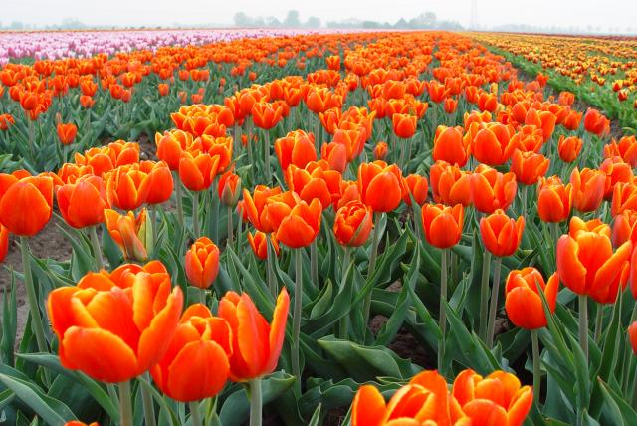
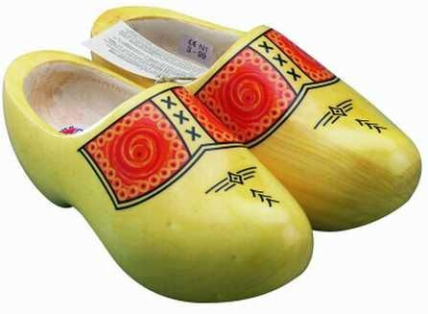
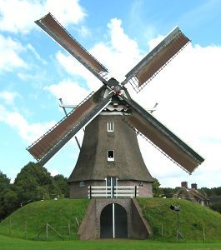
What to see in the Netherlands

Slide 2
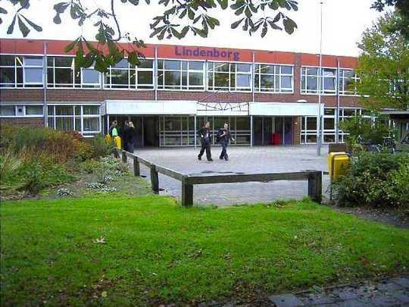
De Lindenborg
This is our school. There are about 1100 students.
Each lesson lasts 50 minutes and everyday we have about 7 lessons.

Slide 3
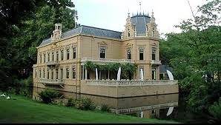
Nienoord
The estate Nienoord is a beautiful park in our community, Leek. Nienoord is best known for the borg Nienoord, a kind of palace. In Nienoord you also have a family park, and the National Museum.

Slide 4
Groningen
Groningen is our city and it is in the province Groningen. The municipality of Groningen had since last year 190,500 inhabitants. Groningen is a very nice college town, it is known of the Martini and the Groningen Museum!

Slide 5
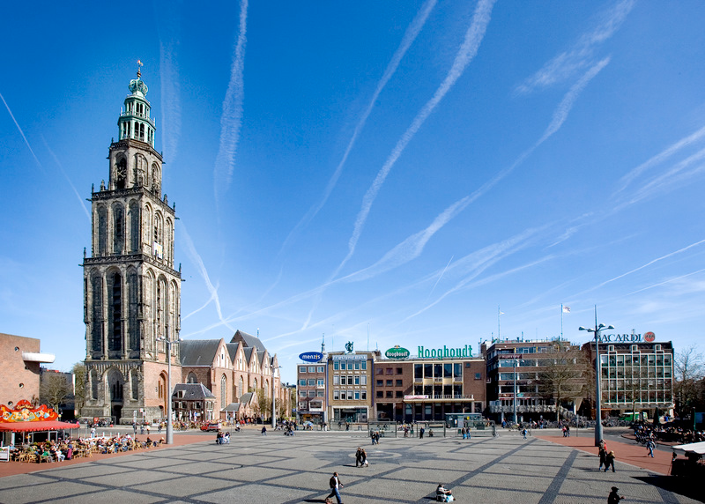
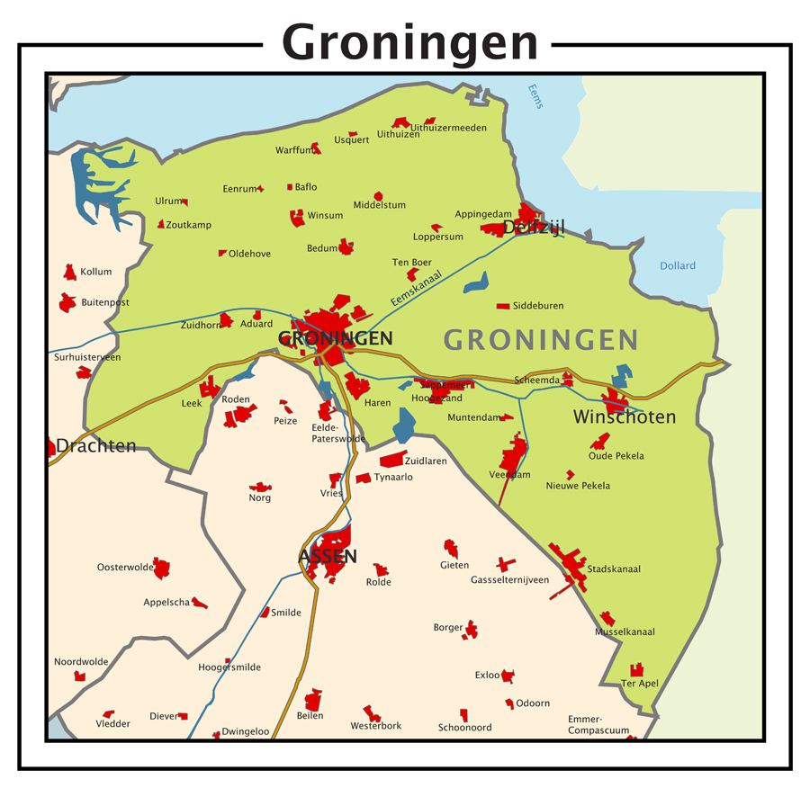
Groningen

Slide 6
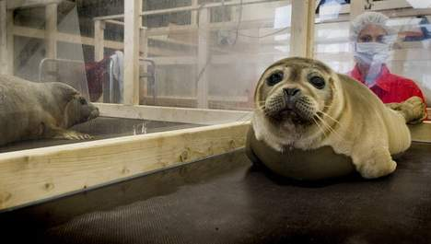
Lenie ‘t hart
Lenie ‘t Hart is an institution in the village Pieterburen where sick, weak and stranded seals are temporarily kept and provided with food and health care. Usually they are young and they have lost their mother. There are two kinds of seals, you have the normal seal and the grey seal. In the Dutch Shallows there are approximately 2108 seals.

Slide 7
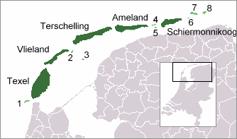
The Dutch Shallows
Belong to the Netherlands. There are 5 big islands: Texel, Vlieland, Terschelling, Ameland and Schiermonnikoog. These are mainly holiday islands but people also live there permanently

Slide 8
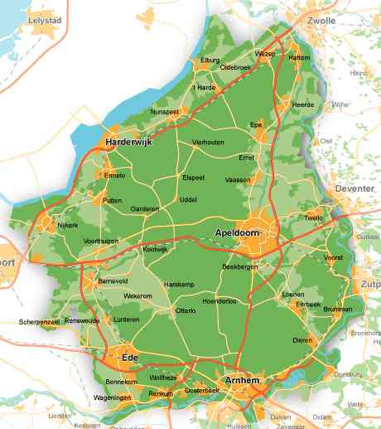
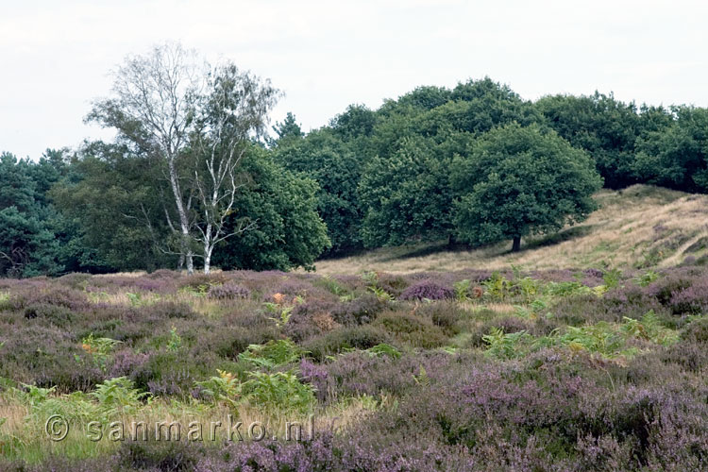
The veluwe
The Veluwe is a wooded area in the Dutch province Gelderland. It is the largest nature area in northwest Europe. The highest spot on the Veluwe is about 110 meters high. There are a lot of animals on the Veluwe and there are many different plants and flowers to see.

Slide 9
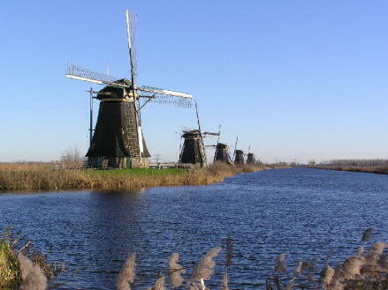
Mills of Kinderdijk
The Netherlands are famous for their windmills. Today there are still more than 1.000 mills. Nowhere in the world will you find as many windmills as near (the Dutch village) Kinderdijk. Around 1740, no less than 19 sturdy mills were built there. They have been well preserved to the present day.

Slide 10
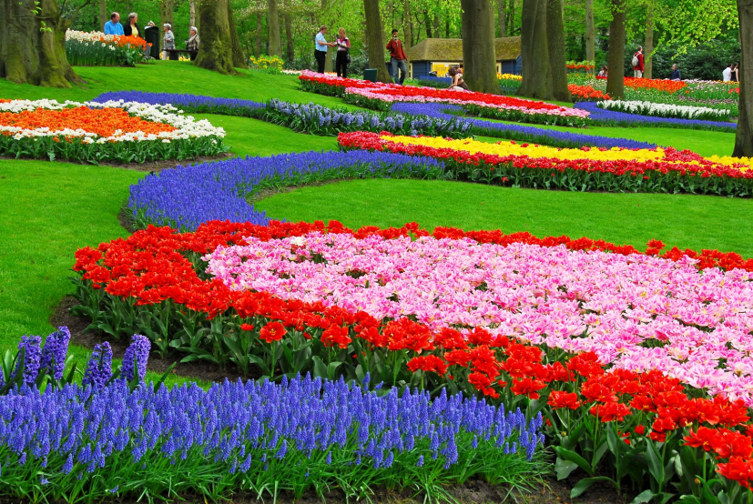
Keukenhof
That’s the place to see spring blossom. The park is unique, world famous, and has been one of the most popular destinations in the Netherlands for sixty years now.

Slide 11
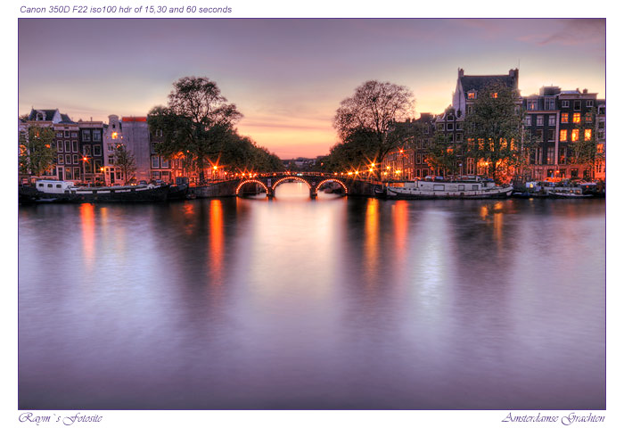
The canals of Amsterdam
Amsterdam is the capital of the Netherlands, and Amsterdam is famous for its unique canals. Many beautiful houses are situated near the water.

Slide 12
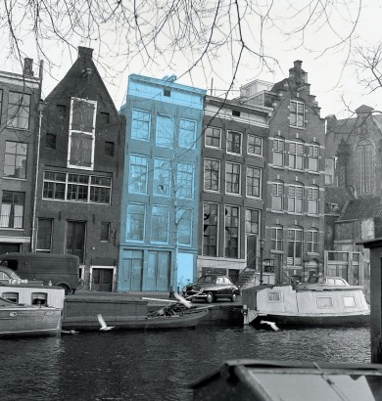
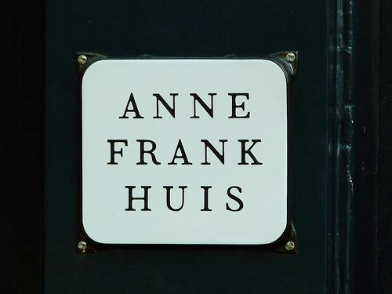
The Anne Frank House
You can find the Anne Frank house in Amsterdam on the Prinsengracht. It is now a memorial in memory of Anne Frank and her family. They were hiding in this house in the Second World War.

Slide 13
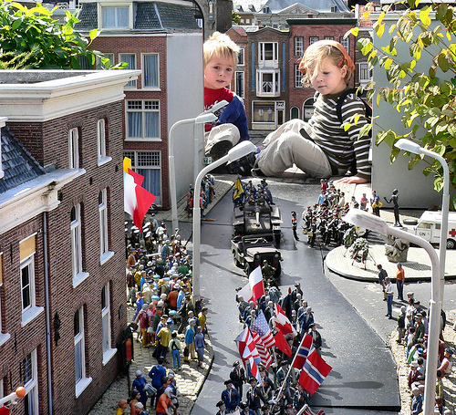
Madurodam
Madurodam shows you the most typical Dutch buildings in miniature. At a glance you can see what makes the Netherlands so typically Dutch.

Slide 14
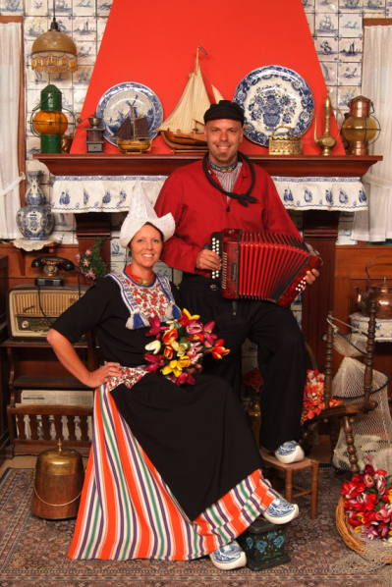
Volendam
The Volendam costume is the best known Dutch cultural costume and plays a significant role in advertising and the promotion of Holland. Often it is considered the "national" costume of the Netherlands.

Slide 15
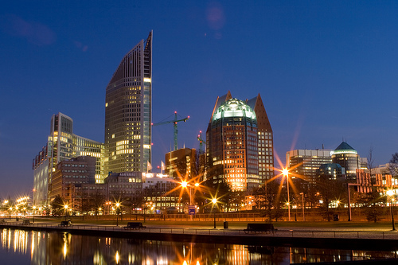
Den haag – The Hague
Is a city with about 500,000 inhabitants. in the Hague, the Dutch
Government
and the parliament are located.

Slide 16
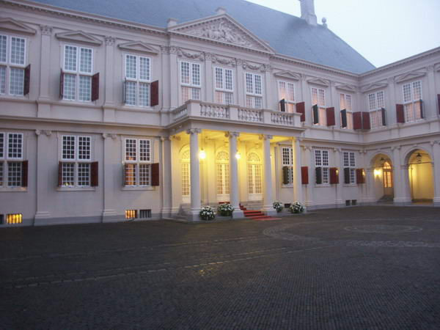
Palace Noordeinde
Palace Noordeinde in Den Haag is the workpalace of the Queen. The palace is also used for the funeral of deceased members of the Royal Family. But the palace is also used for fun events.

Slide 17
Come and see us in 2014, you will love it

