Slide 1
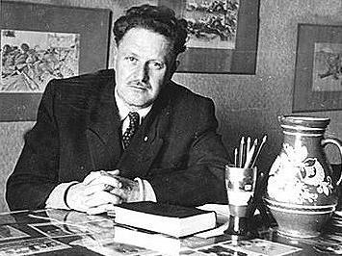
NAZIM HİKMET RAN

Slide 2
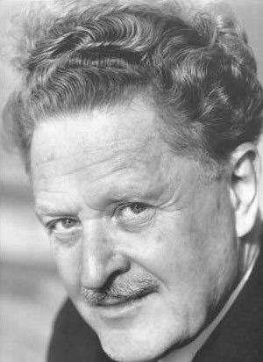
Nâzım Hikmet Ran Born : 15 January 1902 Salonica, Ottoman Empire, today Thessaloniki Greece Died : 3 June 1963 (age 61) Moscow Russia Soviet Federative Socialist Soviet Union Nationality : Turkish Ethnicity : Turkish Occupation: poet, playwright, novelist, memoirist

Slide 3
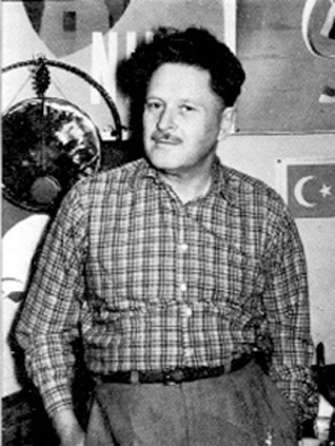
THE JAPANESE FISHERMAN A young Japanese fisherman was killed by a cloud at sea. I heard this song from his friends, one lurid yellow evening on the Pacific. Those who eat the fish we caught, die. Those who touch our hands, die, This ship is a black coffin, you'll die if you come up the gangplank. Those who eat the fish we caught, die, not straight away, but slowly, slowly their flesh rots, falls off. Those who eat the fish we caught, die.

Slide 4
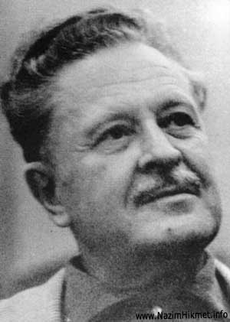
Those who touch our hands, die. Our loyal, hardworking hands washed by salt and sun. Those who touch our hands, die, not straight away, but slowly, slowly their flesh rots, falls off. Those who touch our hands, die. Almond Eyes, forget me. This ship is a black coffin, you'll die if you come up the gangplank. The cloud has passed over us.

Slide 5
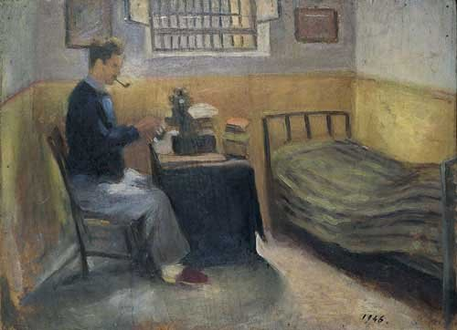
Almond Eyes, forget me. Don't hug me my darling, you'll catch death from me. Almond Eyes, forget me. This ship is a black coffin. Almond Eyes, forget me. The child you have from me will be rotten from a rotten egg. This ship is a black coffin. This sea is a dead sea. Human beings, where are you? Where are you? Nâzım HİKMET

Slide 6
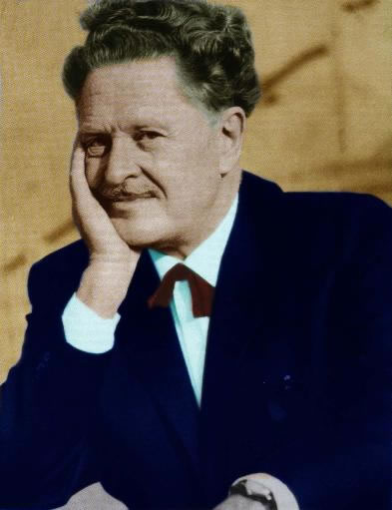
Hiroshima Child I come and stand at every door But none can hear my silent tread I knock and yet remain unseen For I am dead for I am dead I'm only seven though I died In Hiroshima long ago I'm seven now as I was then When children die they do not grow

Slide 7
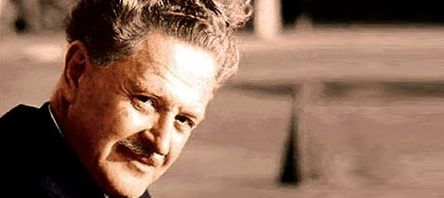
My hair was scorched by swirling flame My eyes grew dim my eyes grew blind Death came and turned my bones to dust And that was scattered by the wind I need no fruit I need no rice I need no sweets nor even bread I ask for nothing for myself For I am dead for I am dead All that I need is that for peace You fight today you fight today So that the children of this world Can live and grow and laugh and play Nazım Hikmet

Slide 8
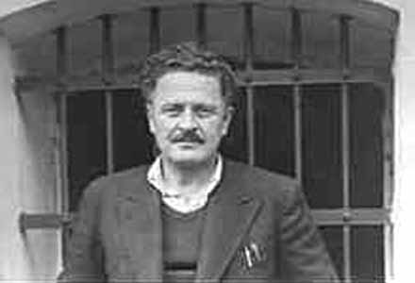
Since I’ve Been In Jail Since I've been in jail the world has turned around the sun ten times And if you ask the earth, it will say: 'It's not worth mentioning, a microscopic time.' And if you ask me, I will say: 'It's ten years of my life.' I had a pencil the year I came to jail. It wore out in a week from writing. And if you ask the pencil, it will say: 'A whole life.'

Slide 9
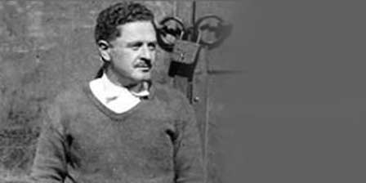
And if you ask me, I will say: 'It's nothing, a mere week.' who was jailed for murder completed a seven-year stretch and left since I've been in jail. He wandered around outside for a while, and then got jailed again for smuggling. He served a six-month term and left again, and yesterday a letter came saying he's married and a child will be born in the spring. Now they're ten years old the children who fell from their mothers' womb that year I came to jail,

Slide 10
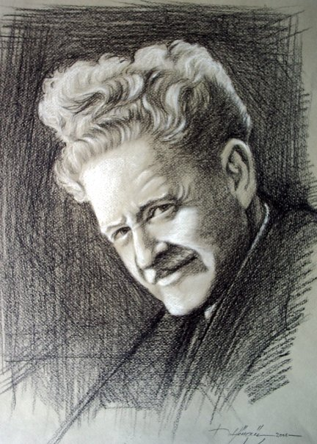
And the colts of that year who had long thin shaky legs have long since become docile broad-rumped mares. But the olive shoots are still shoots and they're still children. New squares have opened up in my distant city since I've been in jail. And our family is living in a house I've never seen on a street I don't know. The bread was pure white, like cotton, the year I came to jail. Later it was rationed out,

Slide 11
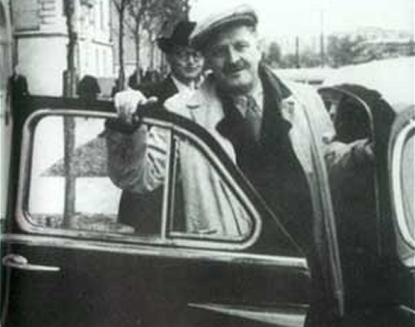
And we here on the inside beat one another for a piece of black crust the size of a fist. Now it's free again, But brown and tasteless. The year I came to jail The Second One had just begun. The ovens in Dachau Camp were not yet lit, The atom bomb was not yet hurled upon Hiroshima. Time flowed like the blood of a child with his throat cut. Later that chapter was officially closed, Now American dollars are talking about a Third. But in spite of everything, the days have brightened since I've been in jail,

Slide 12
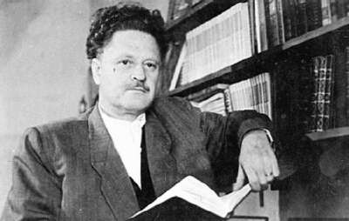
And about half of them put their heavy hands on the pavement and on the edge of darkness straightened up. Since I've been in jail the world has turned around the sun ten times. And again I repeat with the same passion what I wrote for them the year I came to jail: They whose number is as great as ants on the earth fish in the water

Slide 13
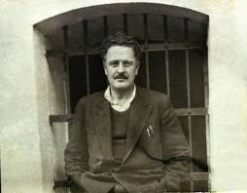
birds in the sky are fearful and brave ignorant and learned and they are children, And they who destroy and create it is only their adventure in these songs.' And for the rest, for example, my lying here for ten years, it's nothing...
Nazım Hikmet RAN

Slide 14
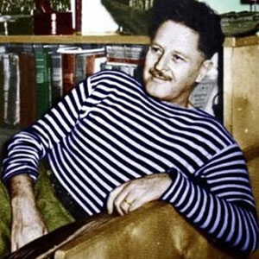
Today Is Sunday Today is Sunday. For the first time they took me out into the sun today. And for the first time in my life I was aghast that the sky is so far away and so blue and so vast I stood there without a motion.

Slide 15
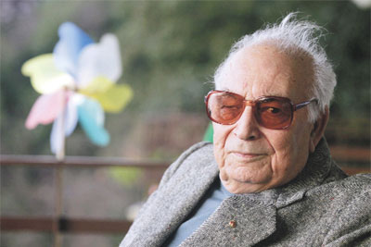
Then I sat on the ground with respectful devotion leaning against the white wall. Who cares about the waves with which I yearn to roll Or about strife or freedom or my wife right now. The soil, the sun and me... I feel joyful and how. Nazım Hikmet RAN

