Slide 1
TURKISH RAVIOLI-MANTI

Slide 2
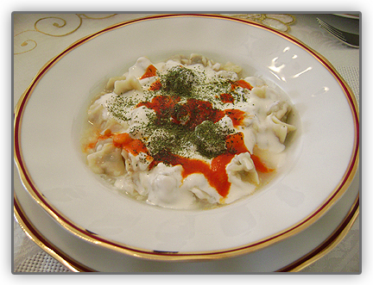
Turkish Meat Ravioli
It is called ‘Mantı’ in Turkey. It consists of many bundles with meats in it.
It is served with garlic yoghurt sauce and tomatoe sauce on it. It is difficult but a very delicious meal.

Slide 3
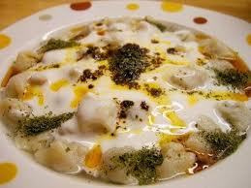
MANTI (TURKISH RAVIOLI)

Slide 4
INGREDIENTS
Dough:
3-3 ½ cups flour 1 egg 2/3 cup lukewarm water 1 teaspoon salt to taste
Filling: ½ kg ground beef 1 onion, chopped ½ teaspoon salt to taste ½ teaspoon black pepper
For cooking: 8 cups water 1 teaspoon salt
Sauce: 2 cups yogurt 3-4 cloves of garlic, minced ¼ teaspoon salt to taste 3-4 tablespoon butter/oil 1 tablespoon tomato paste/1 tablespoon paprika 2-3 tablespoons water Dried mint Sumac

Slide 5
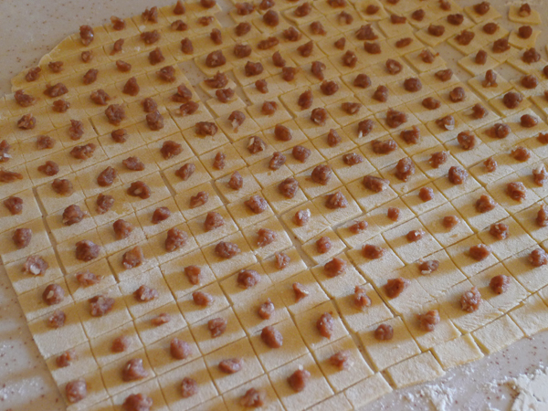
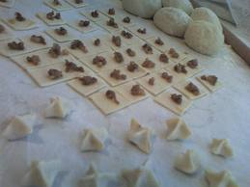
DIRECTIONS
In a bowl place the flour, crack the egg and add the salt and water. Then knead till you get a firm and smooth dough.
Meanwhile in a plate mix all the filling ingredients and set aside.
Flatten the dough with a rolling pin as thin as you can.
Then, cut it with a knife into square pieces .
Then place ¼ tsp filling over each square . Then stick the sides with your finger tips .

Slide 6
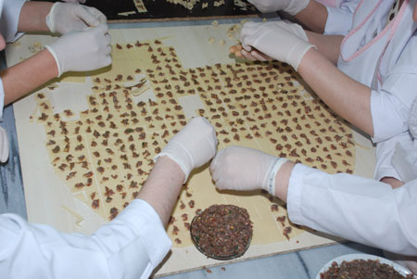
For cooking, boil the water in a big pot and add salt.
Then add all the manti into the boiling water.
Stir with a wooden spoon to prevent them sticking to each other.
Cook over medium heat till manti gets soft (for about 10-15 minutes).

Slide 7
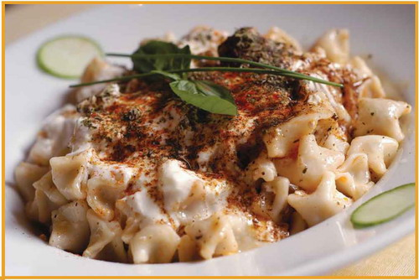
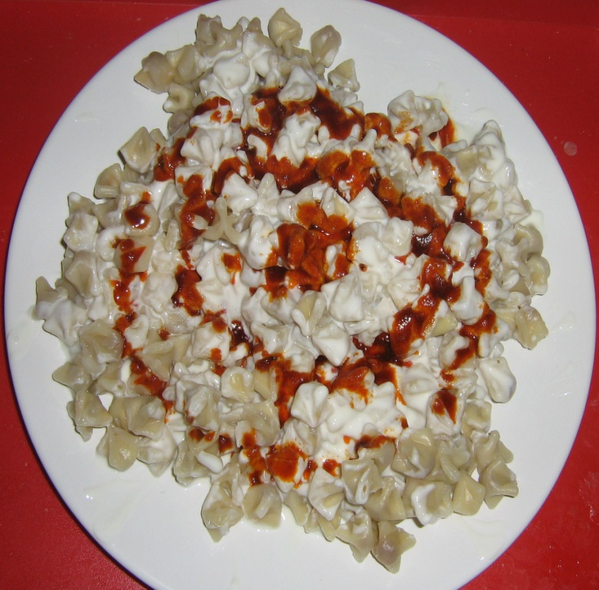
Meanwhile prepare the sauce. In a bowl mix yogurt, salt and garlic.
In a small pan; melt the butter/oil and stir in tomato paste and water.
Cook for 2 minutes over low heat.
Drain the cooked manti and transfer it into serving plates.
Let it cool for a while and pour the yogurt sauce over.
Finally pour about one tbsp of butter/oil mixture all over .
And if desired sprinkle some dried mint and sumac over the Turkish Ravioli.

Slide 8
THANK YOU
HACI BAYRAM ANADOLU IMAM HATIP
HIGH SCHOOL
ANKARA

