Slide 1
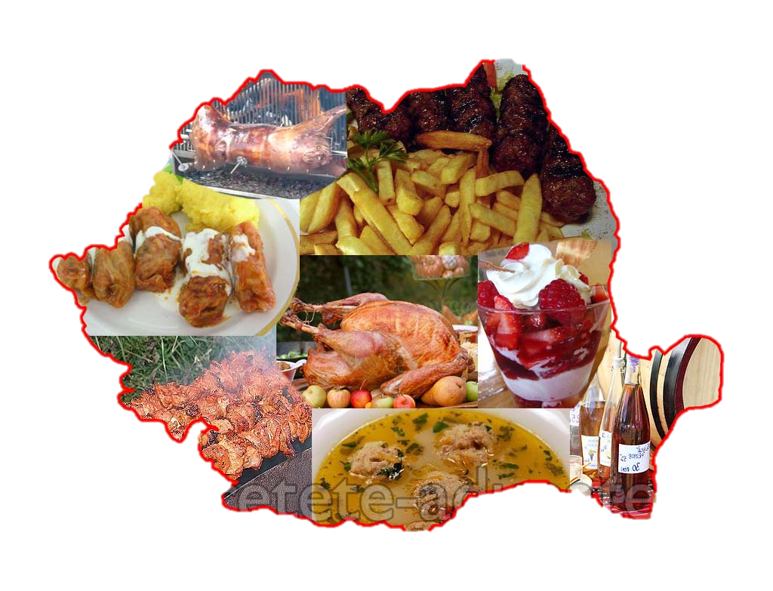
Comenius multilateral project
my world
Is
your world
Come
closer,
Romanian cuisine
Școala Gimnazială Nr. 5 Arad
This project has been funded with support from the European Commission.
This publication reflects the views only of the author, and the Commission cannot be held responsible for any use which may be made of the information contained therein.

Slide 2
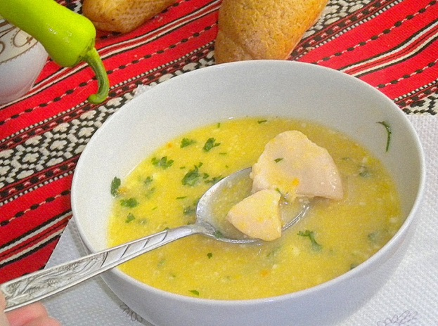
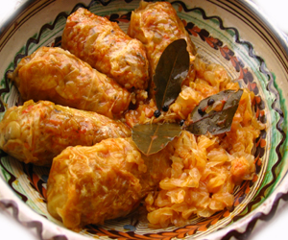
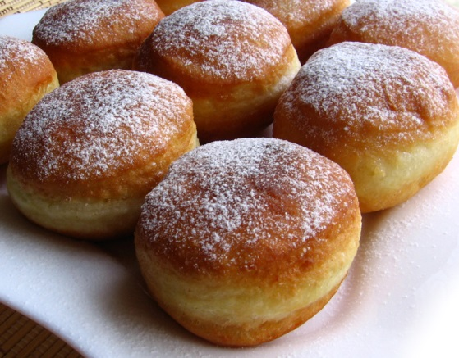
Romanian cuisine is a diverse blend of different dishes from several traditions with which it has come into contact, but it also maintains its own character. It has been greatly influenced by Ottoman cuisine, while it also includes influences from the cuisines of other neighbours, such as Germans, Serbs, Bulgarians and Hungarians.

Slide 3
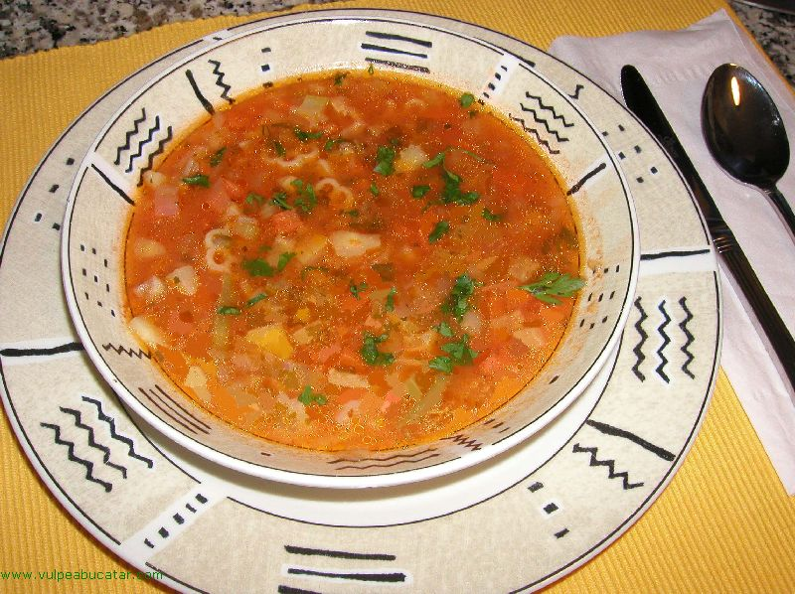
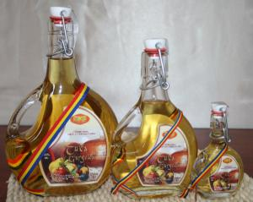
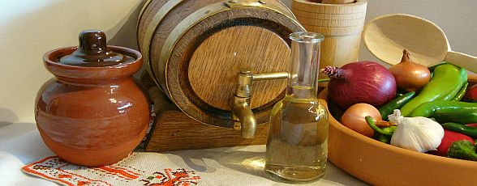
Quite different types of dishes are sometimes included under a generic term; for example, the category ciorbă includes a wide range of soups with a characteristic sour taste. These may be meat and vegetable soups, tripe and calf foot soups, or fish soups, all of which are soured by lemon juice, sauerkraut juice, vinegar, or traditionally borş. The category ţuică (plum brandy) is a generic name for a strong alcoholic spirit in Romania, while in other countries, every flavour has a different name.
ciorbă
ţuică

Slide 4
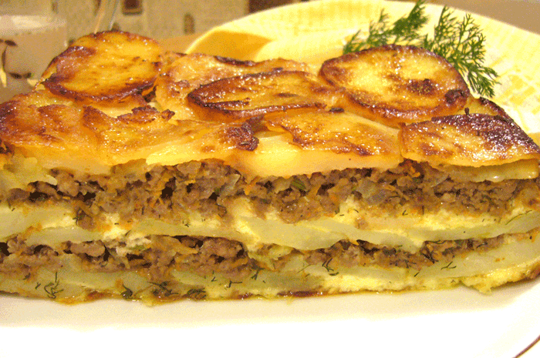
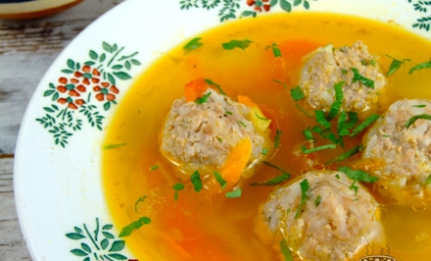
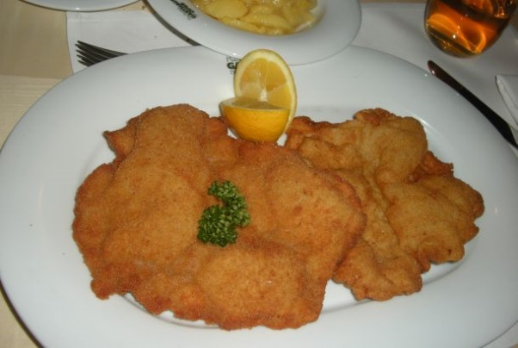
Romanian recipes bear the same influences as the rest of Romanian culture.
From the Greeks there is musaca
The Turks have brought meatballs (perişoare in a meatball soup)
From the Austrians there is the şniţel
The Romanians share many foods with the Balkan area (in which Turkey was the cultural vehicle), with Central Europe (mostly in the form of German-Austrian dishes introduced through Hungary or by the Saxons in Transylvania) and Eastern Europe. Some others are original or can be traced to the Roman or other ancient civilizations.

Slide 5
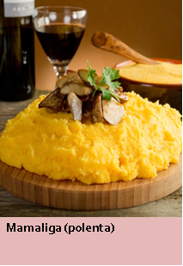
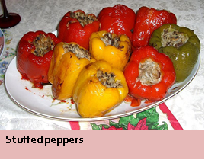
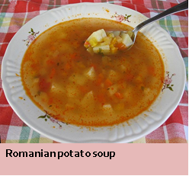
One of the most common meals is the mămăliga, a type of polenta, served on its own or as an accompaniment.
Pork is the main meat used in Romanian cuisine, but also beef is consumed and a good lamb or fish dish is never to be refused.
Vlaiconi Cristiana and Reștea Gabriela
Clasa a VIII-a D

