Slide 1
Protected animals in the Netherlands
Made by: Nikki Smit and Julie Nannenberg.

Slide 2
The protected animal species.
The seal
The hamster
The wild cat
The wolf
The beaver
The fallow deer

Slide 3
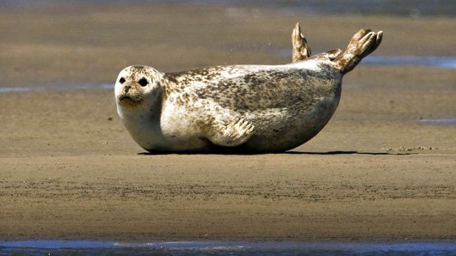
The seal
The seal is a sea predator that is found in the sea in the North of the Netherlands which is called ‘de Waddenzee’(The Dutch Shallows). Earlier there were so many seals, that they got hunted. But in the twentieth century there were only a few thousands of them left. Another cause could be the water pollution. Now the seal is a protected species and since it has been protected the population has grown enormously.

Slide 4
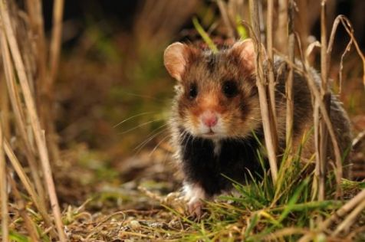
The hamster.
The hamster is a medium sized rodent with a short tail. The hamster lives in grasslands, fields and especially farmland. A few years ago the hamster was almost extinct, because of the cold and wet weather in the Netherlands but now the population of the hamster seems to have stabilized, but they aren’t out off the ‘danger-zone’ yet.

Slide 5
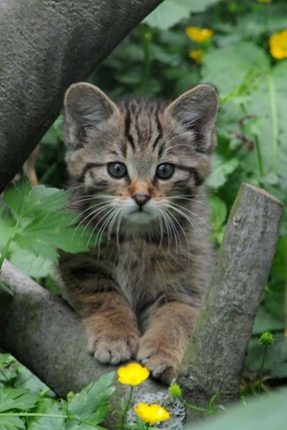
The wild cat.
The wild cat is very similar to the normal house-cat, the only difference is that the tail of the wild cat is much thicker. The wild cat is a protected animal because earlier they got hunted for fun, and many of them don’t survive the cold winters. But now that it is a protected animal, it is doing fine again.

Slide 6
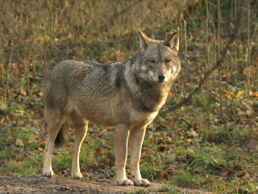
The wolf
This year the wolf is coming closer to the Netherlands. The first group of wolves are already in the south of the Netherlands. So there are really few wolves, that is why the wolf is a protected animal.

Slide 7
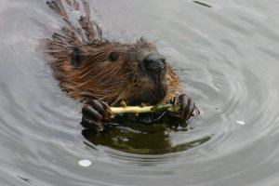
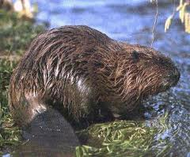
The beaver
The beaver is the biggest rodent of Europe. Since the sixteenth century people have hunted the beavers because of their fur. They were almost extinct. Now they’re protected animals.

Slide 8
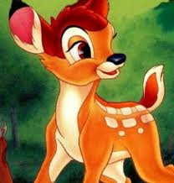
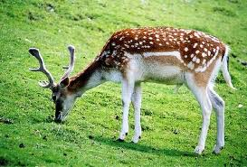
The fallow deer
A fallow deer looks like Bambi. Even though the deer is a protected species there are a lot of them. They cause much damage to crops.

