Slide 1
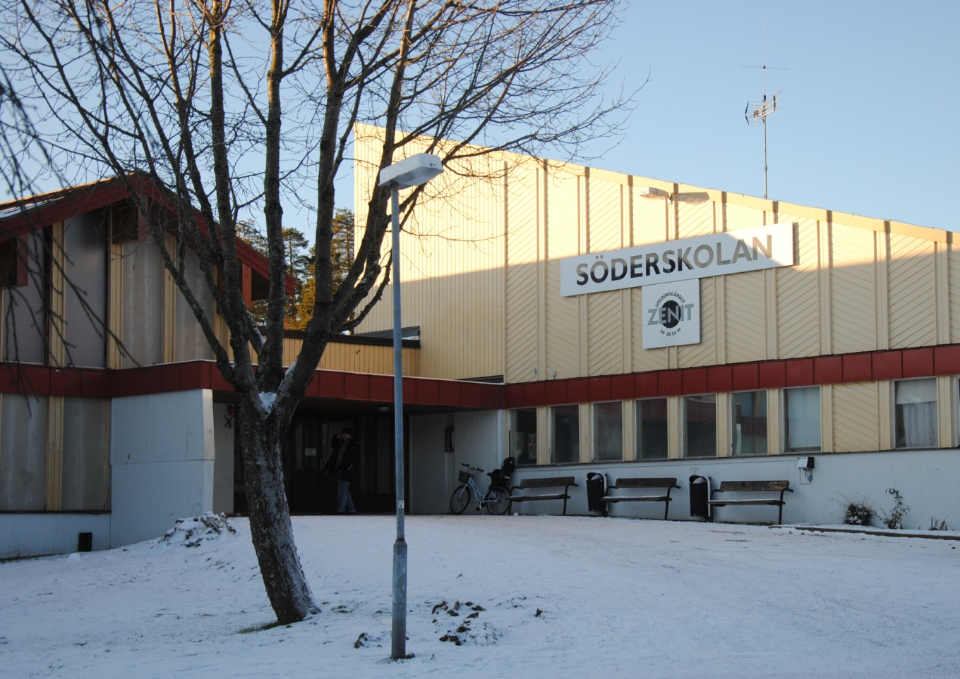
Presentation of Sandviken

Slide 2
Hammaren
It’s actually not a statue, it’s a big part of Sandviken And Sandvik’s history. Hammaren was the very foundation of the company Sandvik. This is the very symbol of Sandviken’s muncipality.

Slide 3
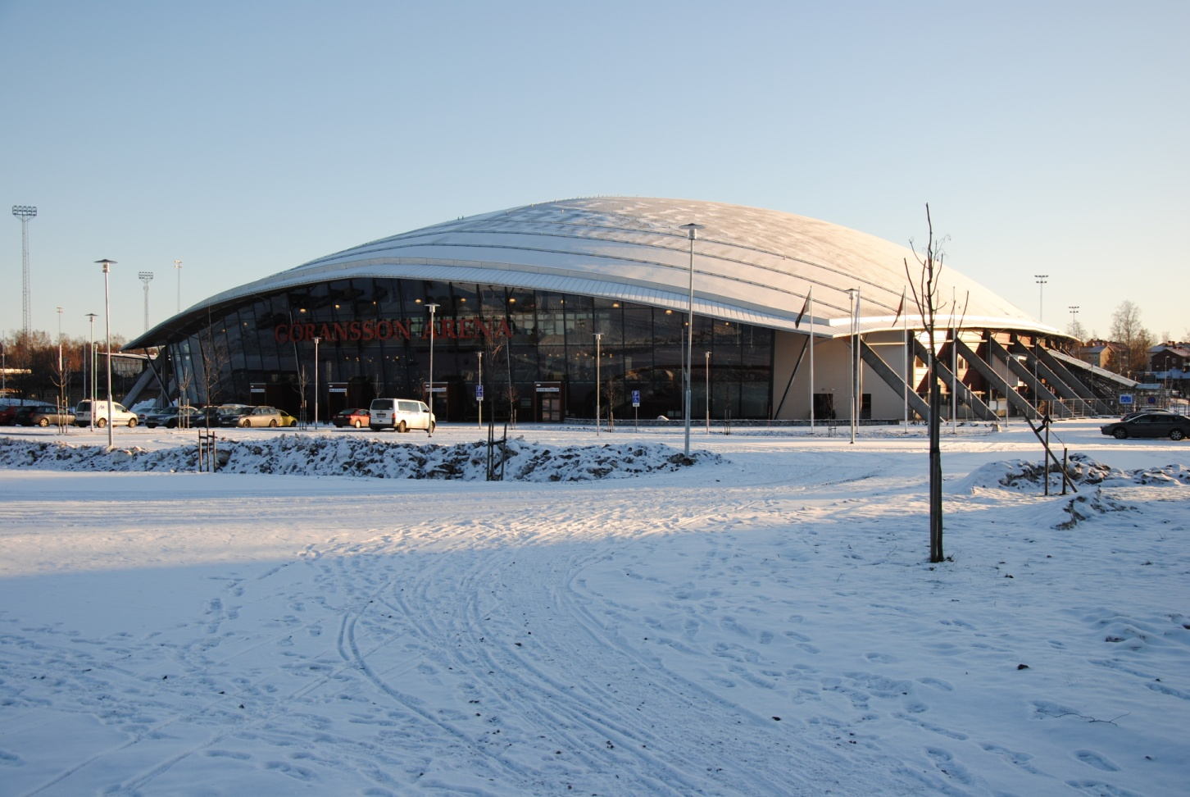
Göransson Arena
This is a big multi purpose arena in Sandviken, were the have conserts and play bandy and all sorts of sports.

Slide 4
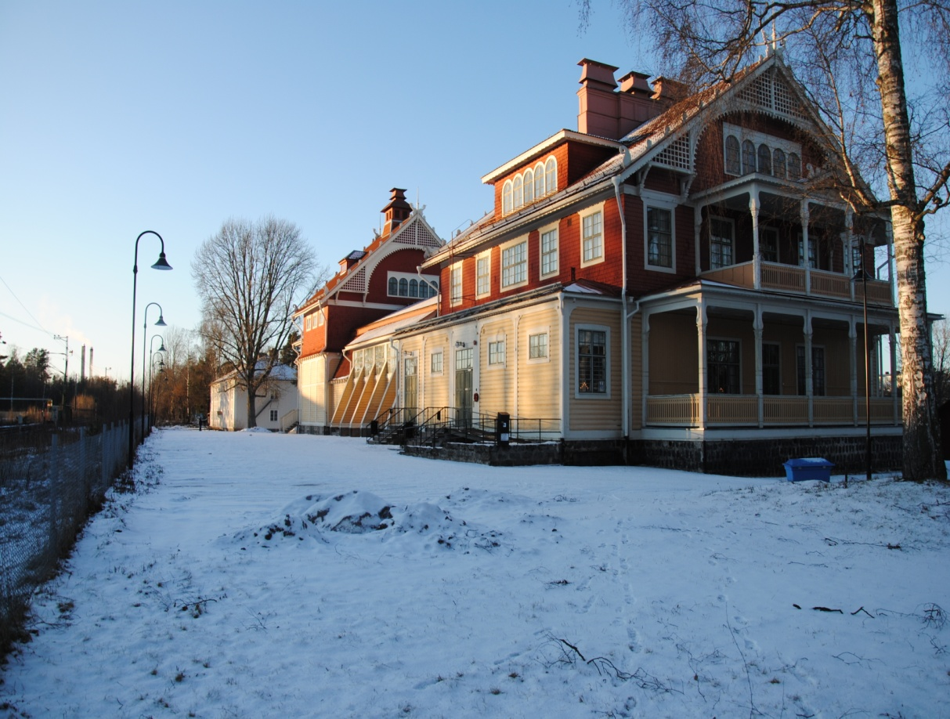
Valhalla
Valhalla is a big building , that is often used for parties, conserts, theatrer shows and lots of other things. It’s owned an ran by a senoir citicen’s club.

Slide 5
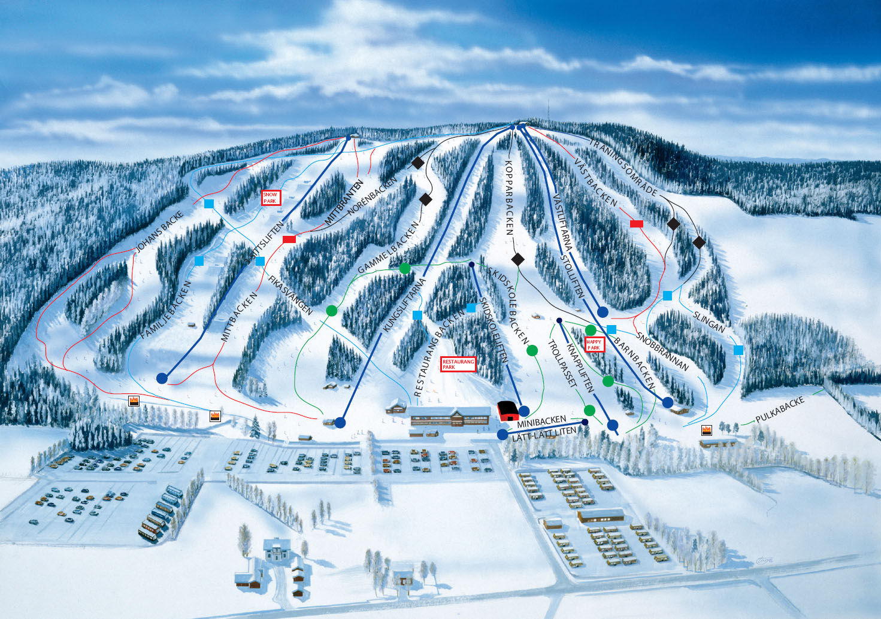
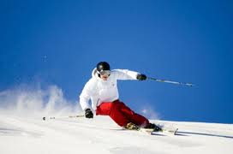
Kungsberget
Kungsberget is a skii resort in Gästrikland.
People from large areas of Sweden come here
to skii.

Slide 6
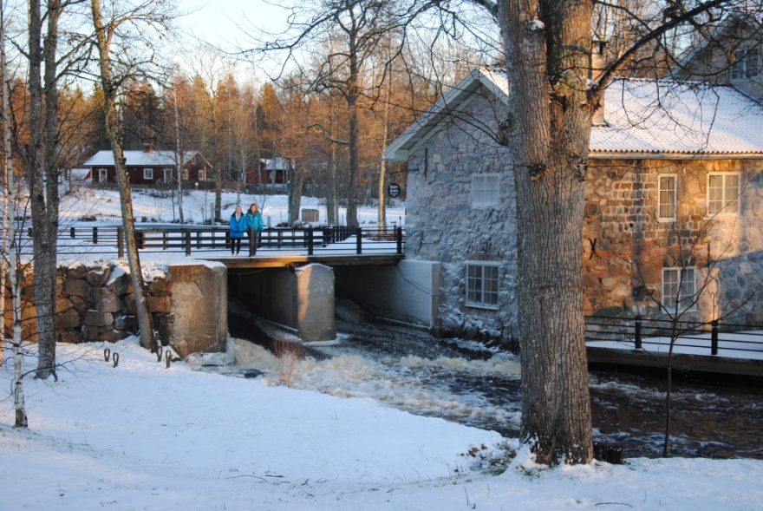
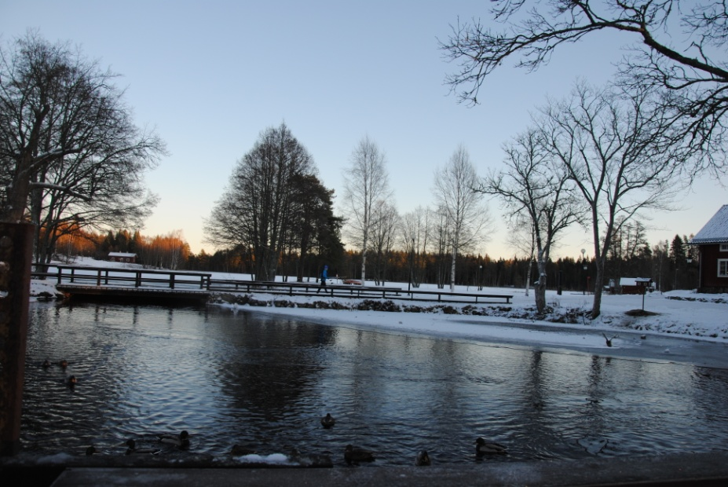
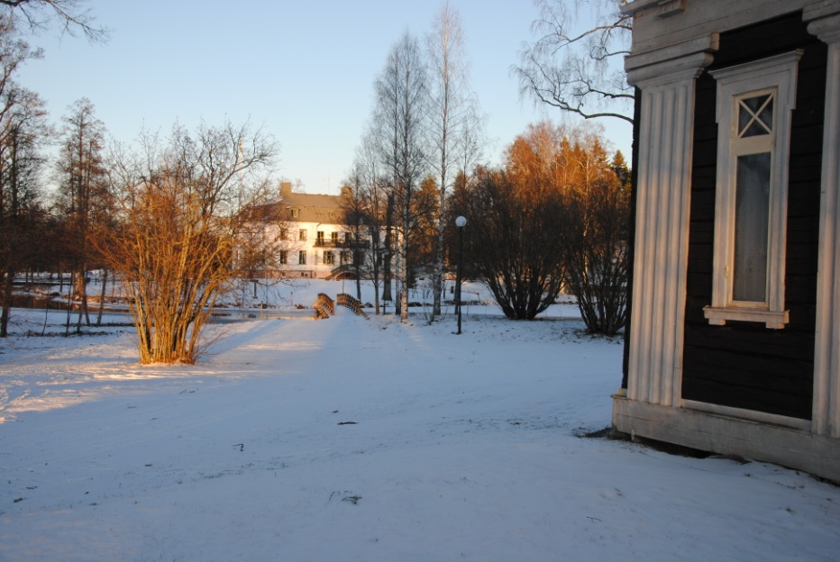
Högbo Bruk
It’s a combanation of nature, activities and
cultural history. There is something for
everyone, small as big. It’s free and for everyone to use.

Slide 7
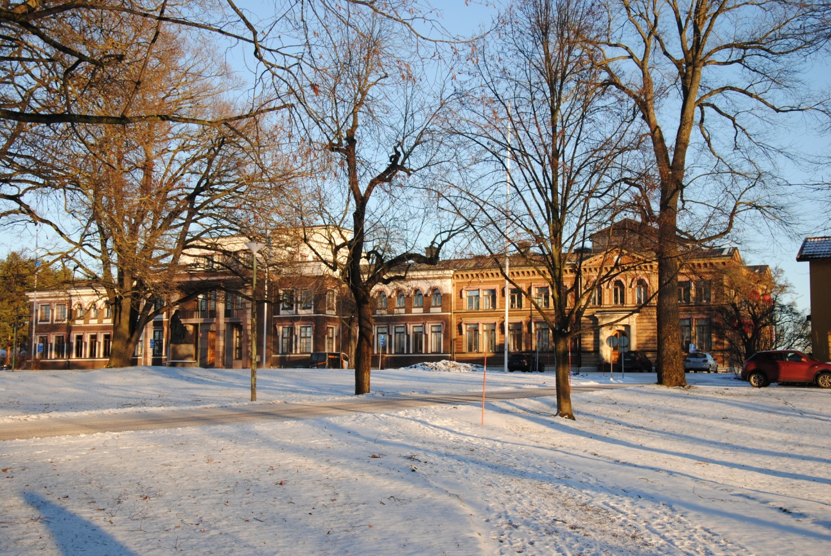
Huvudkontoret Sandvik
This is the headquarter of Sandvik.

Slide 8
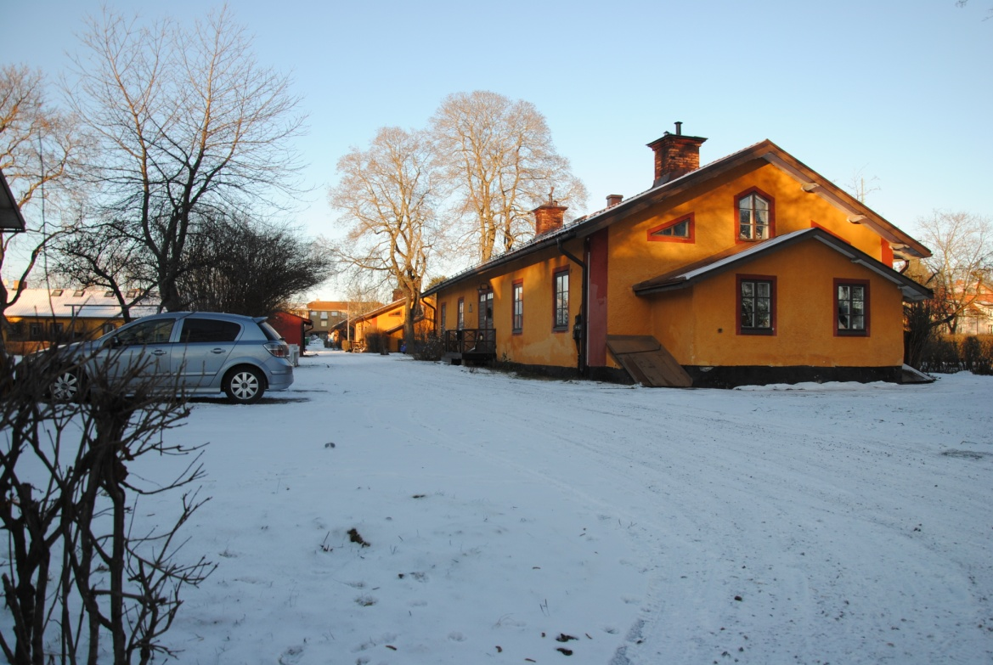
Gamla Bruket
This is the old part of Sandviken and here the employers who worked at Sandvik lived. The houses are very popular to live in.

Slide 9
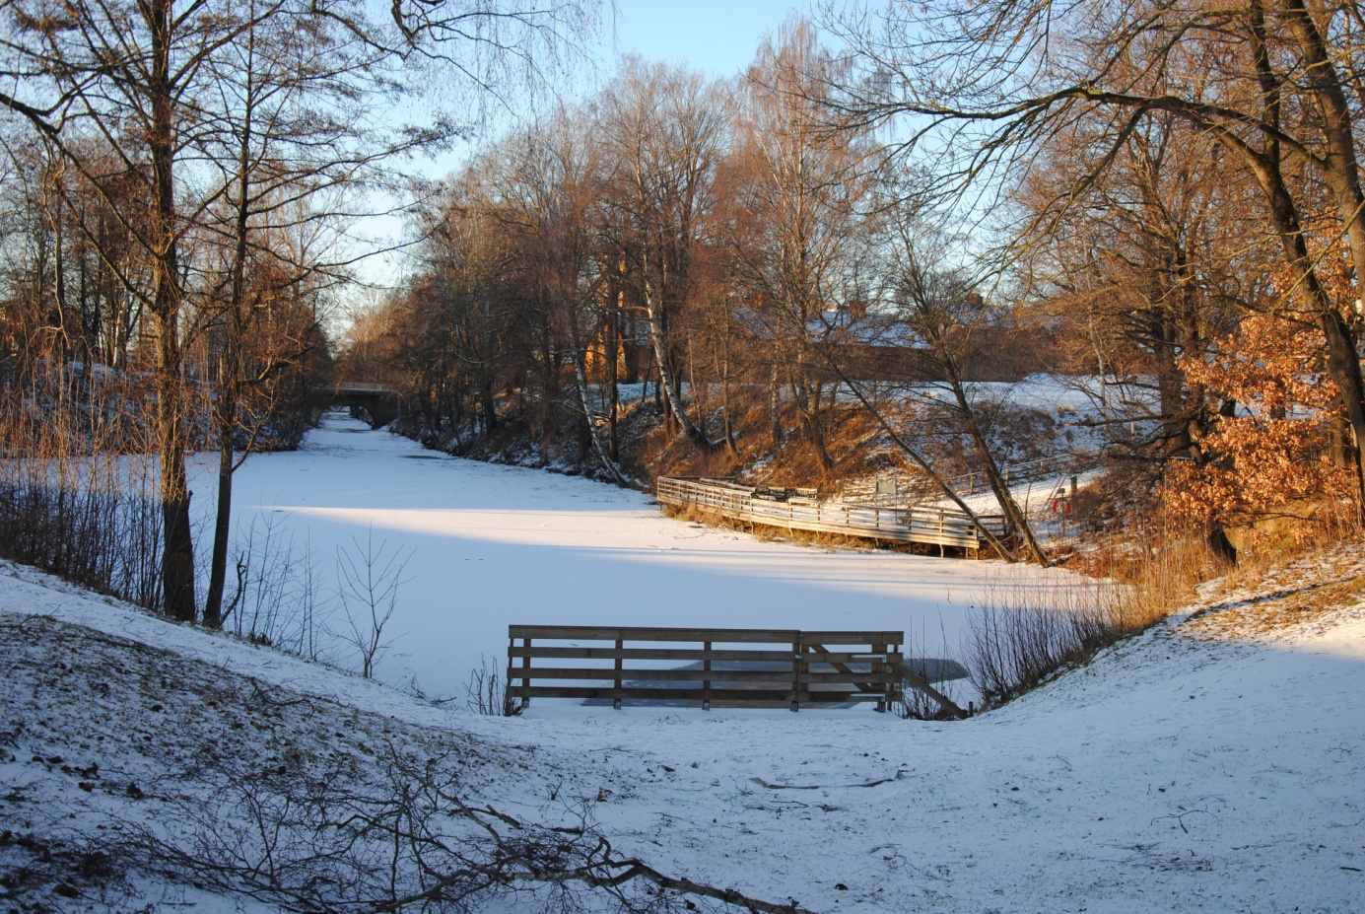
Dalbrittas Damm
Is the end of a channel in Sandviken, and was importante for the communication to and from Sandvik in the old days. The channel was hand dugged inte the 1930s.

Slide 10
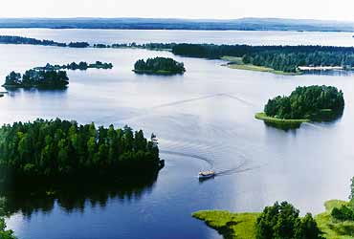
Storsjön
A popular destination with many beaches and wonderful fishing.
There are 365 small islands in the lake. A very popular place for summer
cottages and boating.

Slide 11
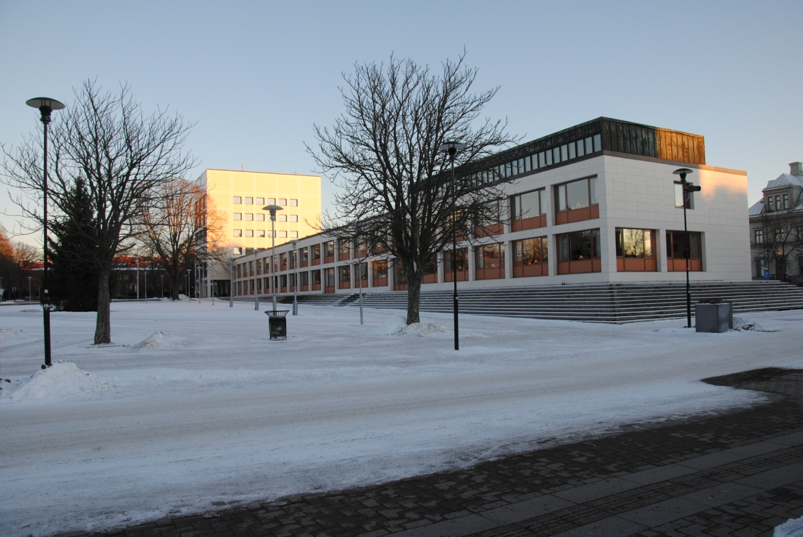
Stadshuset
The city hall of Sandviken, with lots of offices. The people in charge have their offices here.
On the top floor you can have a magnificiant view and you can get married there.

Slide 12
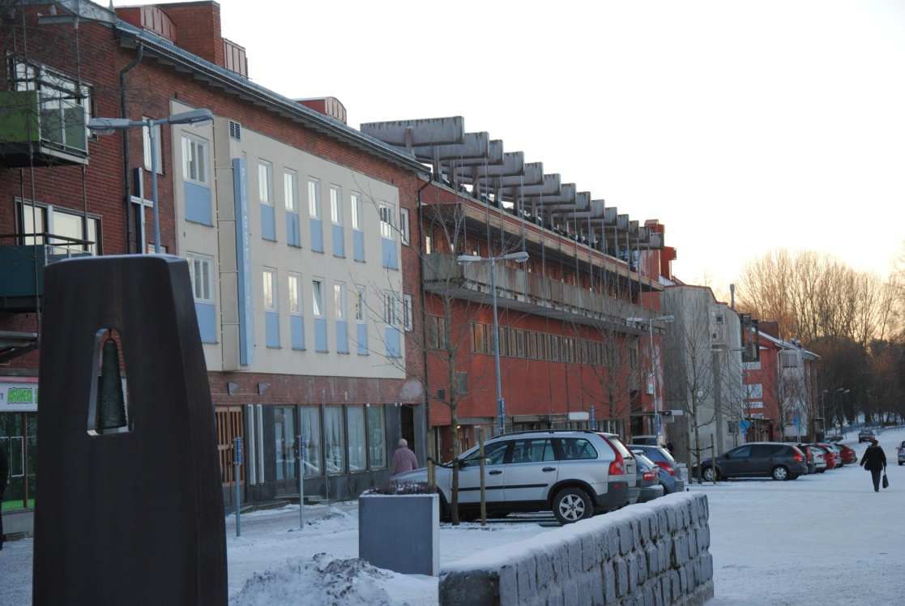
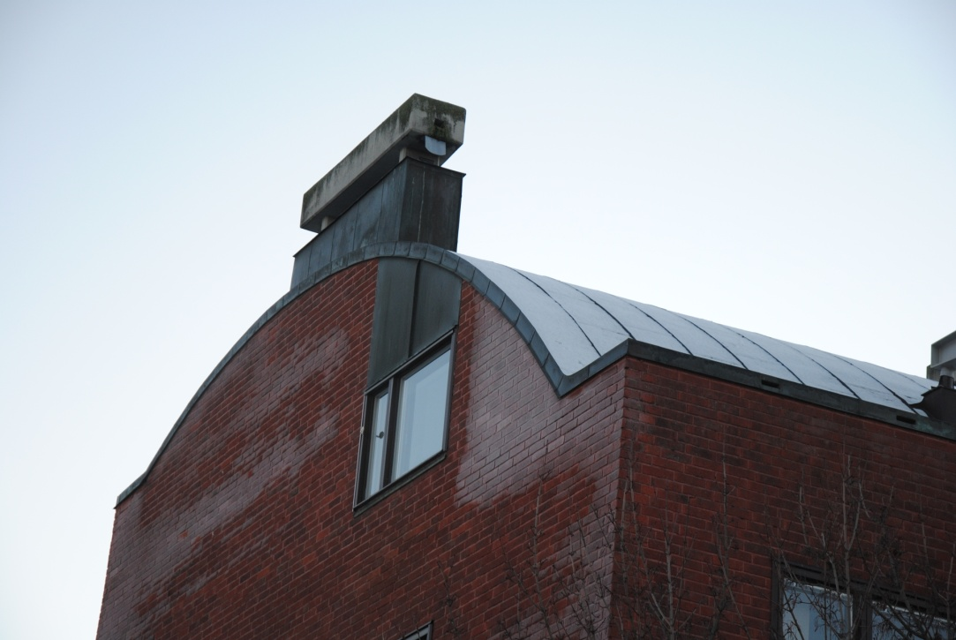
Ralph Erskine
He was a famous Brittish architect who have designed a lot of buildings in Sandviken.
Nya Bruket is the most famous one.

Slide 13
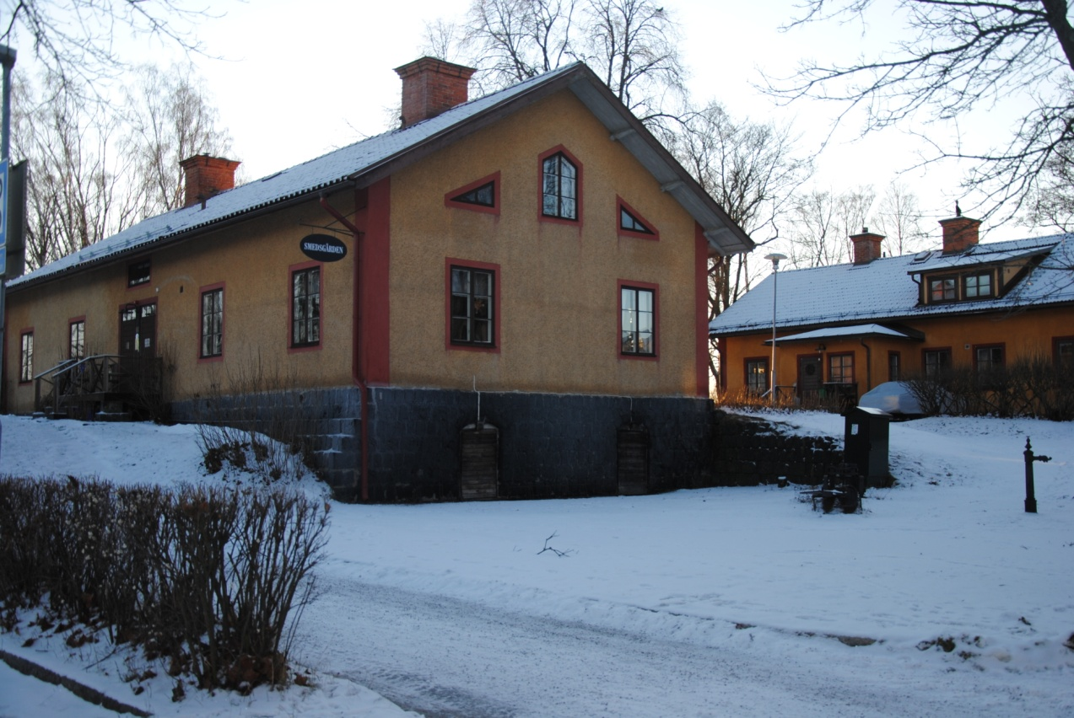
Smedsgården
It’s a museum of a typical worker’s home from the 1900s.

Slide 14
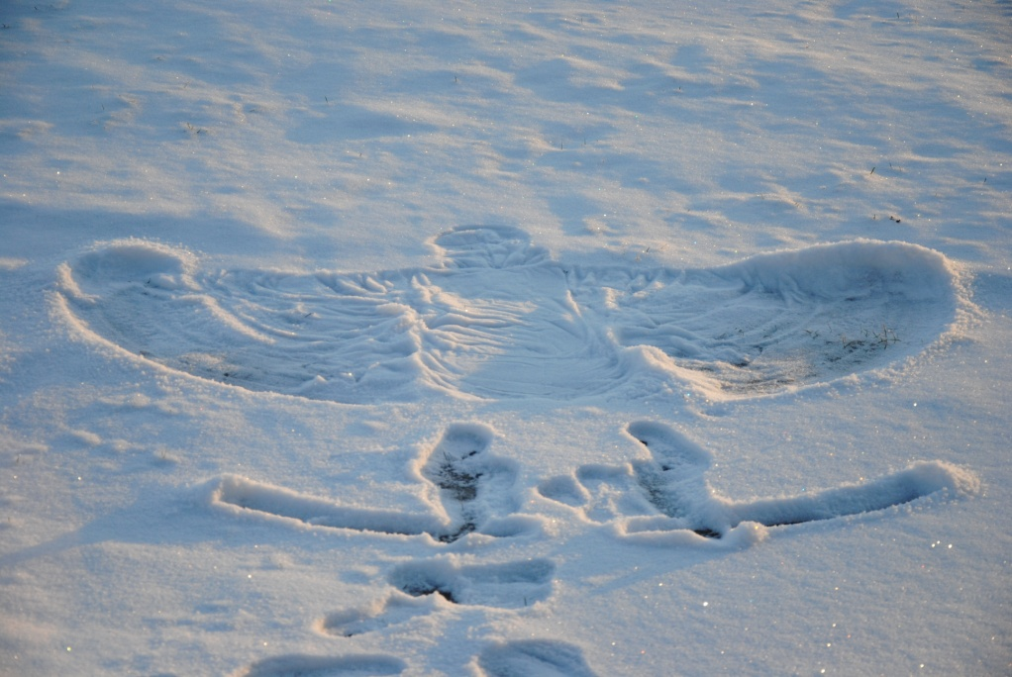
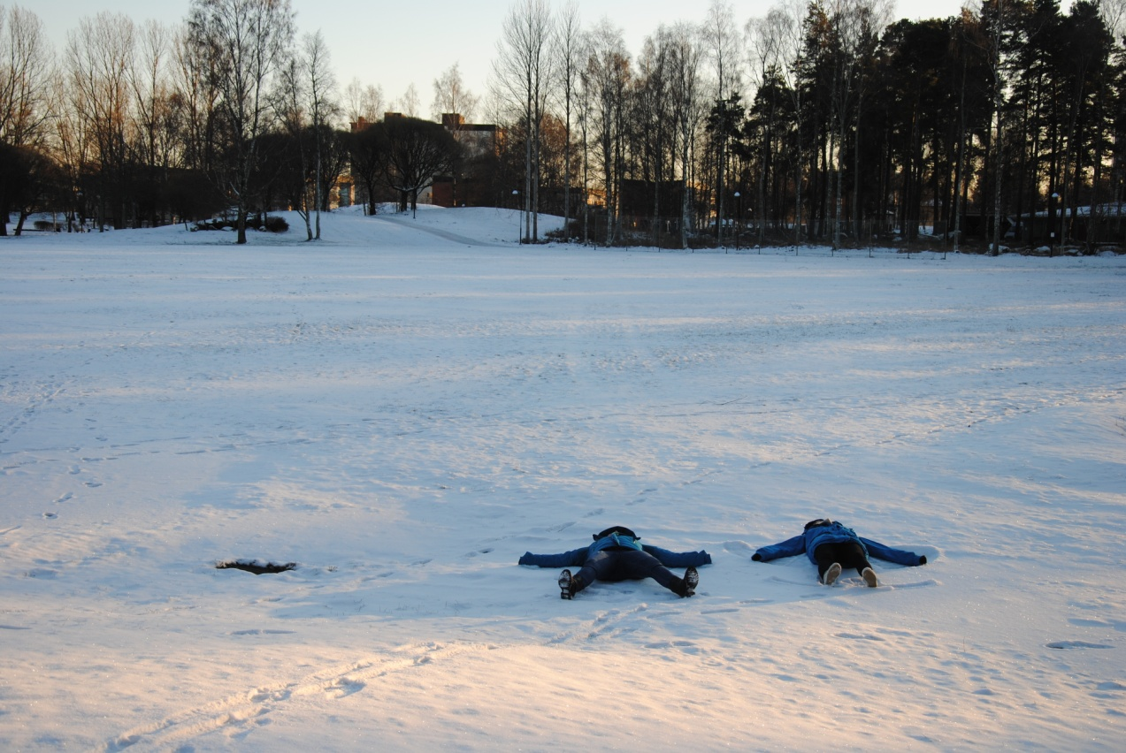
Stadsparken
It’s a playground for everyone, and by the way it’s a perfect place for making snowangels.

