Slide 1
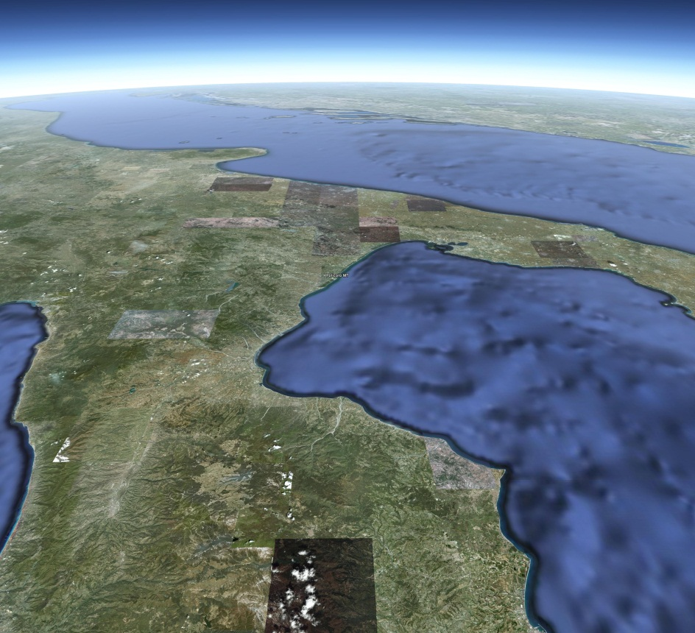
POLICORO
Policoro is a town in the province of Matera, in the Southern Italian region of Basilicata
POLICORO

Slide 2
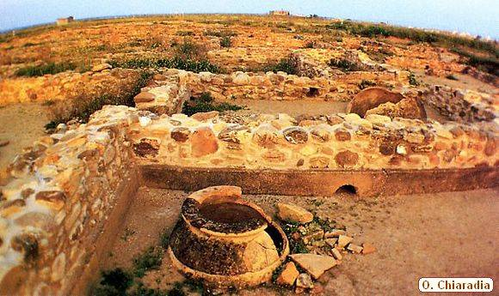
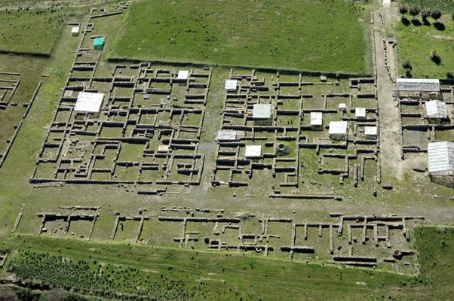
Heraclea
It is situated not far from the ruins of the ancient city of Heraclea, where in 280 BC Pyrrhus fought the Romans.

Slide 3
Bosco Pantano
It is an area of great naturalistic and scientific interest
because there is a deciduous forest with rare flora and fauna including wild boar, roe deer, pine martens and otters.

Slide 4
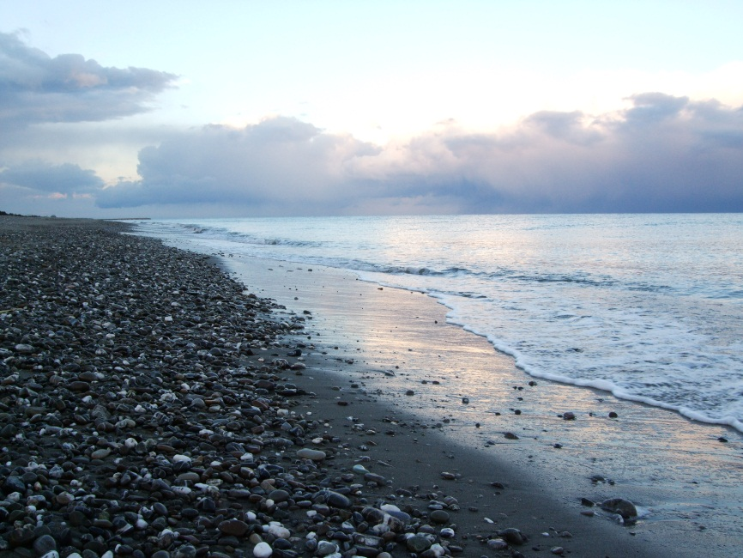
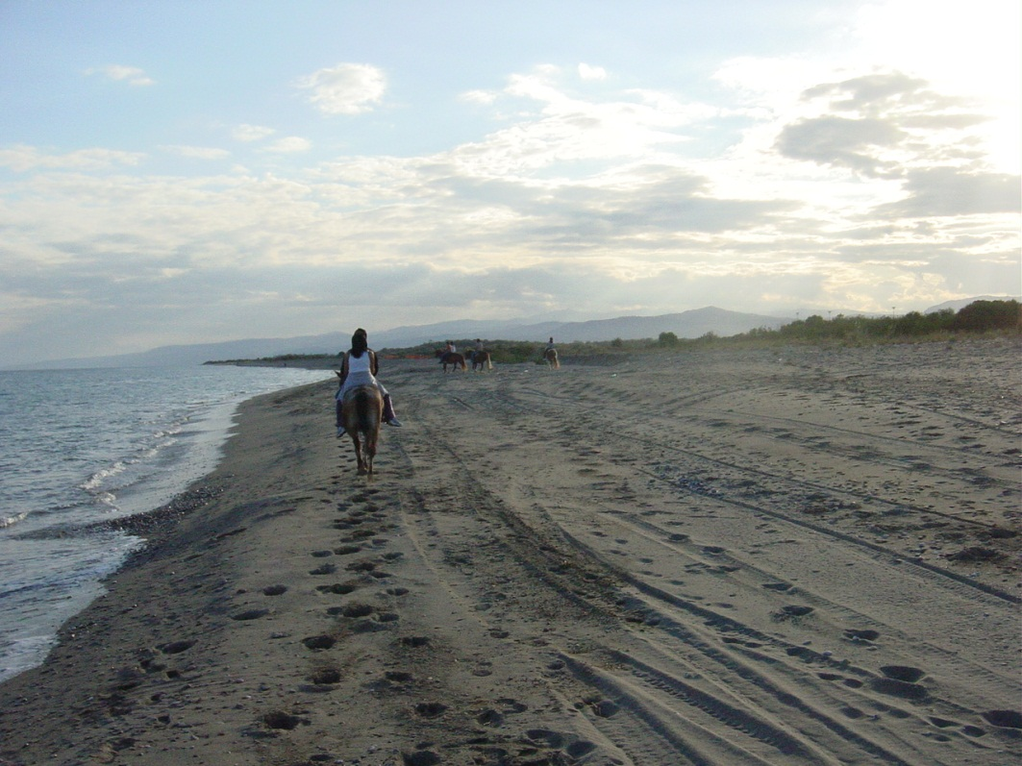
There is a beatiful sea

Slide 5
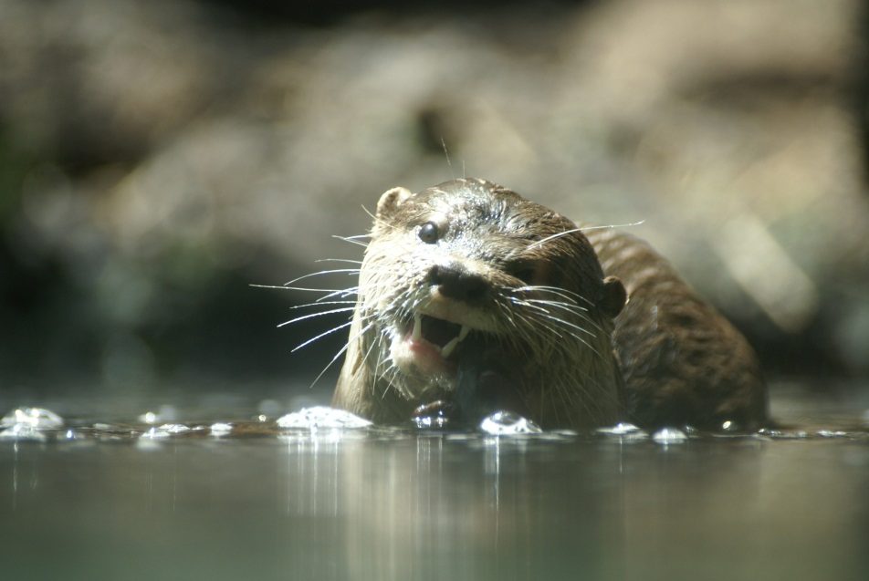
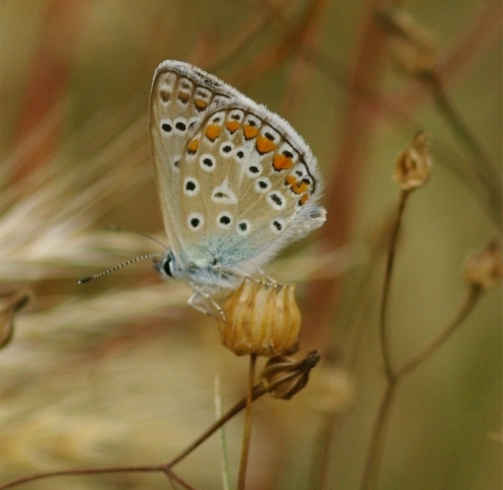
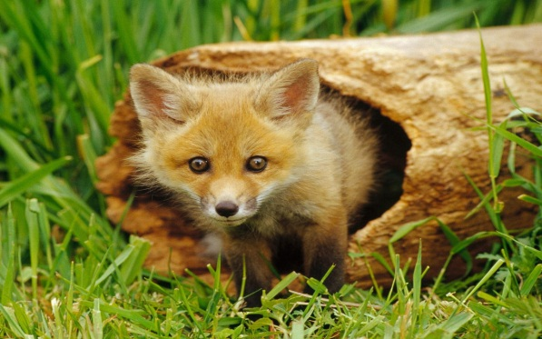
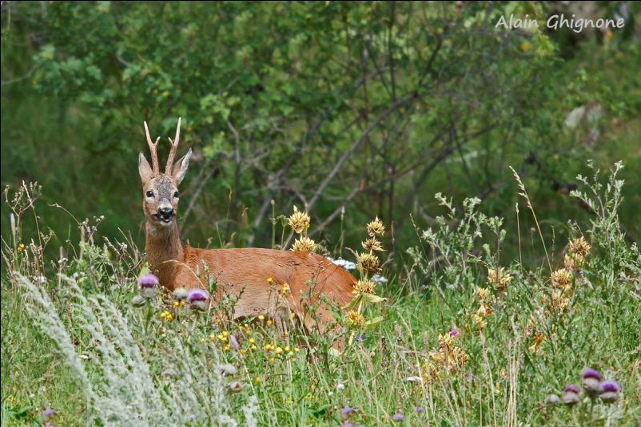
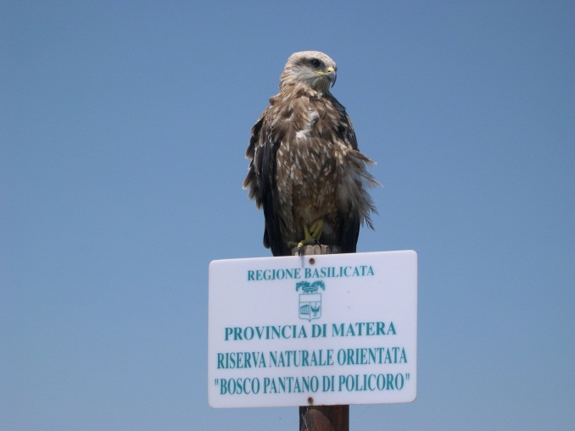
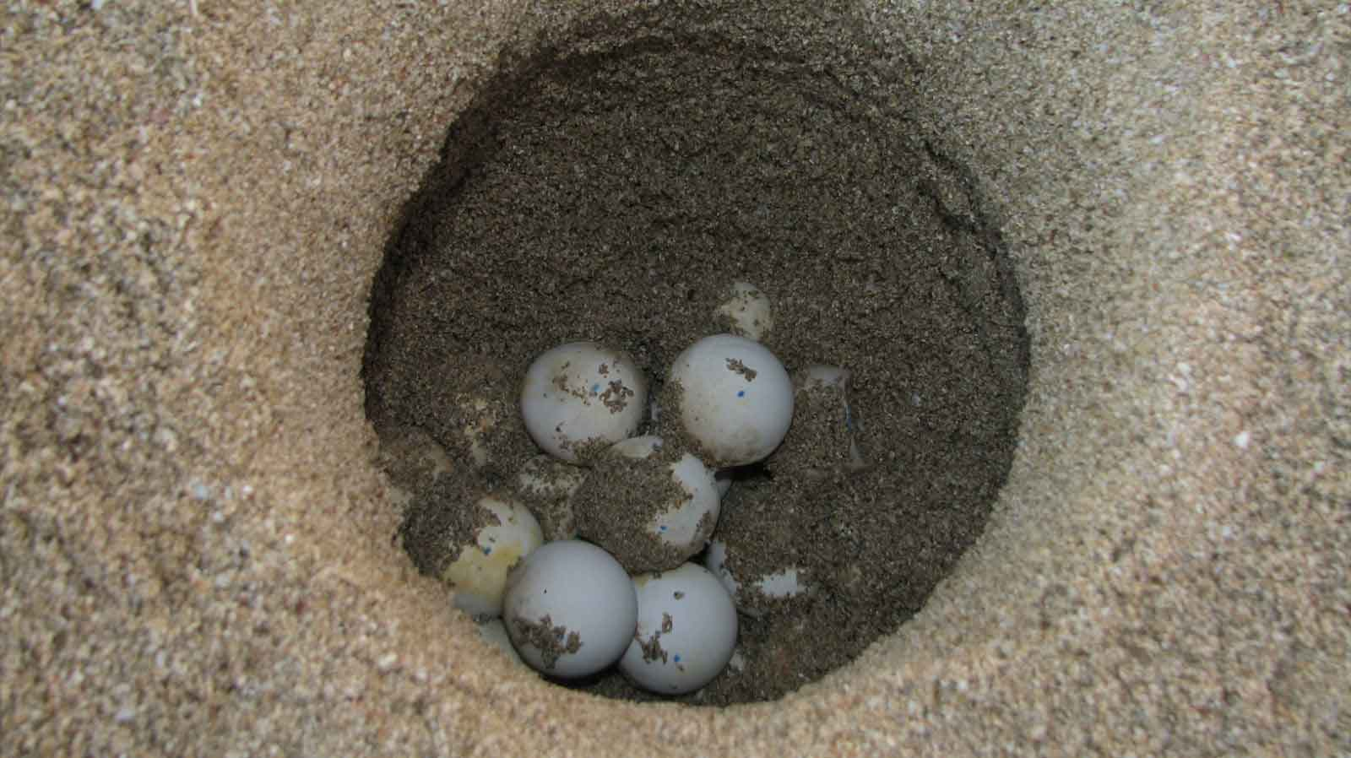
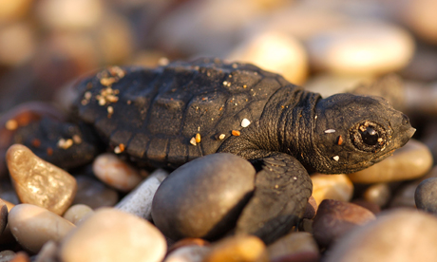
THIS SITE GIVES HOSPITALITY TO A LARGE VARIETY OF ANIMALS…

Slide 6
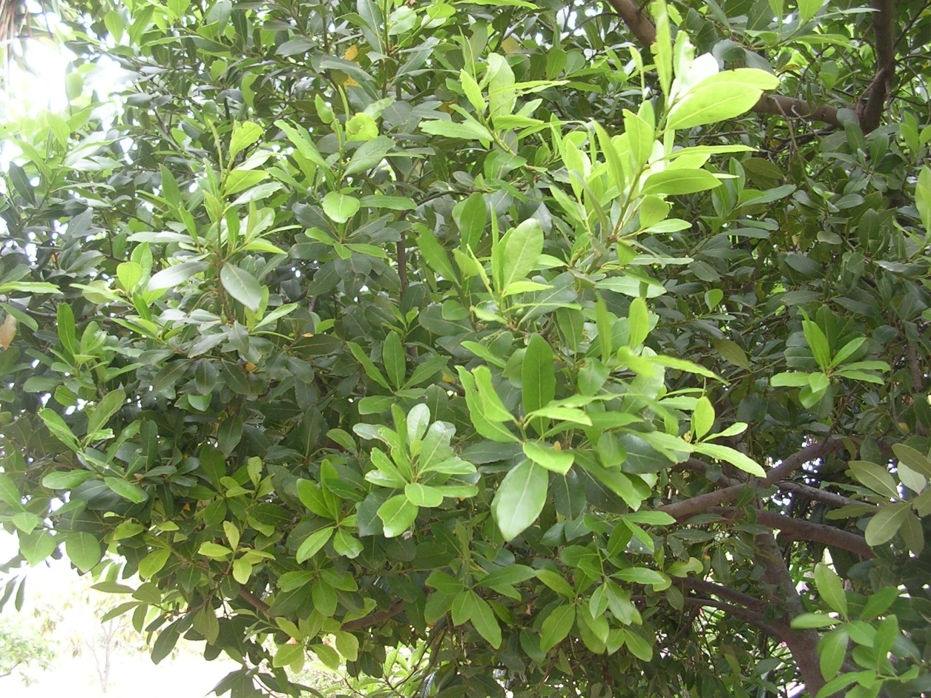
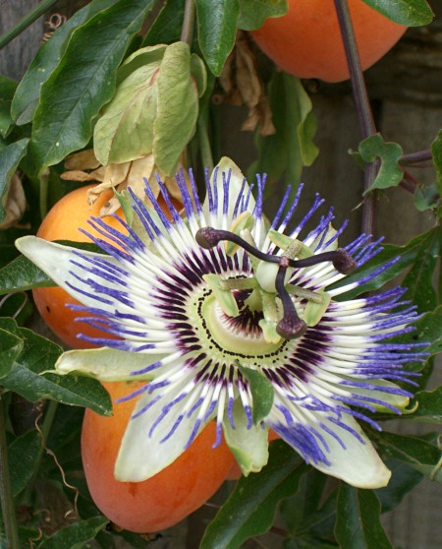
And of plants…

Slide 7
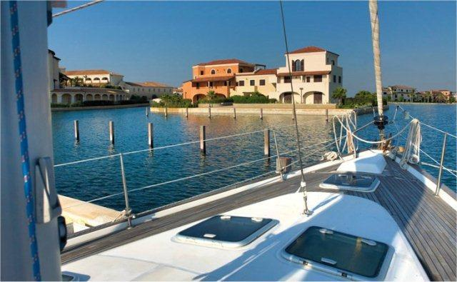
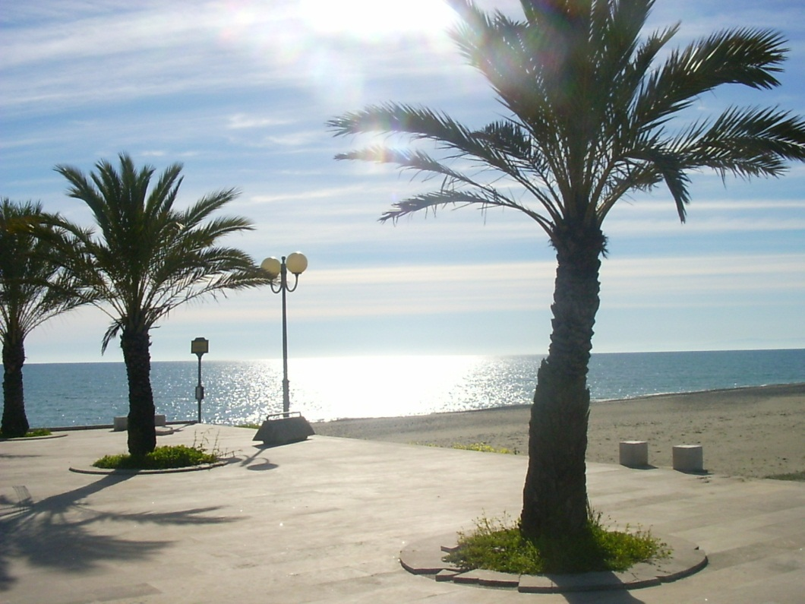
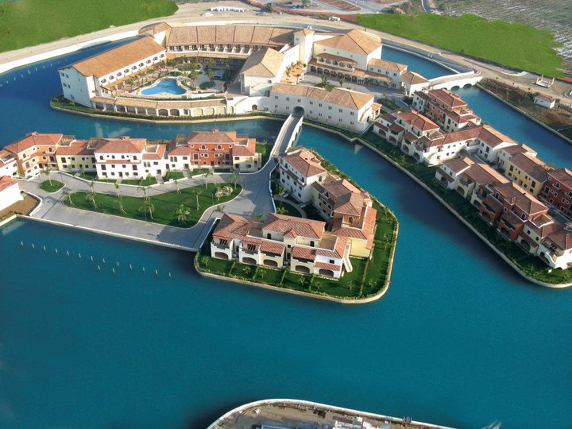
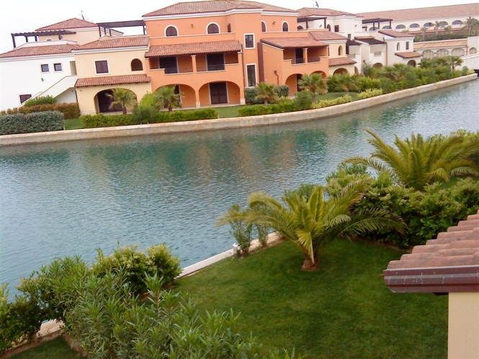
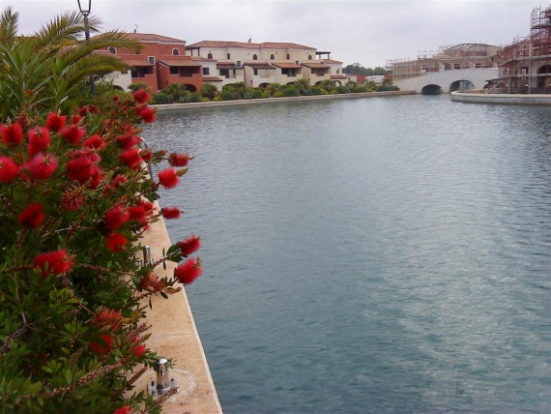
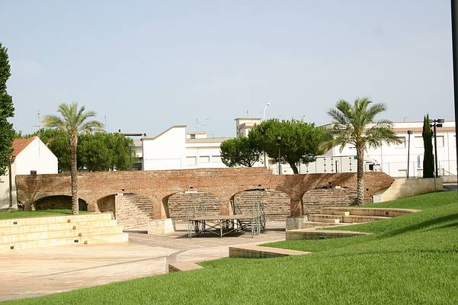
There is tourism…
MARINAGRI

Slide 8
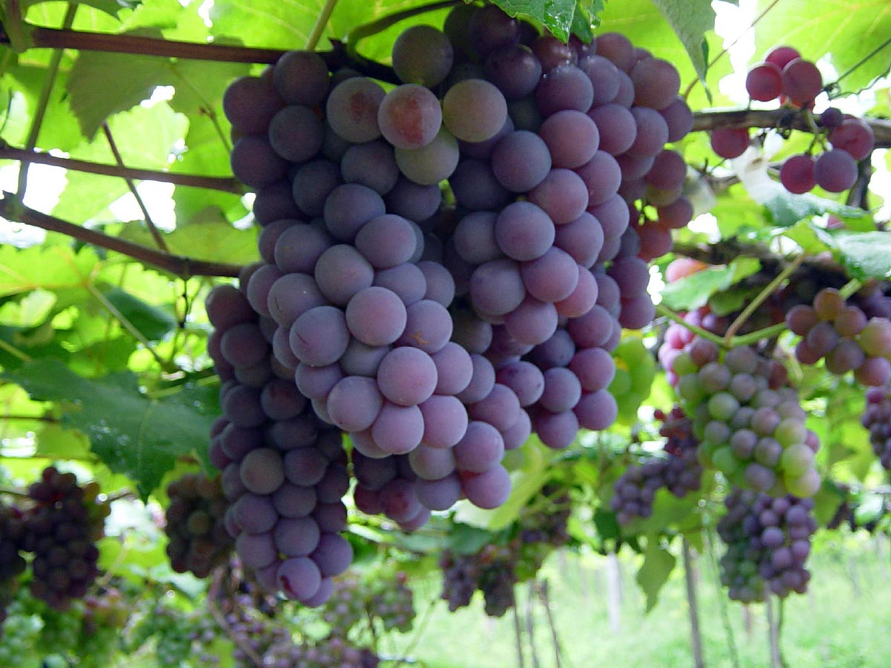
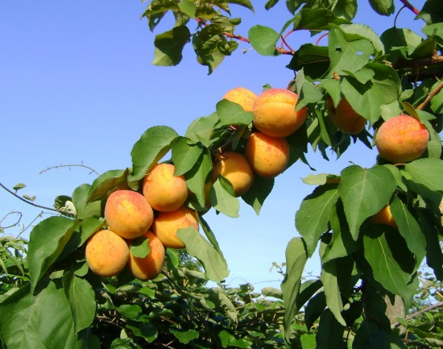
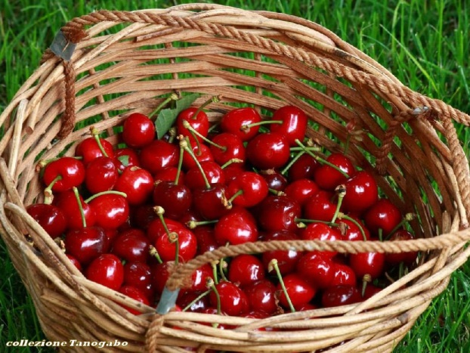
There is a good farming…
We grow apricots, cherries, olive, grapes and much other fruits…

Slide 9
Eraclea Square: the first town square
In this square there is the mother church...

Slide 10
Square Segni…
In this square the church Buon Pastore is located

Slide 11
Next to square Segni there is the town hall

Slide 12
From the Middle Ages developed a small village near the Baronial Castle…

Slide 13
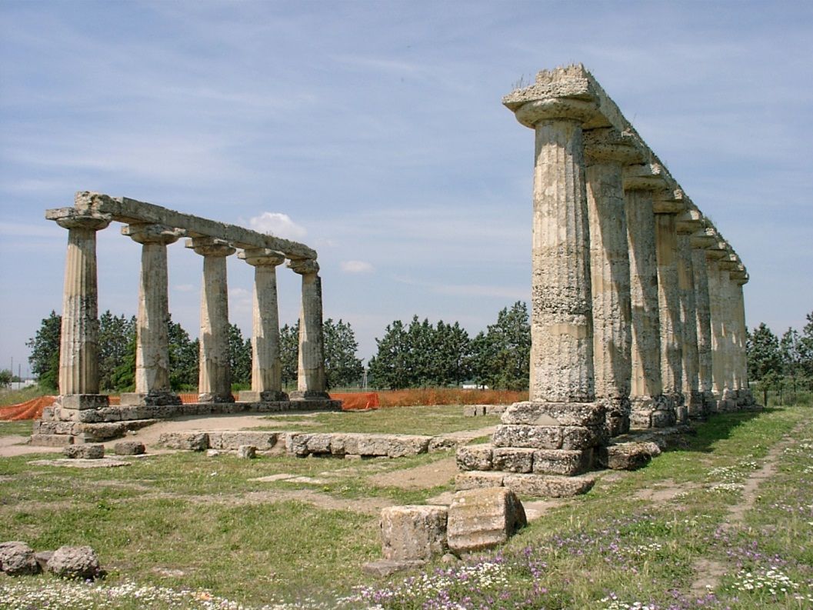
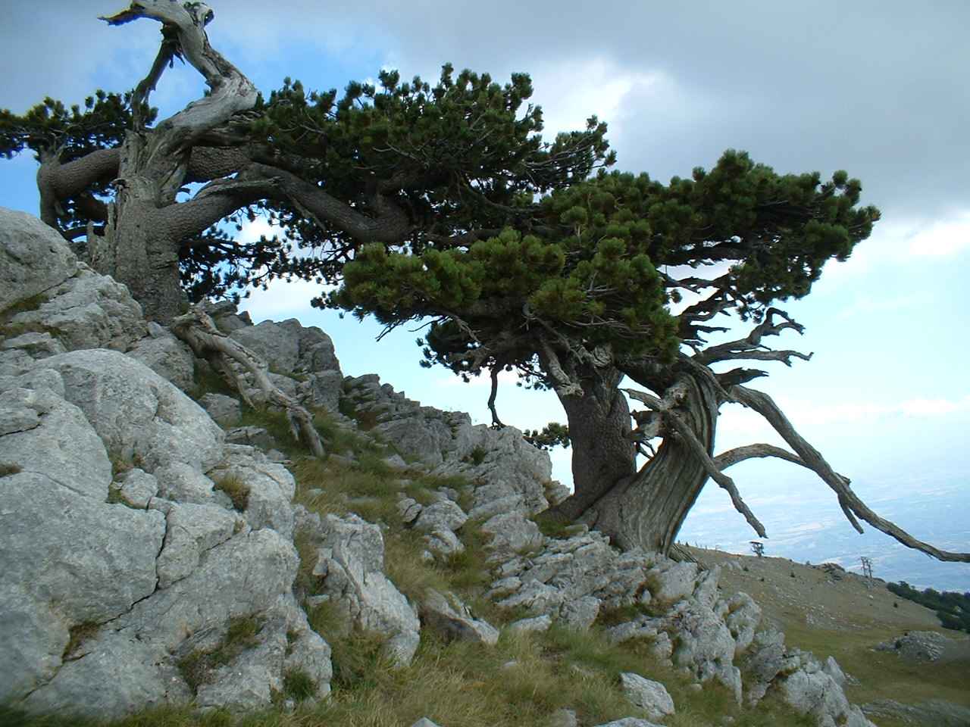
There are many interesting places around Policoro…
Metaponto
Pollino

Slide 14
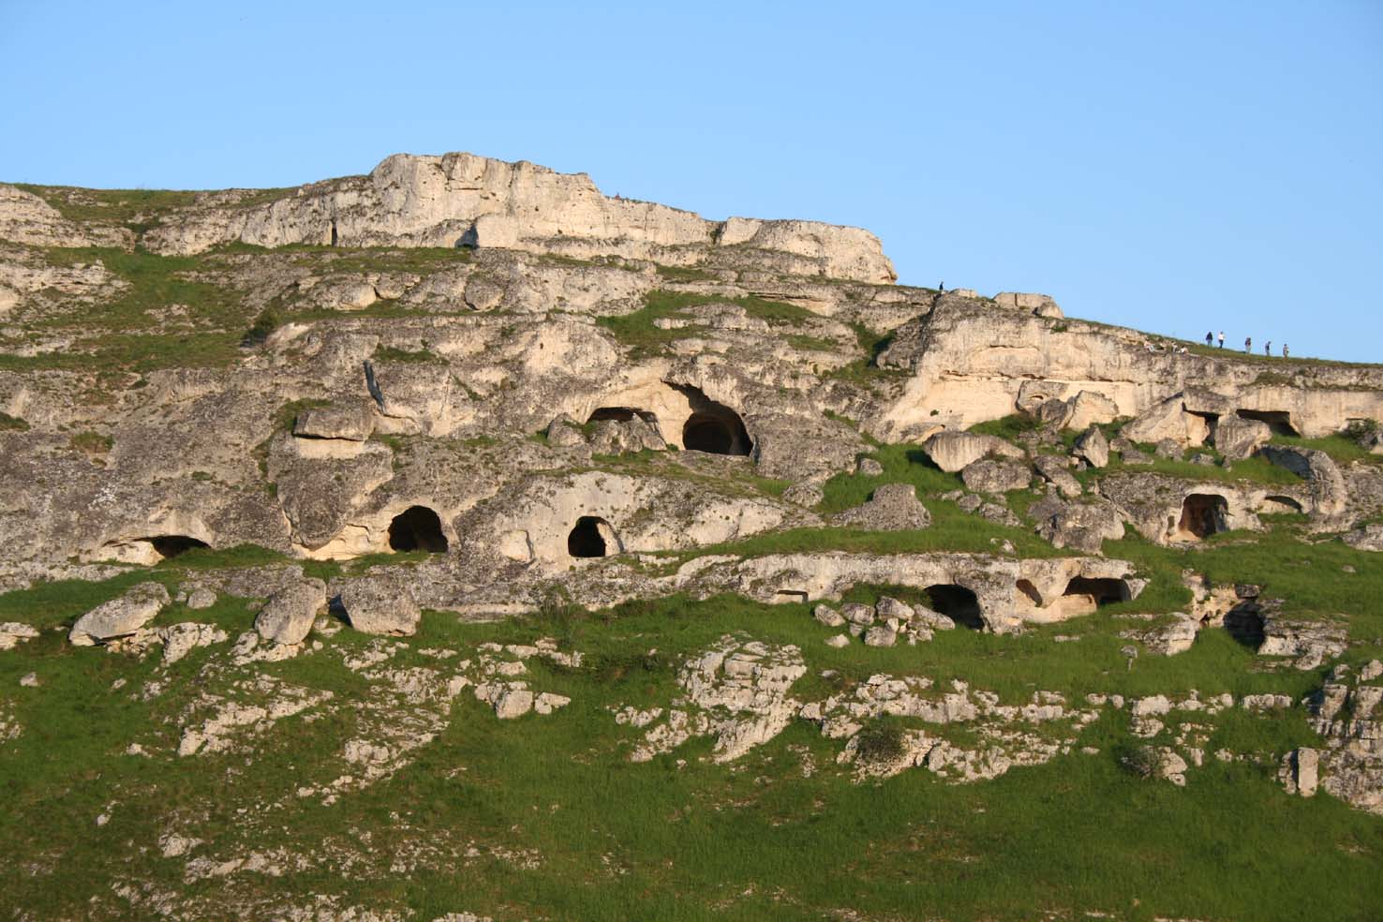
Maratea…
Matera…

Slide 15
Came closer…
…my world…
Is your world…

