Slide 1
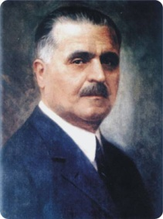
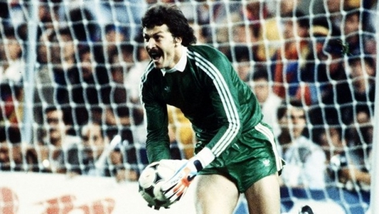
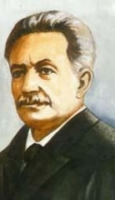
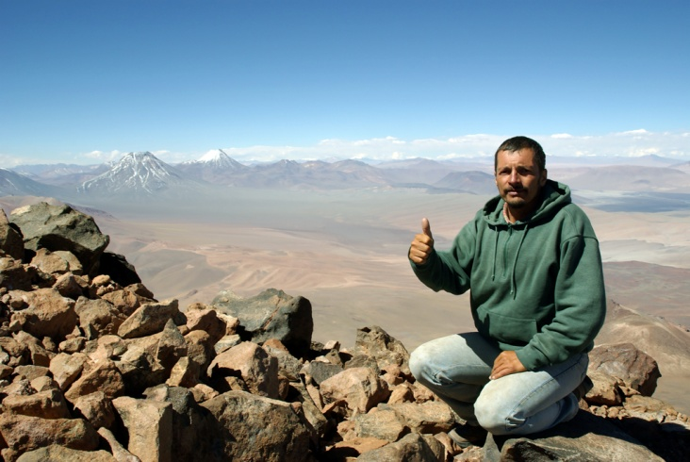
ȘCOALA GIMNAZIALĂ NR. 5 ARAD
COME CLOSER, MY WORLD IS YOUR WORLD
COMENIUS PROJECT
FAMOUS PEOPLE OF ARAD
This project has been funded with support from the European Commission.
This publication [communication] reflects the views only of the author, and the Commission cannot be held responsible for any use which may be made of the information contained therein.

Slide 2
Meet alin totorean...
the man who walked around the world
Alin Totorean is a Romanian speleologist, explorer, photographer and reporter.
He is known for his expeditions to Mongolia, Ethiopia, Morroco, India, Bolivia and Australia. Keen traveller to places that are home to some of the most beautiful treasures of the world, to far away cultures and civilizations, landscapes and people, the daring loner undertook the mission to discover his fellows, to know them better, beyond linguistic boundaries, in a project entitled „Discover your fellows”.

Slide 3
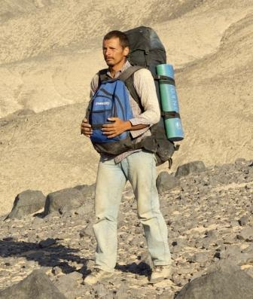
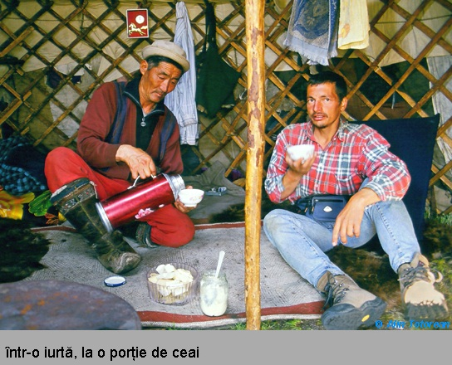
Mongolia
He was the first Romanian to cross the Mongolian Steppe in a solitary expedition. He travelled 550 km on foot from the volcanic area Khorgo to Ikh Bogd Mountain, in the Gov-Altay desert. He set off on foot towards the Gobi Desert, strewn with volcanic plateaus and frozen lakes, and on his way to the springs of the Orhon he crossed a maze of canyons with high steep walls. He walked for two days without meeting a single human being accompanied by the eagles that were hovering above the walls of the canyon. As he confessed to the students, he experienced a state of extreme loneliness. The globe trotter then told the students how he arrived in the inhabited areas (here people live in yurts). He said that Mongolia has a special place in his heart because he was surrounded by clean and surprising landscapes and by wonderful people.

Slide 4
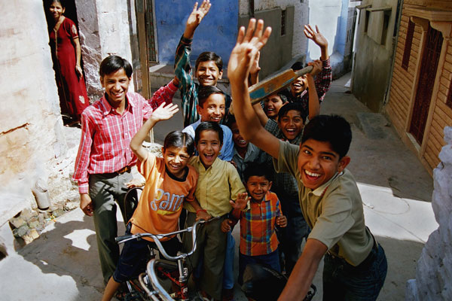
INDIA
He travelled on his own through regions which are less known to tourists: Aurangabad, Hampi. He wandered through the medieval town of Orchha, and climbed 4,000 meters to the foot of the glacier where the river Ganges has his springs. He was impressed by the difficult life of the people he met, who work hard for a few rupees a day.

Slide 5
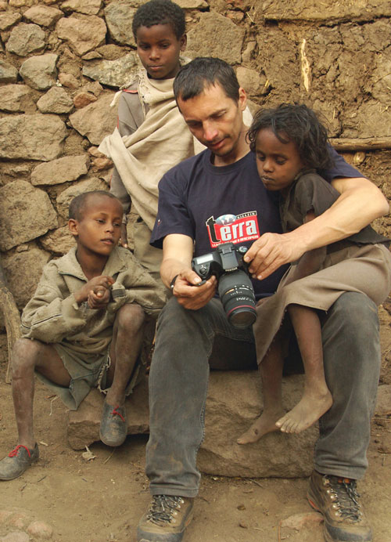
ETHIOPIA
His wish to know better his fellow people lead him to the far-away lands of Africa, where he lived for two months in one of the poorest countries in the world: Ethiopia. He set off on his journey from Addis Ababa and went to the plantations in the Kafa region. He wanted to see what it’s like to live in the middle of a volcano, so he spent a week in the huts in the Wenchi Crater. He worked for two weeks together with the farmers on the suspended plateau of Abune Yosef at 4,000 m altitude.

Slide 6
ATACAMA DESERT
The expedition to Atacama was a fight against his own limits since the Atacama Desert is the driest place in the world. He crossed the “absolute desert’, terrifying sterile lands that have never known rain. “On my way there was complete stillness nothing ever moved – not a blade of grass, I haven’t seen a single bird and I couldn’t watch a lizard run,” the globetrotter confesses.

Slide 7
AUSTRALIA
His next destination was, at the beginning of 2009, the Australian desert: an unpredictable desert, with herbs as sharp as knife blades, impossible to avoid, with snakes lurking at every turn, threatened by dingo attacks and unwanted encounters with the unfriendly Aborigines. Unfortunately, the desert provided a new challenge: a state of physical sickness , combined with the supernatural effort to travel tens of kilometers in temperatures of more than 55°C, the lack of water and varied food which lead to a temporary break. He was rescued by the Australian emergency service helicopters and taken to hospital. A few days later, he returned and successfully completed the first Romanian solitary expedition through the Australian desert. The expedition lasted for three months. Alin had walked over 800 km through the desert.

Slide 8
With his backpack full of stories and photos he travels through the country answering to invitations to participate in symposiums and conferences. He is welcomed especially by the students who look forward to hearing about his new adventures.
His project, "Discover your Fellows” brings people together, discovering that beyond the differences, the human soul is the same. The people discovered by Alin Totorean speak the language of the eyes and smile. "I did not know the language of the countries where we went, but I can say that there is a universal language: the language of your eyes. And the smile completes the task".

Slide 9
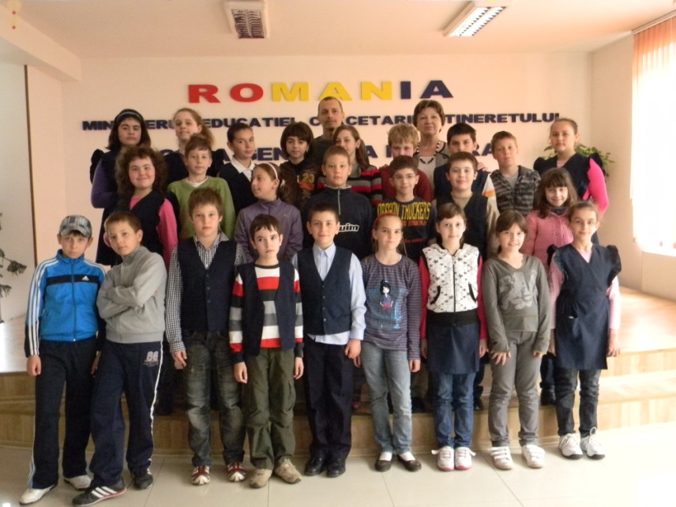
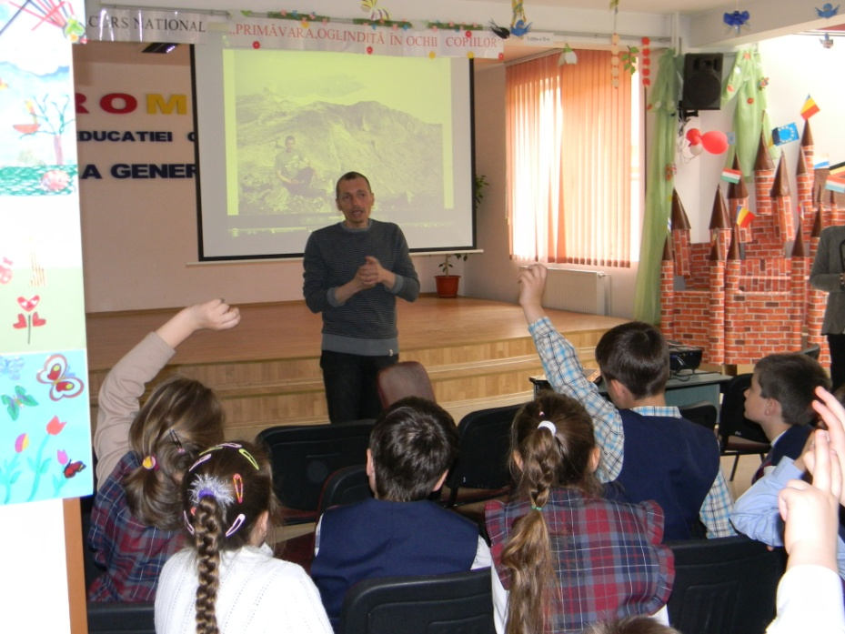
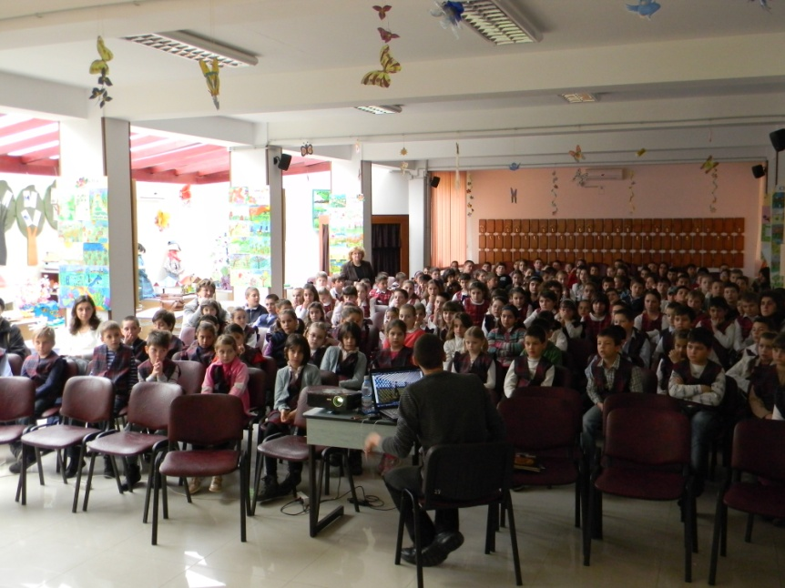
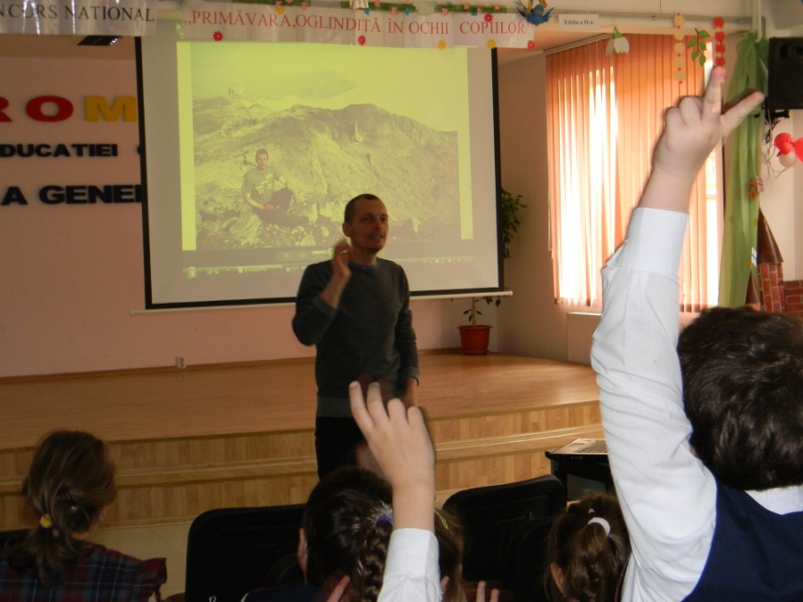
Meeting with the pupils

Slide 10
OTHER FAMOUS PEOPLE FROM ARAD
Ioan Slavici was a Romanian
writer and journalist.
Slavici was born in the village of Șiria, near Arad, in 1848. He made his debut in Convorbiri literare ("Literary Conversations") (1871), with the comedy Fata de birău ("The Mayor's Daughter"). His first book, Nuvele din popor, a collection of short stories, was published in 1881. It included Moara cu noroc (The Lucky Mill) and Budulea Taichii, two of Slavici's most well-known and crafted works. Today, the theatre from Arad is named ”Ioan Slavici”.

Slide 11
Vasile Goldiș (12 November 1862 – 10 February 1934) was a Romanian politician and member of the Romanian Academy.
He studied at the Faculty of Letters and Philosophy in Arad as a scholar of the Orthodox Church, at Ubiversity of Budapest and Vienna where he received a Bachelor of Arts degree. After graduating, he became a professor at the Eötvös High School in Budapest. One year later he quit this job for patriotic reasons and moved to Caransebeș, where he taught History and Latin at the Pedagogic-Theological Institute.
Since 1905 Vasile Goldiș devoted himself to the political activity.
On 1 December 1918, Vasile Goldis speaks in the Grand National Assembly of Alba Iulia his famous speech in which reveals the national and social oppression exercised over the centuries in Transylvania and Banat, emphasizing their durability under harsh conditions. In the interwar period, Vasile Goldis was part of the government in Bucharest.
Due to his importance in the history, the private University from Arad and one highschool from Arad were named ”Vasile Goldiș.

Slide 12
Helmuth Robert Duckadam is a retired Romanian footballer who played as a goalkeeper. He was born in Semlac, Arad county.
He started his career playing in the regional league of Arad county, before moving to FC UTA Arad to become professional.
He was called "the Hero of Seville" due to his heroics in the1986 European Cup Final, won by his main club, Steaua Bucuresti.
Amazingly, he saved four consecutive penalty shots in the shootout, being the first one to do so in an official European competition. Steaua won it 2–0, and the main European trophy for the first time, and much of the credit for the surprise victory was given to Duckadam.

