Slide 1
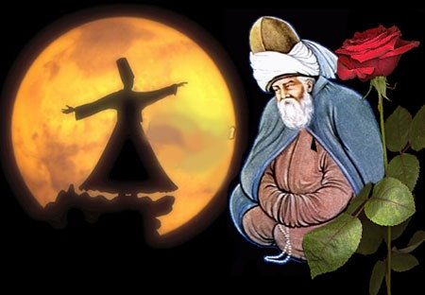
Mevlana Celaleddin Rumi

Slide 2
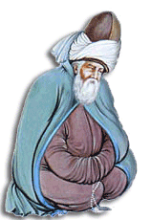
International Mevlana Foundation “Mevlana belongs to everyone”
"Come, come again, whoever you are, come! Heathen, fire worshipper or idolatrous, come! Come even if you broke your penitence a hundred times, Ours is the portal of hope, come as you are."
Hz. Mevlana

Slide 3
Mevlana Museum

Slide 4
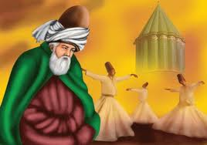
Seven Advices of MEVLANA
In generosity and helping others,
be like a river…
In compassion and grace,
be like sun…
In concealing others’ faults,
be like night…
In anger and fury,
be like dead…
In modesty and humility,
be like earth…
In tolerance,
be like a sea…
Either exist as you are,
or be as you look.
Mawlana Jelaleddin RUMI

Slide 5
Who is Mevlana?
Hz. Mevlana Celaleddin-i Rumi is the great Anatolian mystic, poet and the father of the Mevlevi Order. He is known as Hz. Mevlana in the East and as Rumi in the West.
In his lifetime, he was also referred to as “Hudavendigar”, meaning “distinguished leader”, whereas his present internationally renowned title “Mevlana” was very seldom used. The name “Rumi” was added to the end, rather later on.

Slide 6
Who is Mevlana?
Hz. Mevlana was born on 30 September 1207 in the city of Balkh, Horasan, which at the time was inhabited by Turkish tribes; (Balkh, today, remains within the boundaries of Afghanistan).
His mother Mümine was the daughter of Rükneddin, the “emir” (sovereign ruler) of Balkh and his father, Bahaeddin Veled, was “Sultanu-l ulema”(chief scholar).

Slide 7
Who is Mevlana?
As Mevlana begins attending his father’s lessons at
a very early age, he pursues the divine truth and
secrets.
He acquires Turkish, Arabic, Persian, and common
Greek as well as Classical Greek. He studies the
other religions along with Islam.
From history to medicine, he receives his initial education
from his father and then from Seyyid Burhaneddin Tirmizi
and other top scholars of the time.
Later on he himself, in turn, teaches hundreds of students in
Madrassahs (theological universities).

Slide 8
Mevlana’s Works
In addition to his best-known book of verse, Masnawi, the first eighteen lines of which were written down personally and the rest dictated to his student, Chalabi Husameddin, he also wrote Divan-i Kebir; Fih-i Ma-Fi, Mecalis- i Seb’a and Mektubat.

Slide 9
Masnawi
Mevlana’s Works

Slide 10
Mevlana’s Works
Divan-i Kebir
Preceding Masnawi, it is a collection of poems recited by Hz. Mevlana over a wide span of time. It contains approximately 40 thousand couplets within twenty-one moderate-size divans, as well as one “Divan-i Rubai” .
Fih-i Ma-Fih
It connotes “What’s within is within” and contains Hz. Mevlana’s lectures.

Slide 11
Mevlana’s Works
Mecalis-i Seb’a
As the meaning of the title “Seven Sermons” implies, it contains Hz. Mevlana’s seven lectures.
Mektubat
It consists of the 147 letters Hz. Mevlana wrote to relatives, including his son Sultan Veled, and to friends, rulers, and officials of the State.

Slide 12
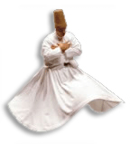
Whirling Dervishes
The 'dance' of the Whirling Dervishes is called Sema and is a part of the inspiration of Mevlana and has become part of Turkish custom, history, beliefs and culture.

Slide 13
Whirling Dervishes
Sema represents a mystical journey of man's spiritual ascent through mind and love to "Perfect". Whirling towards the truth, his growth, through love, deserts his ego, finds the truth and arrive to the "Perfect". He returns from this spiritual journey as a man who reached maturity and greater perfection, so as to love and to be of service to the whole of creation, to all creatures without discrimination of believes, races, classes and nations.

Slide 14
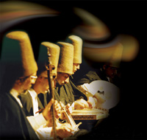
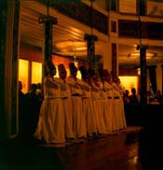
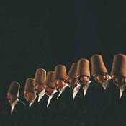
Sema is a part of the inspiration of Mevlana as well as part of the Turkish custom, history, beliefs and culture.

Slide 15
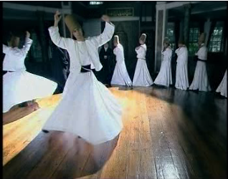
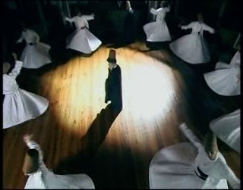
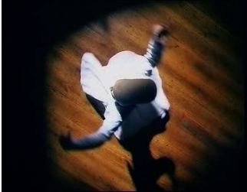
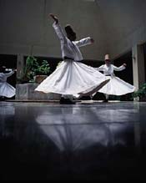
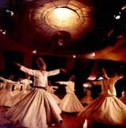
Sema Ensemble

Slide 16
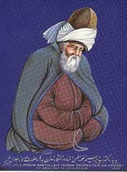
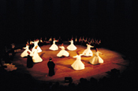
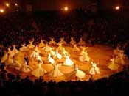
Sema Ensemble
SEMÂ :The "dance" of the Whirling Dervishes is called Sema

Slide 17
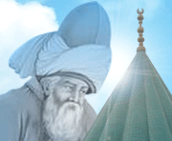
Rumi’s(Mevlana) Most Famous Word
Either seem as you are, or be as you seem.

Slide 18
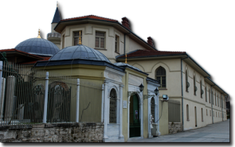
Thank you for your
interest in our culture.

