Slide 1
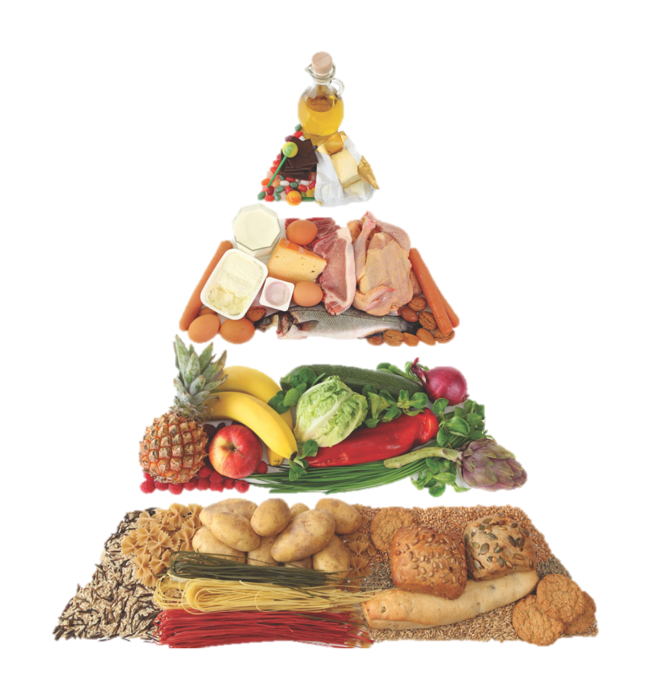
COMENIUS PROJECT
I AM
WHAT I EAT
ȘCOALA GIMNAZIALĂ NR 5 ARAD

Slide 2
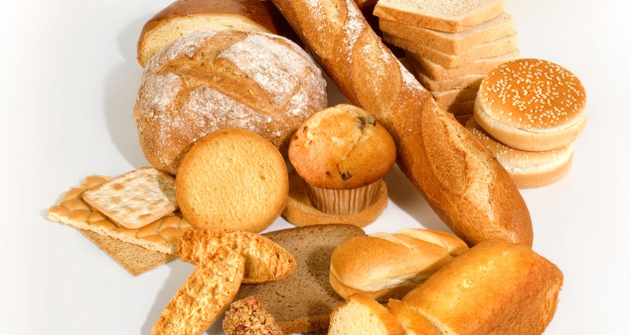
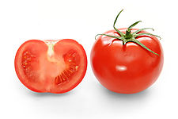
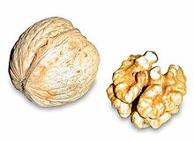
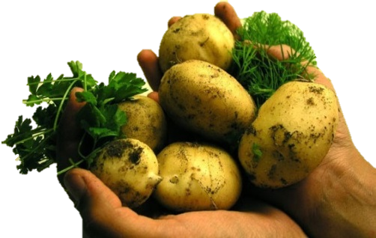
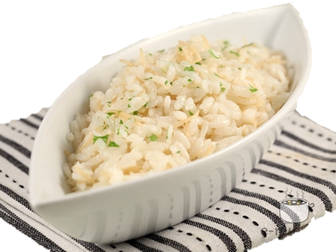
75% of today's diseases are caused by unhealthy eating disordered lifestyle. The way you feed, the origin of eating habits in general are very important in body balance.
Starchy foods like bread, cereal, rice, pasta and potatoes are an important component of a healthy meal and should represent a third of the food we eat. They are a source of energy and the main source of nutrients in our diet. Besides these starchy foods also contain fiber, calcium, iron and vitamin B.
We should consume daily foods with starch or should include at least one meal containing starchy foods.
We could start the day with a breakfast with whole grains, a sandwich for lunch and potatoes, pasta or rice for dinner.

Slide 3
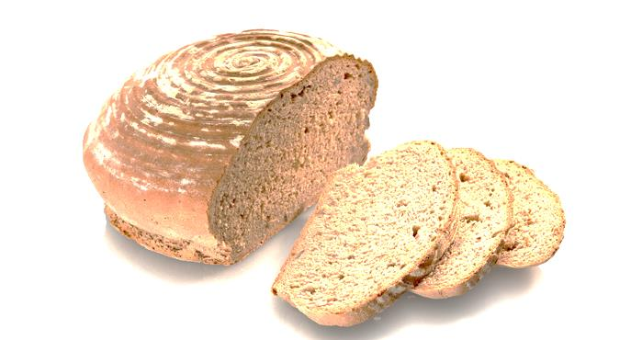
Food grains contain more nutrients than foods with starch grains. Digesting food is slower and it helps you feel full longer.
Whole foods consist of:
- Wholemeal, wholemeal bread
- Grains and brown rice pasta
- Whole grains

Slide 4
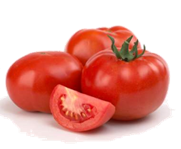
Many people know they should eat more fruits and vegetables, but most ignore this. Try to eat at least five kinds of fruit and vegetables every day! You may, if you want, to increase the number of fruits and vegetables daily. It's easier than you think.
For example, you can use:
- A glass of juice and banana pieces with whole grains
- A salad for lunch
- A pear as a snack lunch
- A serving of peas or other vegetables evening meal

Slide 5
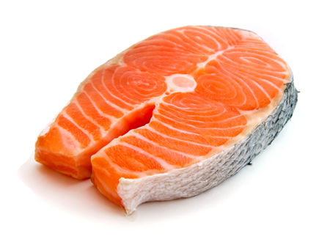
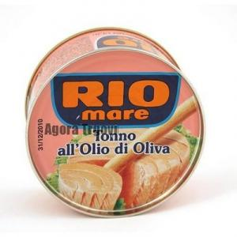
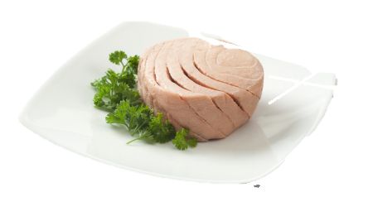
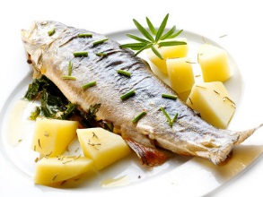
We should eat fish, including a portion of "oily fish" per week. It is an excellent source of protein and contains many minerals and vitamins. Eat at least two servings of fish a day and do not forget to include a serving of „oily fish ". You can choose or fresh, or frozen, or canned, but remember: canned or smoked fish can be salted.
What is "oily fish"?
Some fish are called oily because they are rich in certain types of fats, called omega 3 fatty acids, which help us to keep our heart healthy.
Example of oily fish: sardines, herring, tuna thrive, sardine, mackerel, carp and salmon.

Slide 6
Saturated fat and sugar
To keep ourselves healthy and we need fat in our diet. What is important is the kind of fat we eat. There are two types of fat:
- Saturated fat - if you eat too much saturated fat raise blood cholesterol you risk that increases the chance of having heart disease.
- If you eat unsaturated fats, unsaturated fats instead of saturated fat can lower your blood cholesterol.
Try to reduce foods high in saturated fats and replace them with foods with unsaturated fats such as vegetable oils (sunflower oil, olive oil, canola oil), oily fish, nuts, seeds and avocado.
We should try to eat fewer foods that contain sugar, such as sweets, cakes, biscuits and soft drink without sugar. If we consume these products too often can cause side effects such as: loss of teeth, if these products are used between meals. Many of the foods that have sugar in content may have more calories, so if you get rid of sugar, you could have a little help on weight control.

Slide 7
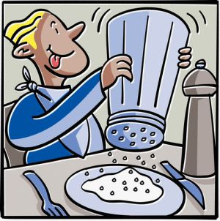
Our health and salt
Many people believe they do not consume too much salt, especially if they add in food. Do not be so sure!
Every day 85% men and 69% women consume more salt then admitted. Adults and children over 11 years should consume no more than 6 grams per day. Young children should consume much less.
75% of the salt we eat is already in the food you buy, for example, cereal, soup, cooked meat and sauces. In conclusion, you already eat more salt than you should. Excessive consumption of salt can lower blood as a consequence. People with high blood pressure may have heart problems or a heart attack.

Slide 8
What should we drink?
You should drink 1.2 liters of water or other fluids every day to not dehydrate. When the weather is warm or when the body needs more water, but avoid to drink with a high sugar content.
Alcohol
There's nothing wrong with the occasional drink, but drinking over the limit causes problems. Alcohol has more calories in content, so if you remove it from the list you, it will reduce weight. Women can drink 2 or 3 units of alcohol, and men 3 or 4 units a day, without having a risk to health.

Slide 9
What about breakfast?
Breakfast can help us have enough energy to face the day. It will also be extra vitamins and minerals. Some people skip breakfast, thinking that help them get rid of weight. But they are wrong, these decisions can have serious consequences on us because we can miss important nutrients.
The researchers found that breakfast can help diets. If we skip breakfast, we'll probably get hungry before lunch and take a snack. Tasting it was a donut, pastry or biscuits, things full of sugar and fat.
So why not pick a bowl full of whole grains, with chunks of banana and a glass of orange juice for a healthy breakfast?
Hope we helped you to become a healthier person,
Victor and Raluca
Clasa a VIII-a D

