Slide 1
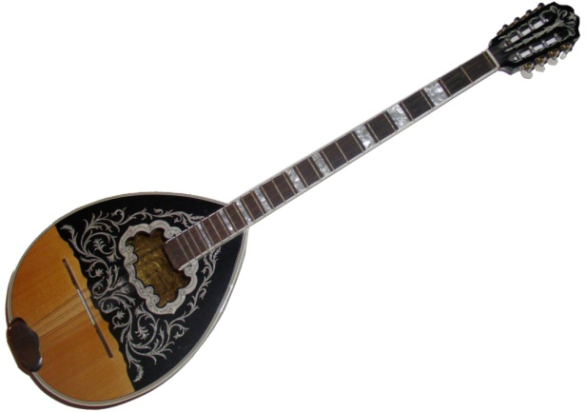
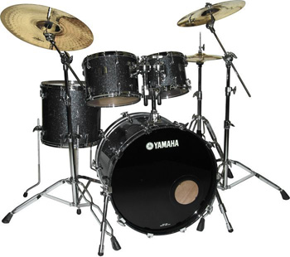
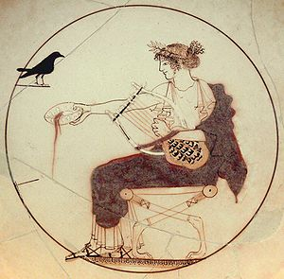
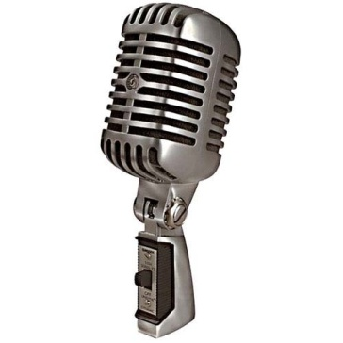
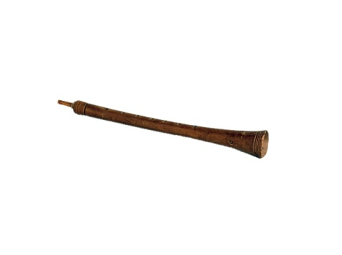
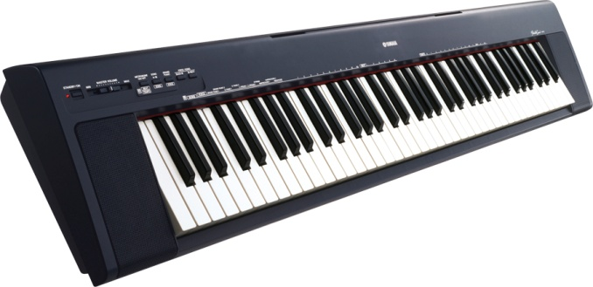
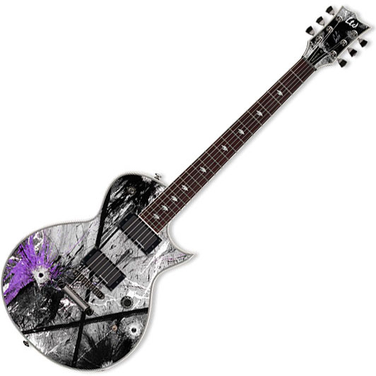
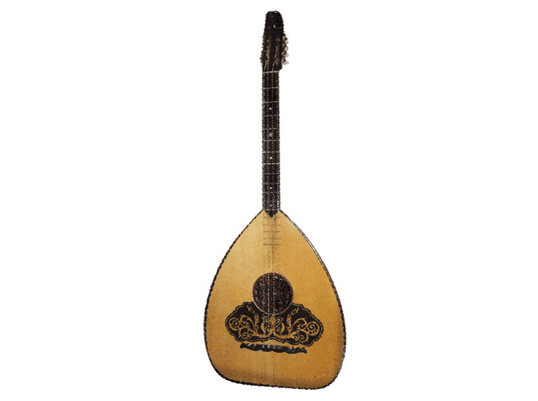
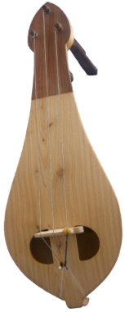
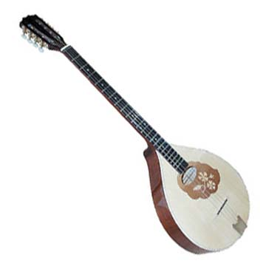
Greek Music History

Slide 2
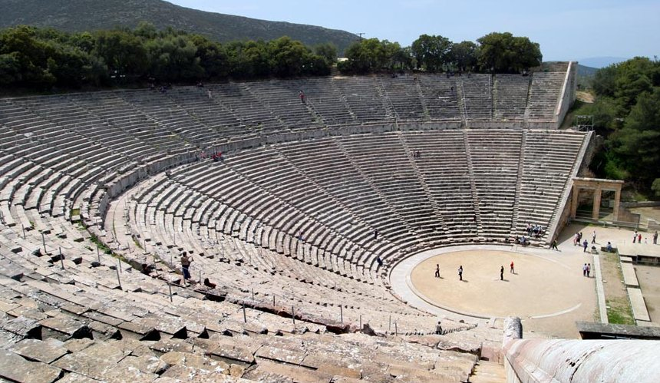
Music in Ancient Greece
Greek music history extends far back into ancient Greece, since music was a major part of ancient Greek theater.
The plays had a chorus of up to 50[12] people, who performed the plays in verse accompanied by music, beginning in the morning and lasting until the evening.

Slide 3
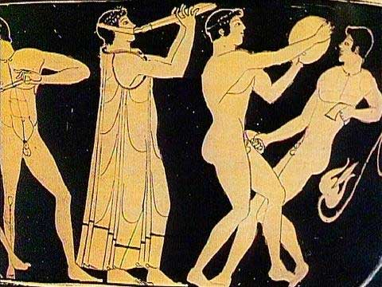
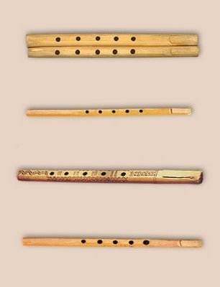
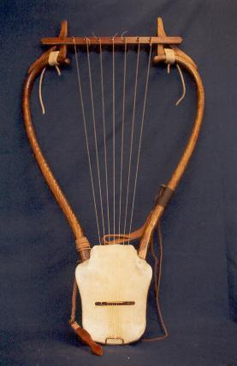
Ancient Times
In ancient Greece, mixed-gender choruses performed for entertainment, celebration and spiritual reasons.
Instruments included the double-reed aulos and the plucked string instrument (like pandura), the lyre, especially the special kind called a kithara.

Slide 4
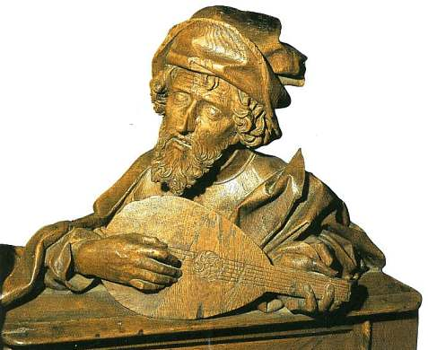
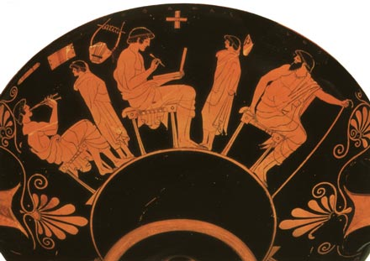
Music as education
Music was an important part of education in ancient Greece, and boys were taught music starting at age six. Greek musical literacy created a flowering of development.
Greek music theory included the Greek musical modes, eventually became the basis for Western religious music and classical music.

Slide 5
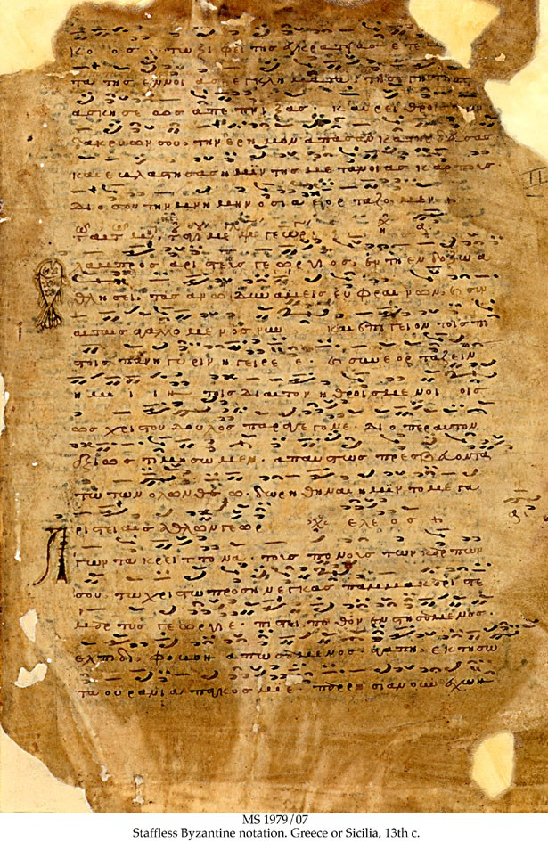
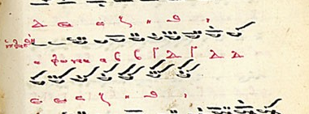
Byzantine Music
Byzantine music (Greek: Βυζαντινή Μουσική) is the music of the Byzantine Empire composed to Greek texts as ceremonial, festival, or church music.[1] Greek and foreign historians agree that the ecclesiastical tones and in general the whole system of Byzantine music is closely related to the ancient Greek system.[2] It remains the oldest genre of extant music, of which the manner of performance and (with increasing accuracy from the 5th century onwards) the names of the composers, and sometimes the particulars of each musical work's

Slide 6
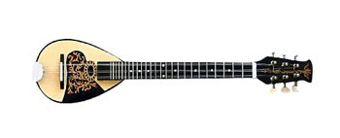
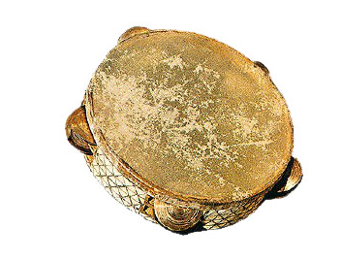
Traditional Greek Music
Nisiotika
Kritika
Rebetiko
Macedonia

Slide 7
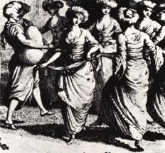
Nisiotika
The Aegean islands of Greece are known for Nisiótika songs. Although the basis of the sound is characteristically secular-Byzantine, the relative isolation of the islands allowed the separate development of island-specific Greek music. Most of the nisiótika songs are accompanied by lyra, clarinet, guitar and violin.

Slide 8
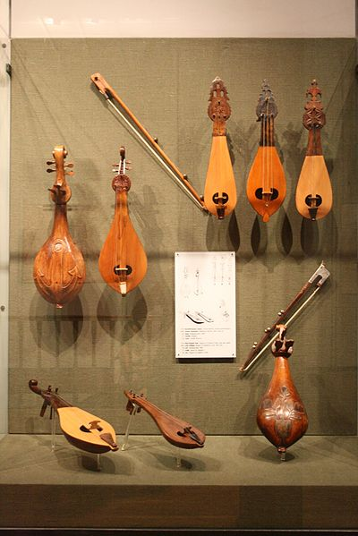
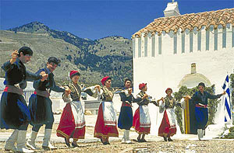
Music of Crete (Kritika)
The Greek islands of Kárpathos, Khálki, Kássos and Crete form an arc where the Cretan lyra is the dominant instrument. Kostas Mountakis is probably the most widely-respected master of the lyra, which is often accompanied by the laouto which resembles a mandolin.

Slide 9
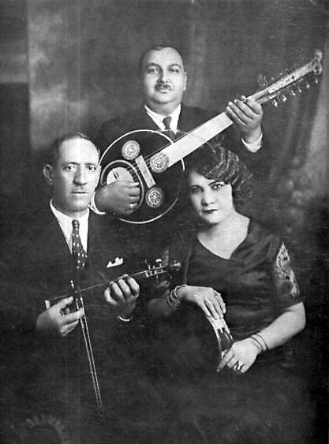
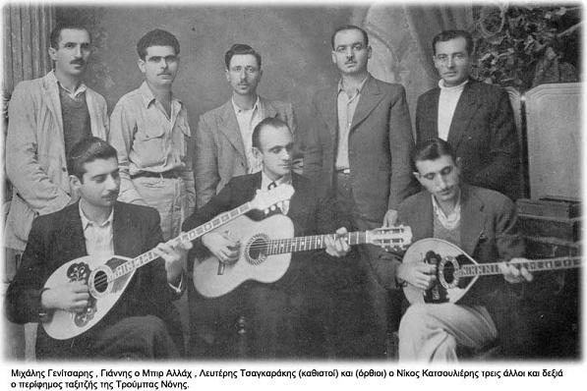
Rebetiko
Rebetiko was initially associated with the lower and poor classes, but later reached greater general acceptance as the rough edges of its overt subcultural character were softened and polished. Rebetiko probably originated in the music of the larger Greek cities, most of them coastal, in today's Greece and Asia Minor.

Slide 10
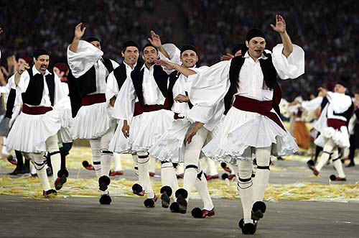
Music of Macedonia
Folk dances in Macedonia include Makedonia (dance), hasapiko, leventikos, zeibekiko, zonaradiko, endeka Kozanis, samarinas, stankena, akritikos, baidouska, Macedonikos antikristos, mikri Eleni, partalos, kleftikos Makedonikos, mpougatsas, kastorianos, tromakton, o Nikolos, antikrystos, sirtos Macedonias and Kapitan Louka. There are also folk songs which make references to the Macedonian Struggle (Greek Struggle for Macedonia), while it is notable the use of trumpets and koudounia.

Slide 11
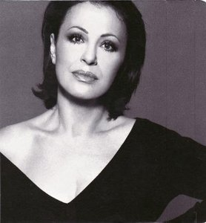
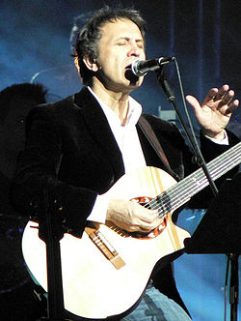
Greek Singers
Gregory Bithikotsis was important Greek songwriter and performer
Giorgos Ntalaras is a Greek laiko, entehno and rebetiko Singer
Haris Alexiou is a Greek laiko, entehno singer

Slide 12
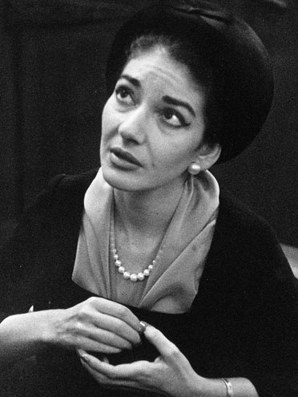
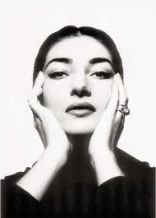
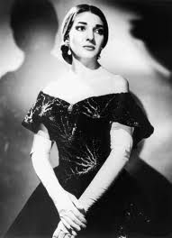
Maria Callas
Maria Callas was an American-born Greek soprano and one of the most renowned opera singers of the 20th century.

Slide 13
Greek Popular Singers
Helena Paparizou, is a Greek—Swedish singer and occasional songwriter and television personality.
Anna Vissi is a Greek-Cypriot recording artist and actress
Sakis Rouvas is a Greek pop,dance singer
Despina Vandi is a Greek pop and laiko Singer

Slide 14
Greek Bands
Onirama
Firewind
Locomondo

Slide 15
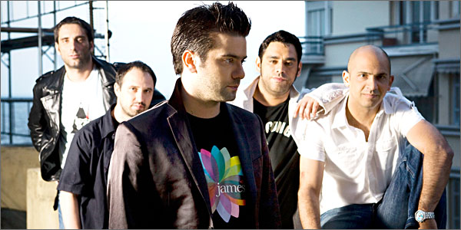
Onirama
The Onirama is a Greek pop rock band scene. have to their creditof successful songs in Greece. The most famous songs are χαμένος θυσαυρός ,αυτός and η μπαλάντα του τρελου

Slide 16
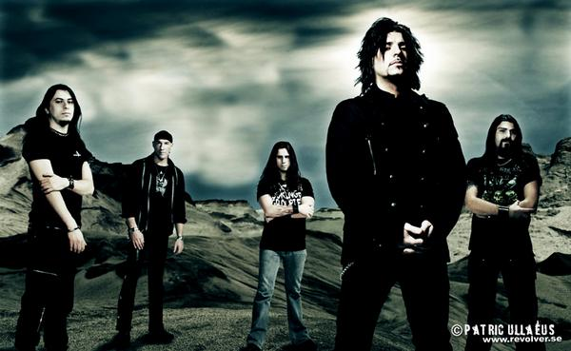
Firewind
Firewind is a Greek Heavy metal band. Formed in 1998, the group is currently signed to Century Media Records and was originally a small project created by guitarist, Gus G. the best hits of Firewind are Breaking the silence, mercury man and falling to pieces.
Notes:
Gus g the lead guitar player is also guitarist of Ozzy Osboune

Slide 17
Locomondo
Locomondo is one of the best known, most successful bands in Greece.
The 7-member band fronted by Markos Koumaris , the main songwriter and composer of the group, fuses Reggae, Ska and Caribbean sounds with Greek traditional musical elements. Some of their songs are: A crazy world, 12 days in Jamaica and the wedding party.

Slide 18
Thank You

