Slide 1
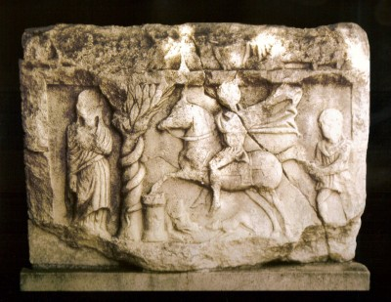
Monuments of Rodopi - Greece
Junior High School of Sapes - Greece
Comenius – Come Closer My world is your world
Year 2011-2012. Version 1.02

Slide 2
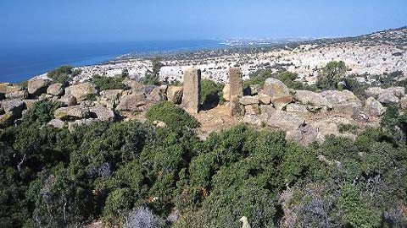
Maronia
Area first inhabited by Thracian races like Kikones from 13th c. BC. Homer talks about Maronia in Odyssya
Ancient city founded in 7th c. B.C. by shelters from island Chios who lived together with locals.

Slide 3
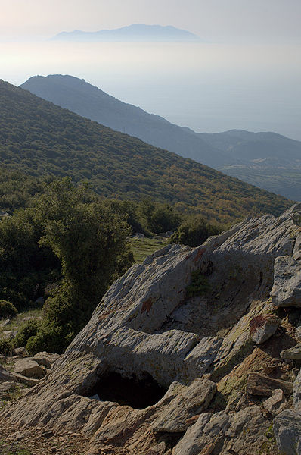
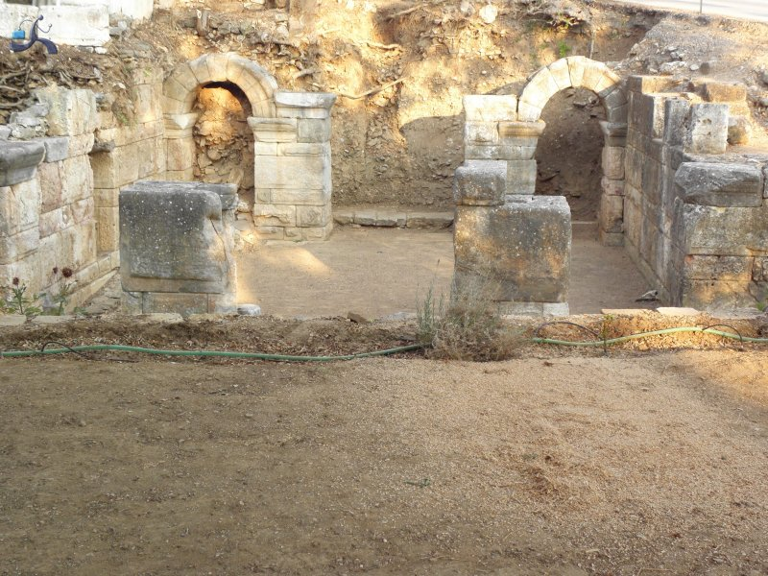
History of Maronia
The ancient city of Maronia stood on the coast , on the site of the modern village of Agios Charalambos with its picturesque little harbour. The legend says that it was found by the king Maron, a priest of Apollo who dwelt amidst the vendure of the god's sacred grove. In the seventh century, a colonist from Chios arrived in the area and the city became an important commercial centre until it was taken by the Persian in 513.
The first Athenian Confederacy's tax registers for 478/7 mentioned. Maronia's contribution was one talent and 3,000 drachamas.
In the Roman period, it experienced renewed economic and cultural prosperity, which continued until the early Chistian times.

Slide 4
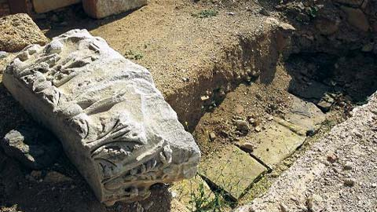
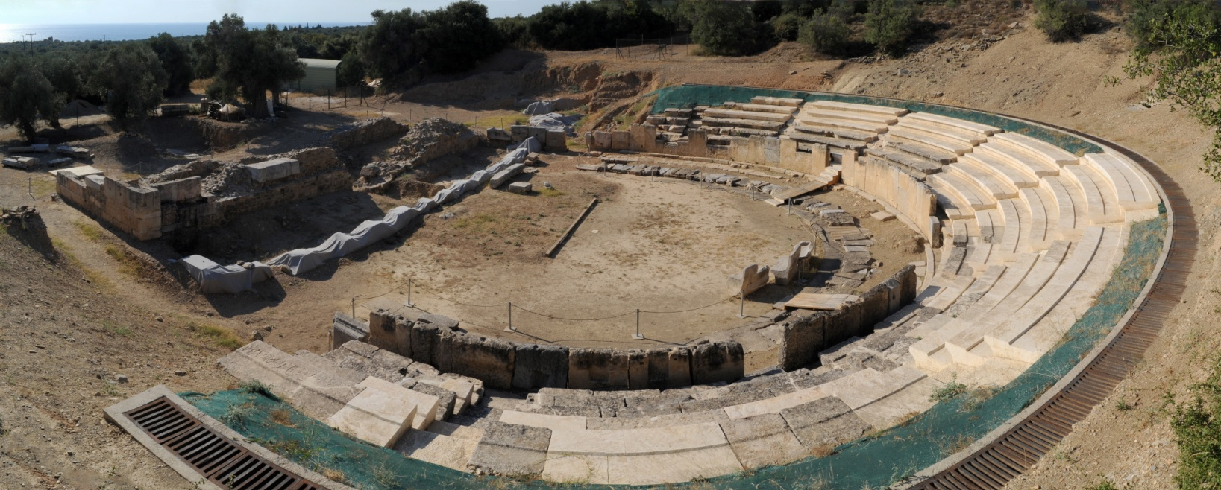
Theatre of Maronia
ANCIENT THEATRE
Archeologists believe that it dates back since the Hellenistic or Roman period. The theatre most probably had the capacity some 3.000 people to be seated. The theatre was destroyed in 1906, the porous seats here broken up and the material was used to build the school of Maronia

Slide 5
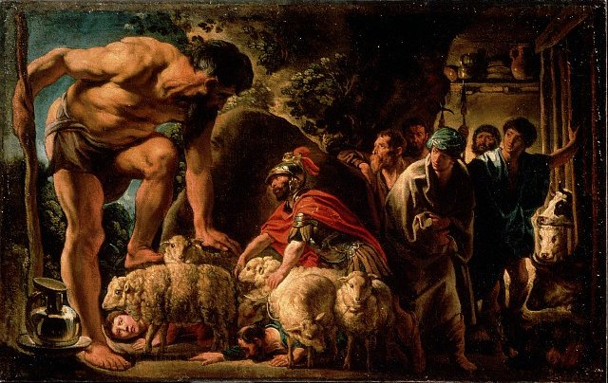
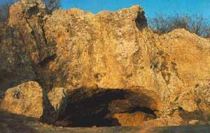
CAVE OF CYCLOP
According to the local lore it was Cyclop's Polyphemus' Cave.
According to the Greek mythology Odysseus, during his 10 year journey home from the 10 year Trojan War, arrived at the Kingdom of Kikonians, the land of the Tracian people who lived between the present -day lake Vistonida and the Estuary of the Evros River, where he tied up his ship.

Slide 6
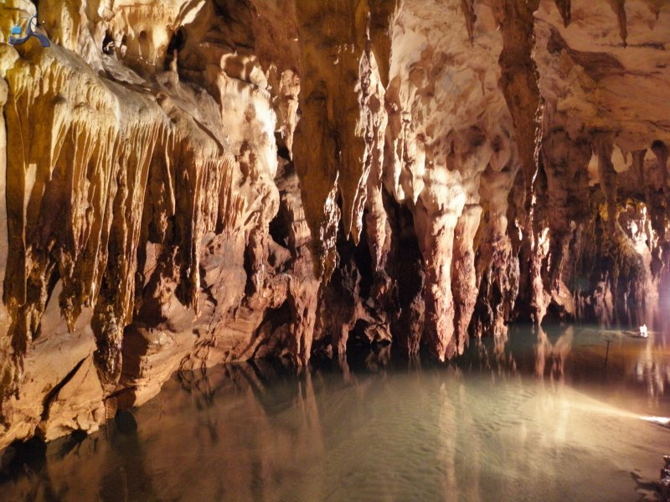
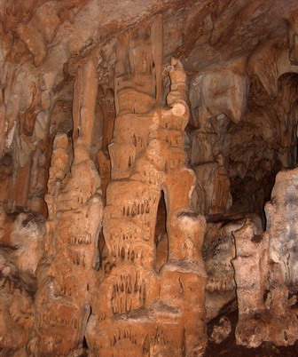
Polyphemus Cave
The Maronia Cave is considered an important monument both with respect to its beauty and its archaelogical interest. Apart from the colorful stalactites and stalagmites, the cave is also home to and breeding ground of two rare species of bats.
The local Rodopi prefectural council recently started to exploit the cave, to set out a 300 meter long trail along which visitors can view the exqusite stalactites and stalagmites

Slide 7
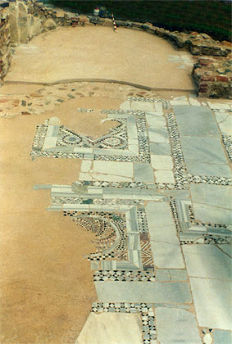
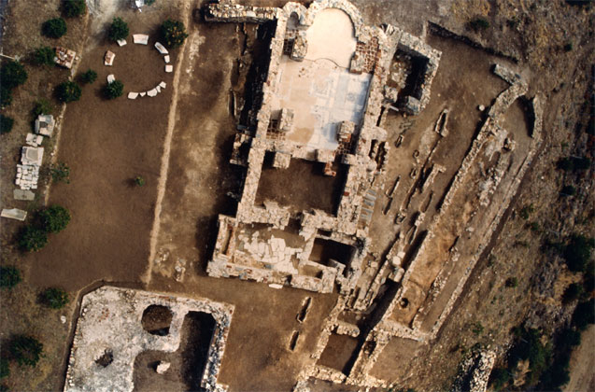
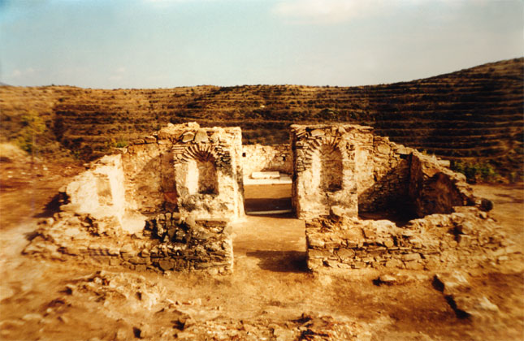
PAPIKIO MOUNT
An important monastic centre near Komotini.
It was the centre of monastic life (11th - 14th century) equal to Agion Oros where historic personalities took their monastic vows, including Alexios the son of Manuel Komninou
Monasteries rouins can still be seen in our days.

Slide 8
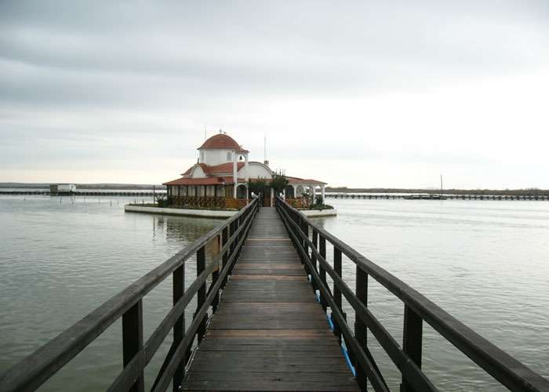
ST. NIKOLAOS CHURCH
It is a monastery which is built on an island southwards the Vistonida Lake, a glebe of the Monastery of Vatopedi at Mount Athos. Awooden pedestrian bridge connects the island with the mainland

Slide 9
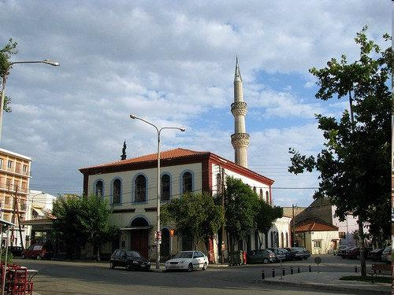
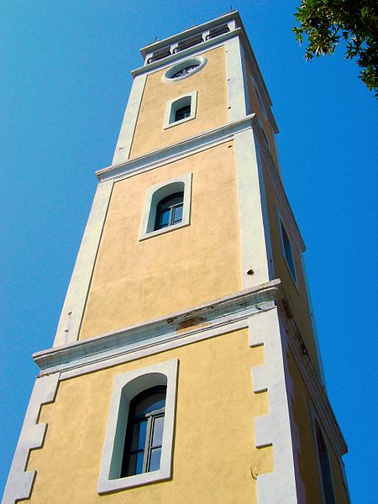
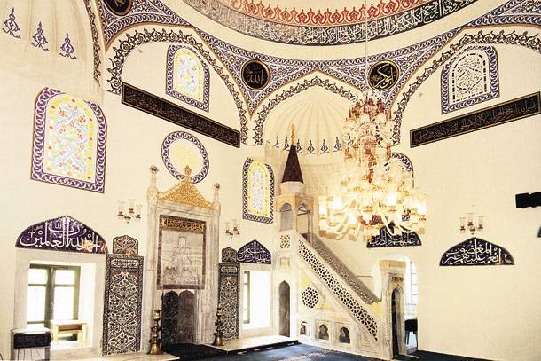
YENI (old) and ESKI (new) MOSQUE
Placed in the centre of the town Komotini, they are two of the oldest mosques in the region.
Yeni Mosque (1585 by Deferdan Pasa) is next to the clock Tower.
Eski
The Clock Tower was builted in 1884, during the time of Sultan Abdul Hamid II
In the 1950's architectural works took place, giving its current form.

Slide 10
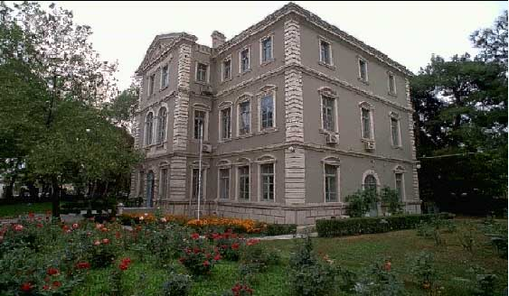
Palia Prytania
Founded in 1907 by a Greek from Egypt.
First name “Dimotiki Astiki Scholi” (kind of high school) 1908-1909
Orphanage 1916
Government Building (general commanding office). 1919-1945
Nomarchia 1945-1972
University Secrecy (prytania) 1972-2000

Slide 11
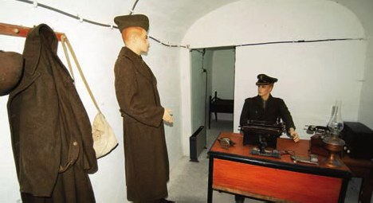
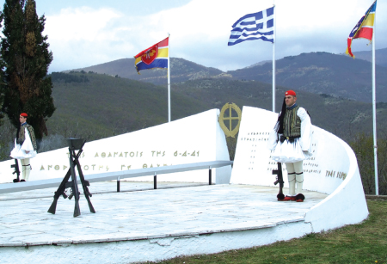
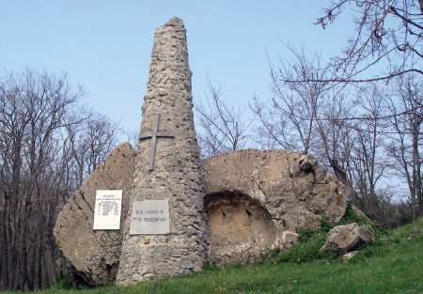
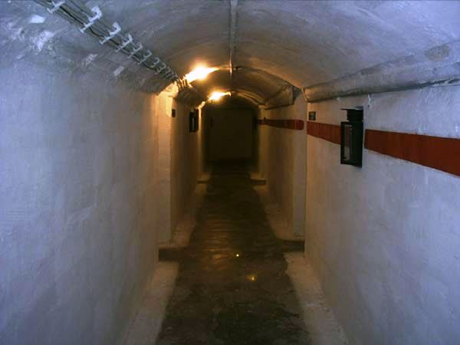
“Nymphea” Fortifications
Builded in 1936-40
Part of Metaxa’s Defensive Line (21 forts)

Slide 12
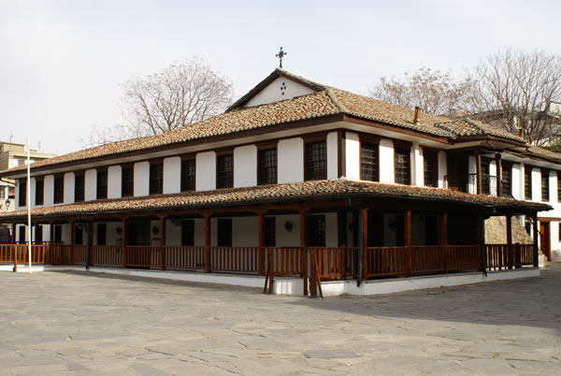
Church of Panagia
Builded during the time of Ottoman Occupation at about 1800 on the ruins of an older byzantine churche.

Slide 13
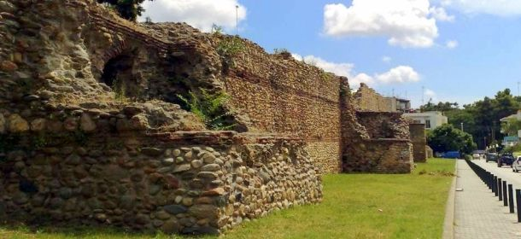
Walls of Komotini
Byzantine Walls. Theodosios A’ could be the founder of the walls (4th AC).
9.6m height, 16 towers. Most towers destroyed - damaged during Bulgarian occupation as stones from it was used as building material.

Slide 14
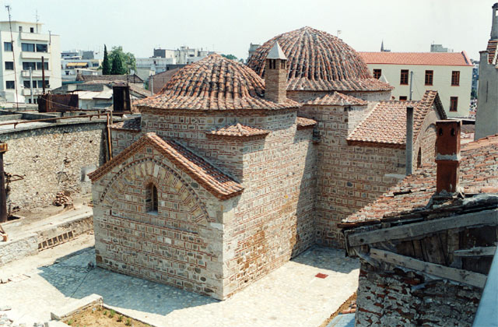
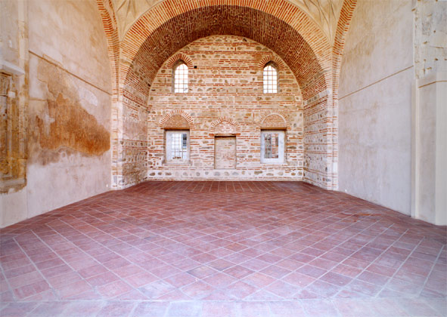
IMARET (POOR HOUSE)
In our days host the Eclesiastical Museum. It was built during the long period of the Ottoman sovereignty.
It was founded (1360-1380) by the conqueror of the town General Gazi Evrenos Bay (Christian in his early years, but then islamized).

Slide 15
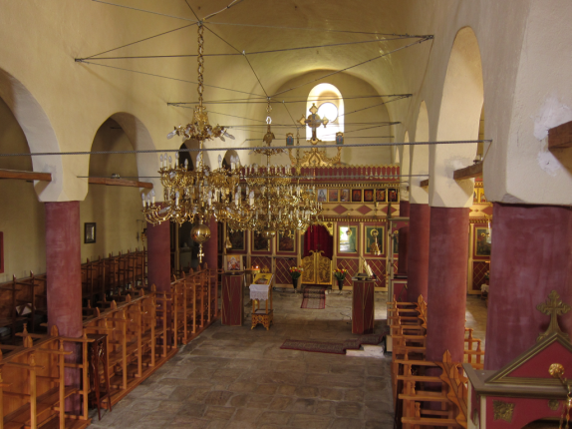
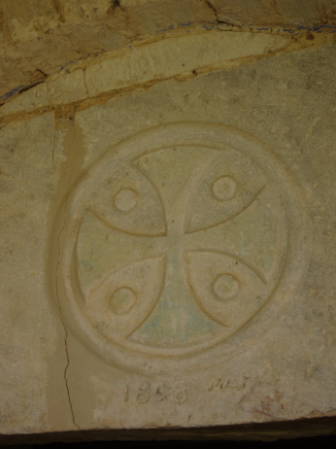
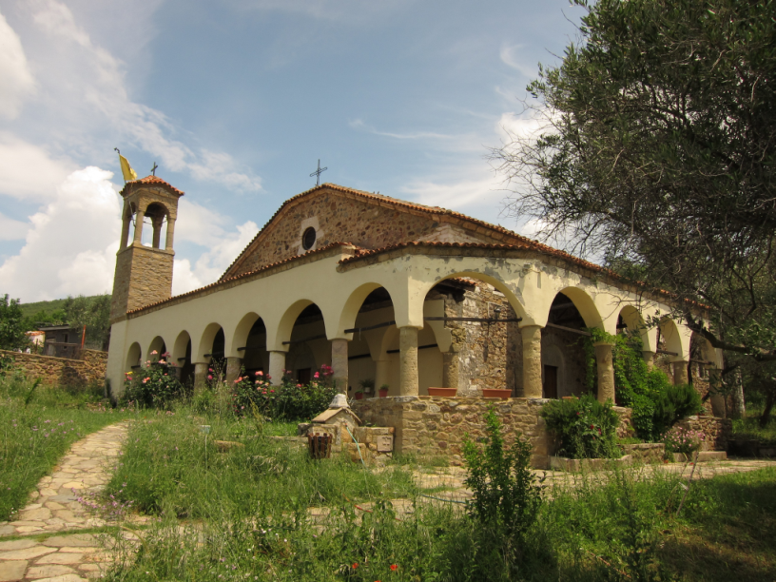
CHURCH OF SAINT DIMITRIOS KASITERA
A women monastery build by Bulgarians in 1858.
In 1924 Pontioi Refuges settle the place.

Slide 16
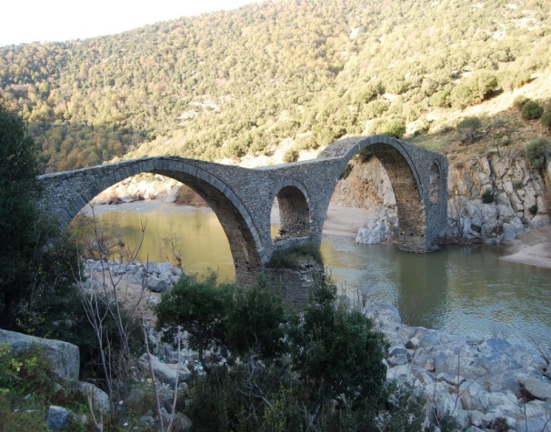
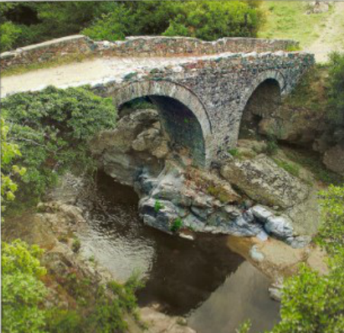
Bridges
Kompsatou Byzantine bridge of 11th century
Paterma Byzantine 11th century bridge.

