Slide 1
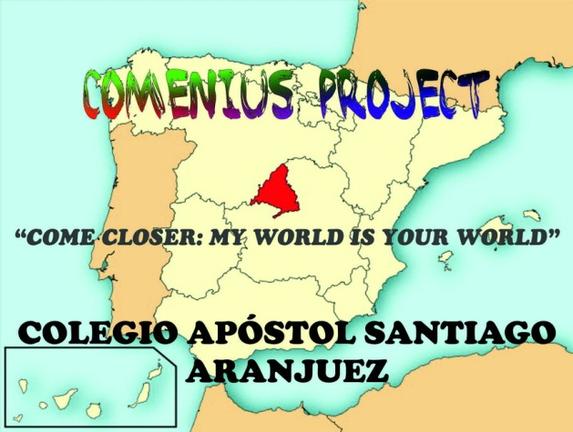

Slide 2
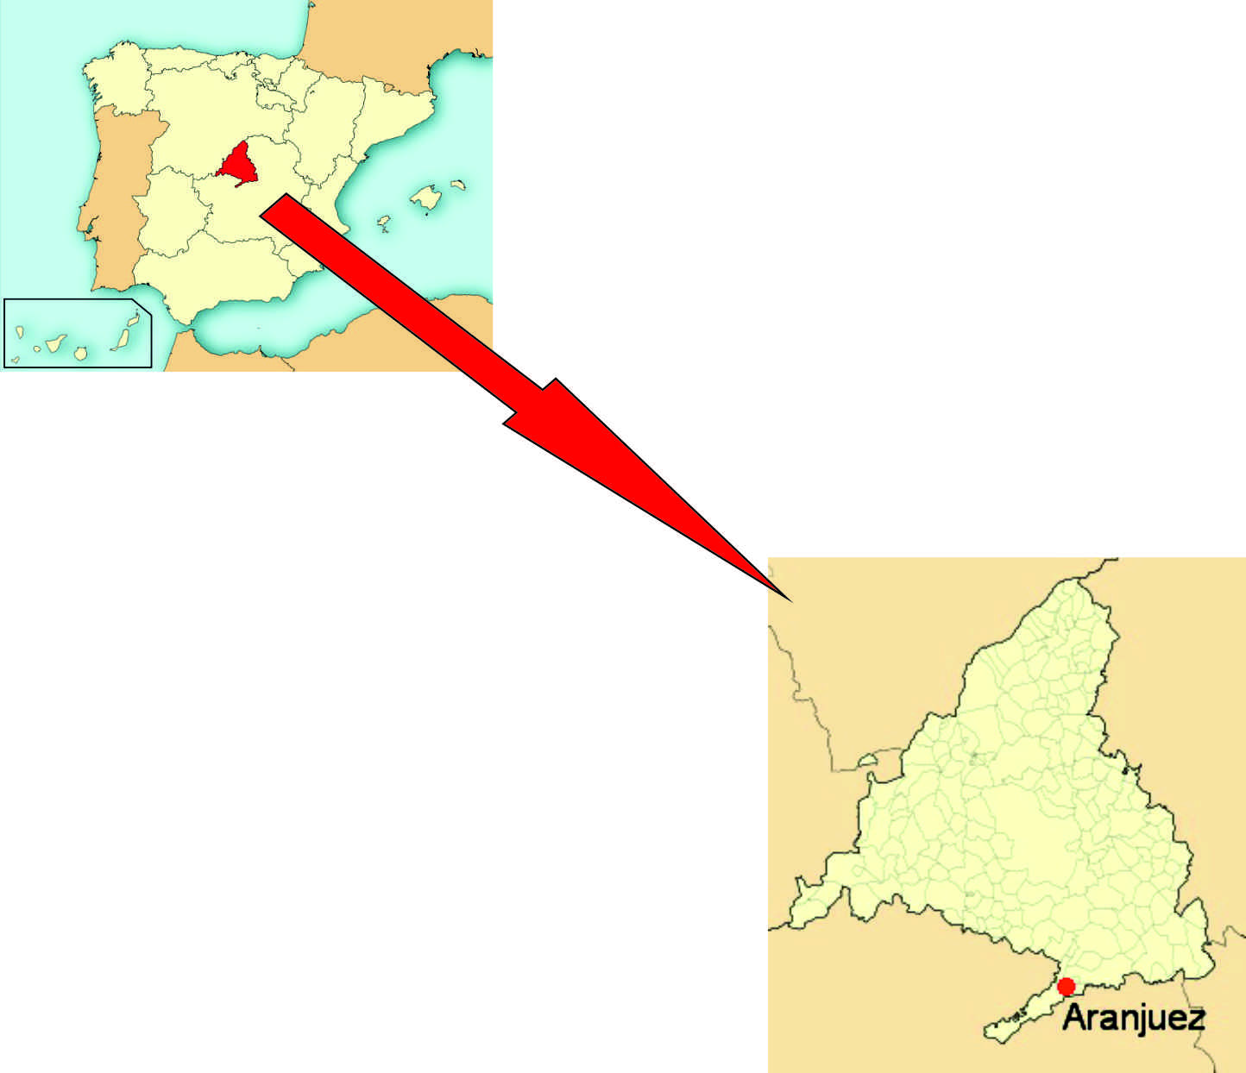
Aranjuez is lying 48 km in the south of Madrid, and at the same distance from Toledo . Because of this it has a privileged situation . Aranjuez has got 55.000 inhabitants.
The main activities for the local economy are hotels , tourism and agriculture. On 14th December 2001 , Aranjuez was designated as a World Heritage Cultural landscape by UNESCO due to its Royal Palace, gardens and beautiful landscapes. From that point on, tourism has kept on increasing in Aranjuez.

Slide 3
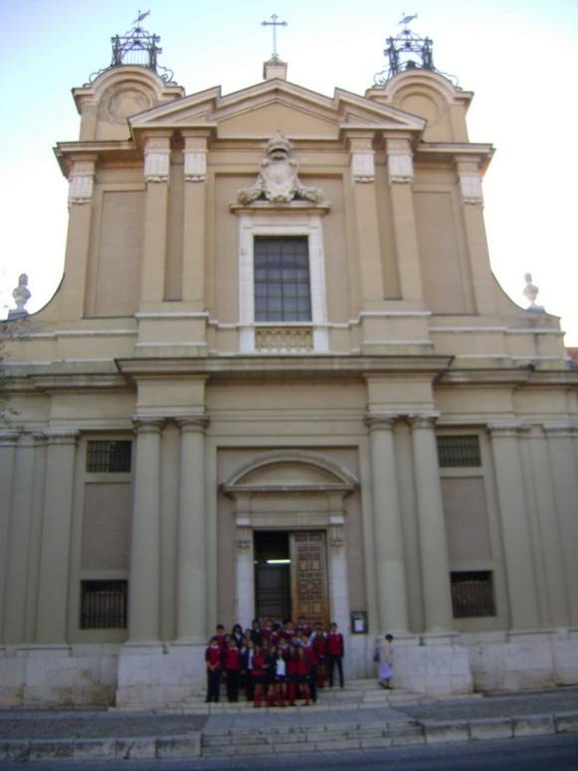
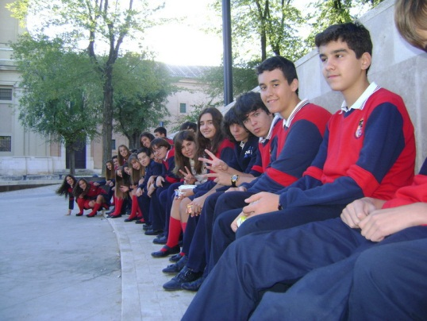
It was built between 1765 and 1770 by order of the King Carlos III. It is National Heritage with a lot of chapels and some famous paintings, in front of the deserted hospital of San Carlos. San Pascual, the church, was a Franciscan monastery. Sometimes we hang out with some friends there.
Aranjuez is a beautiful place with a lot of vegetation and enough emblematic buildings such as the bullring, the Royal Palace and the churches of San Pascual and Alpajés.

Slide 4
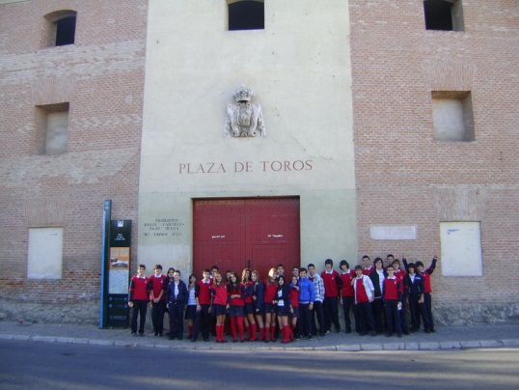
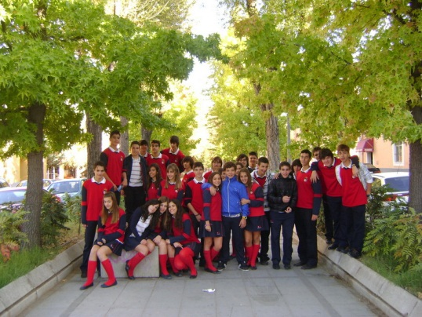
This is the bullring of Aranjuez and it is big and round. It is more than two hundred years. It was founded on 14th of May, 1797.
Here, we are at Capitán Street, a very important street in the middle of the town because there is a lot of vegetation and trees and has a lot of splendour in the different seasons. Now, the trees are yellow, green and red.

Slide 5
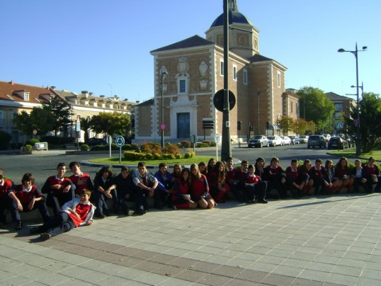
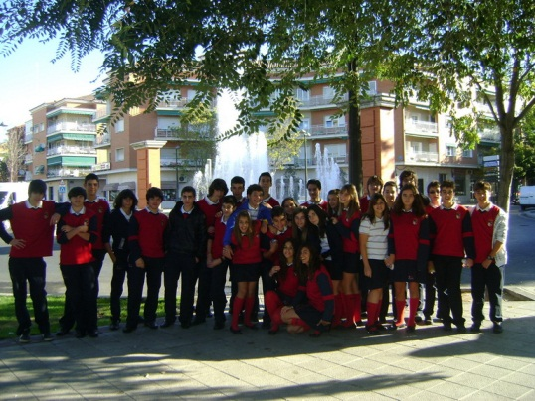
This is the church of Alpajés, where we can celebrate weddings, and more religious events. It was created in 8th June 1669. It is very beautiful because it has got a wonderful structure.
This is one of the numerous fountains that there are in Aranjuez. It is called “Fuente de las Angustias”. It is situated next to “Alpajes Church”.

Slide 6
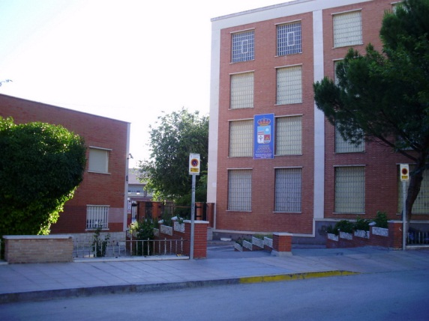
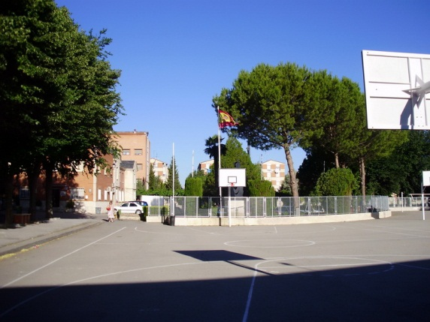
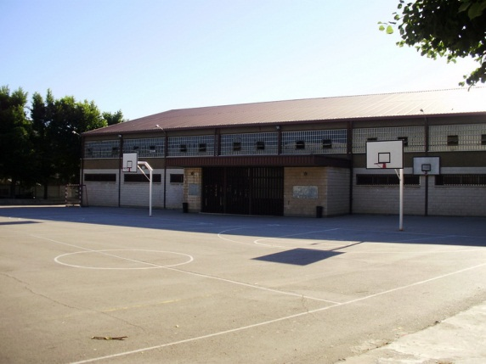
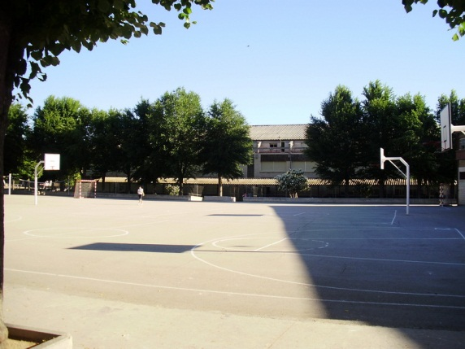
There are four buildings for students: one for the youngest (3 to 6 years old), the primary education building and the secondary one. There is a sports center as well.
This is our school. Some of us have been studying here since we were three years old.
At the entrance we can find the secretary´s office building.
In the playground we can practice basketball, handball and volley ball . There are two football pitches.

Slide 7
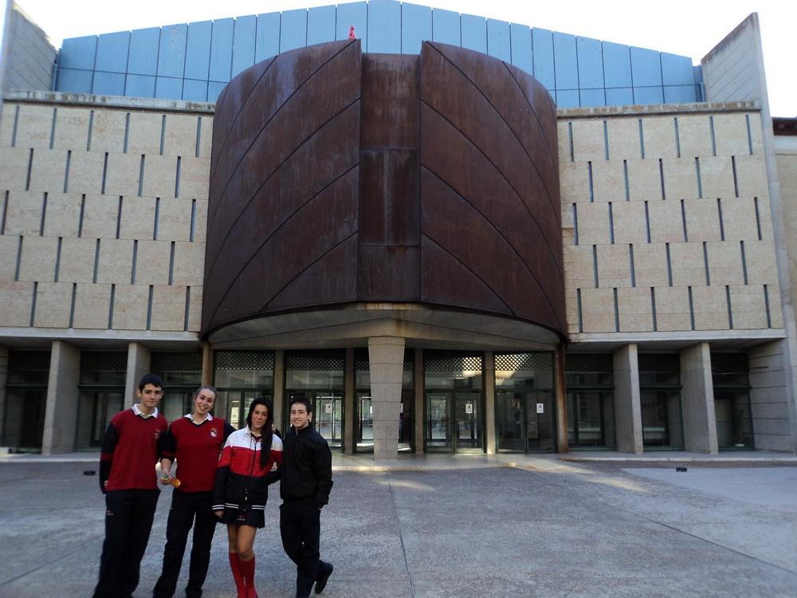
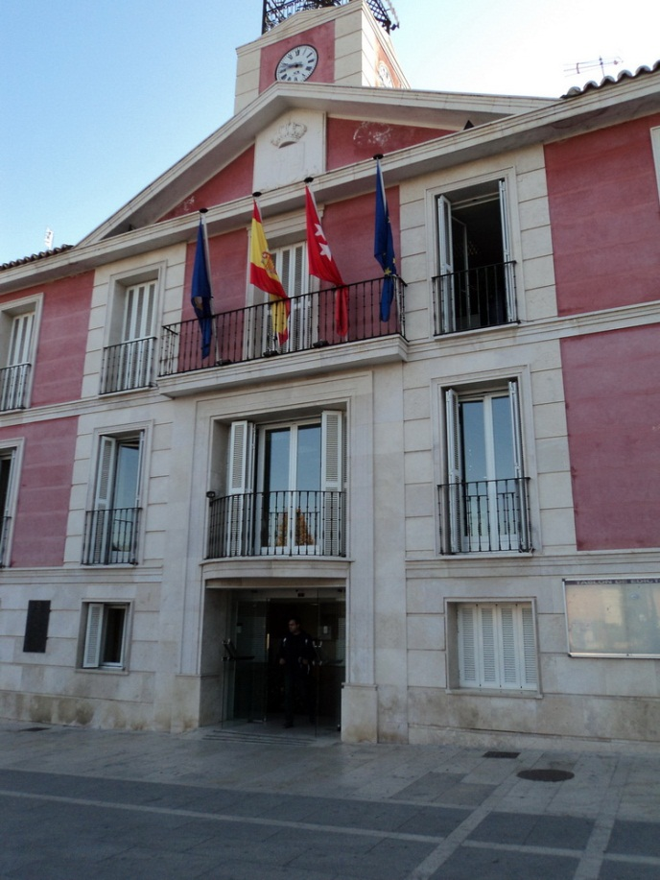
The town-Hall. This building was built in the XVIII by the King Fernando VI. It is situated in the middle of the village. There are many people working there. In front of the city-council there is a nice square with trees and benches.
This is a cultural center. Many young and adult people go there to do different things. They go to study music, performing plays of theatre; you also can go there to revise your exam, because there are a library and a reading-room.
This building used to be the stable and coach horse of the Queen.

Slide 8
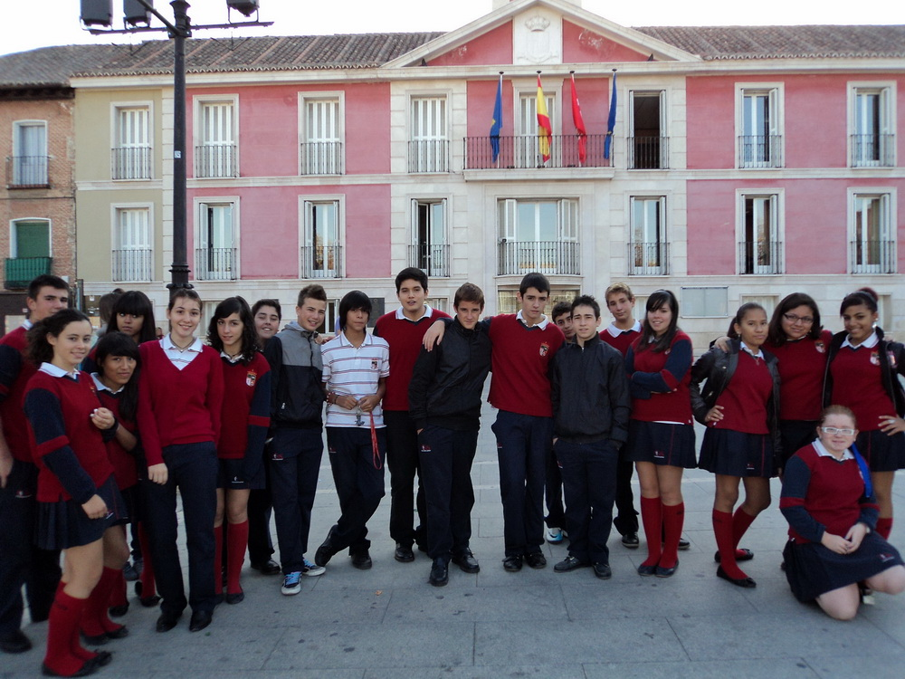
The town-hall square. The town-hall square is just in front of the city-council and opposite the big-market.
This place is the meeting –point for many people. Elderly people go there to sit down and talk to their friends.

Slide 9
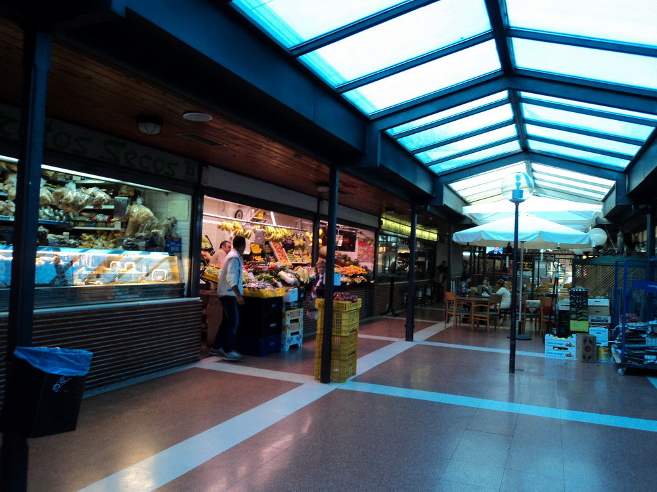
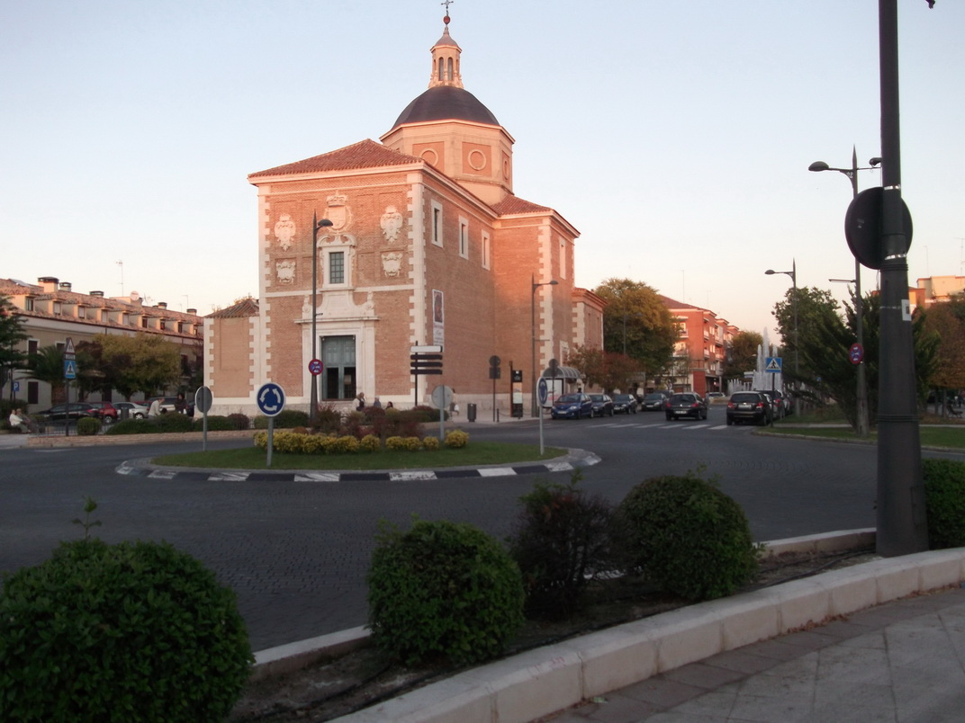
The market. This building was built in the XIX century; it is made of brick, stone and iron. Inside it there are many different food-stalls. People especially adult women go there to buy any kind of quality foodstuff.
This is Alpajés church. It was built in the seventeenth century. This church is close to our school. It is next to the police station as well. We are 3rd ESO students from Colegio Apóstol Santiago. This is the uniform we usually wear. When we have Physical Education lessons we wear blue sports clothes.

Slide 10
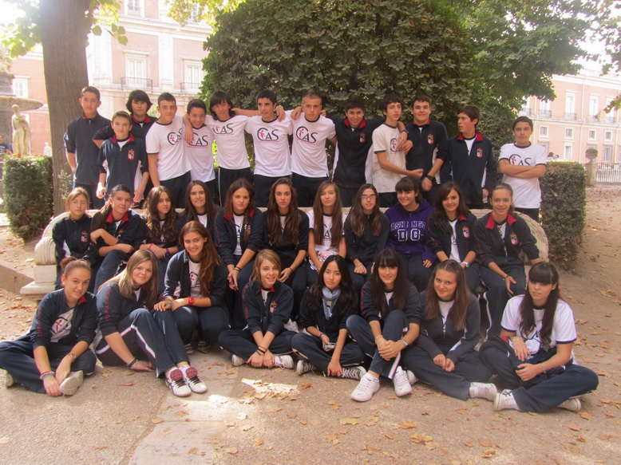
The 3º A class.

Slide 11
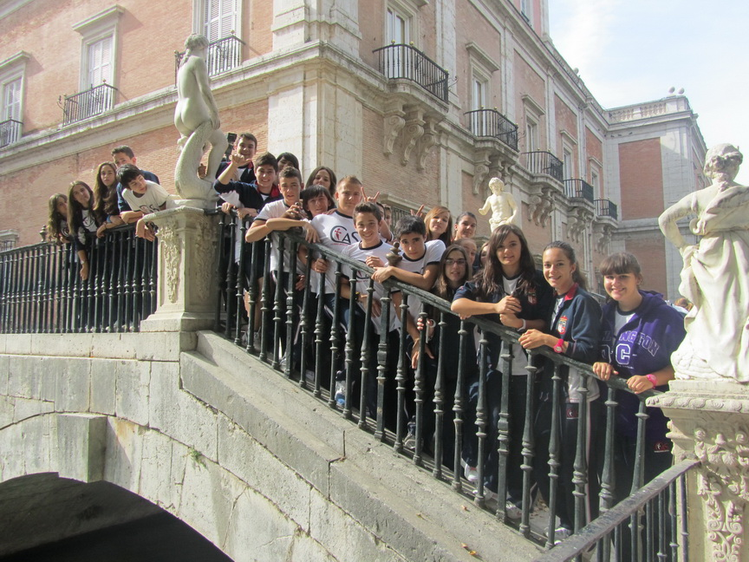
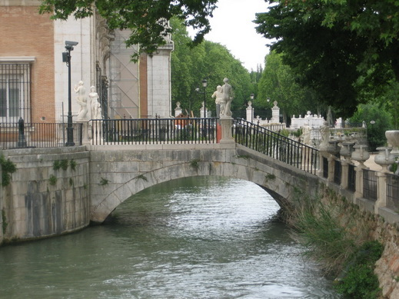
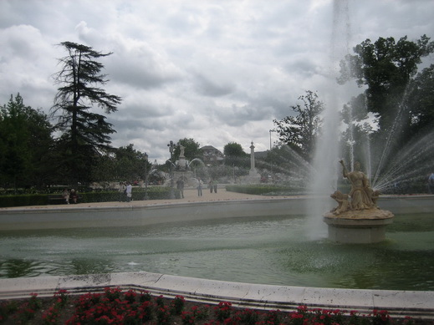
In this picture we are all the 3º A class, at the “Puente de las Estatuas”, which communicates the “Jardín de la Isla” with the “Parterre”, and it crosses the “río Tajo”.
Next to this bridge there are some small artificial waterfalls which were ordered by a Spanish King as a present for his Portuguese wife, because she missed the sound of the sea.
The island garden and the parterre garden are the nearest to the palace. The Royal family used it as a spare time area. And now it is a place for walking . The Island garden is the oldest one and it´s completely surrounded by the Tajo River. The most modern one is called the Parterre garden, whose plants are organized with a rational shape , according to the French flavor.

Slide 12
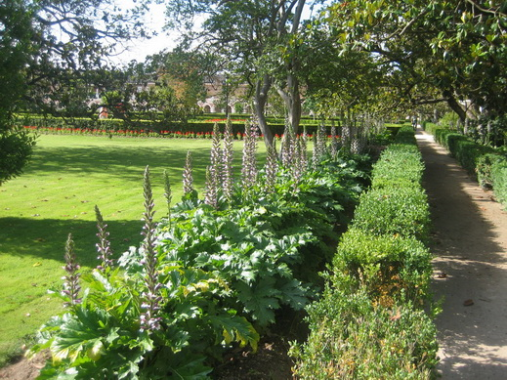
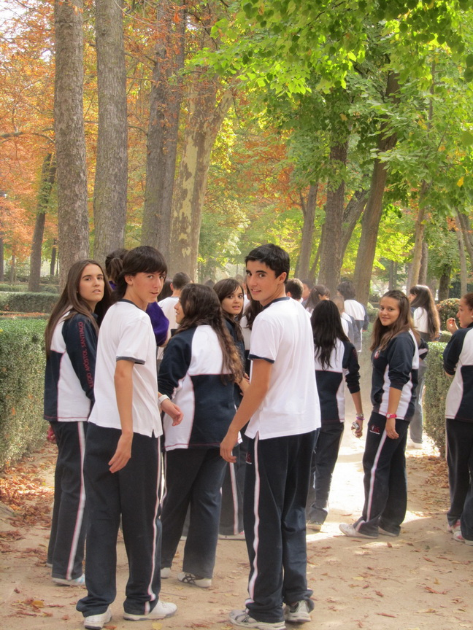
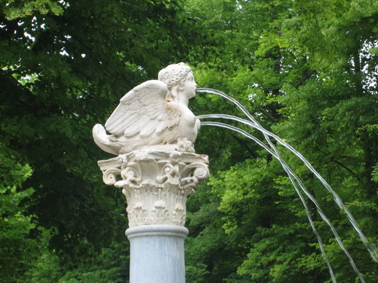
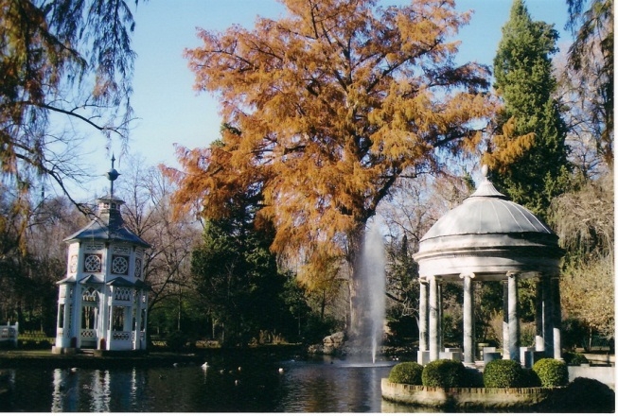
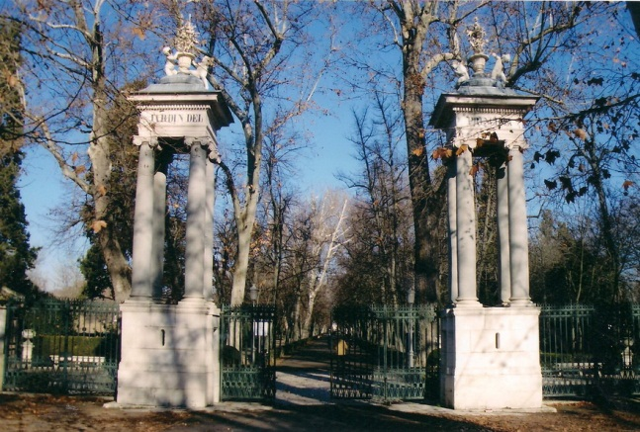
The gardens of Aranjuez have a lot of paths where you can walk for hours and hours. Aranjuez has got some groves around the town. In the gardens you can smell a fresh fragrance. Aranjuez gardens are wonderful.
Another garden: The Prince´s Garden. This garden is the most extensive, the garden distribution is more rugged than other ones, more romantic. Here you can see Faluas pier and Labrador´s house. It was a place for hunting and meeting .

Slide 13
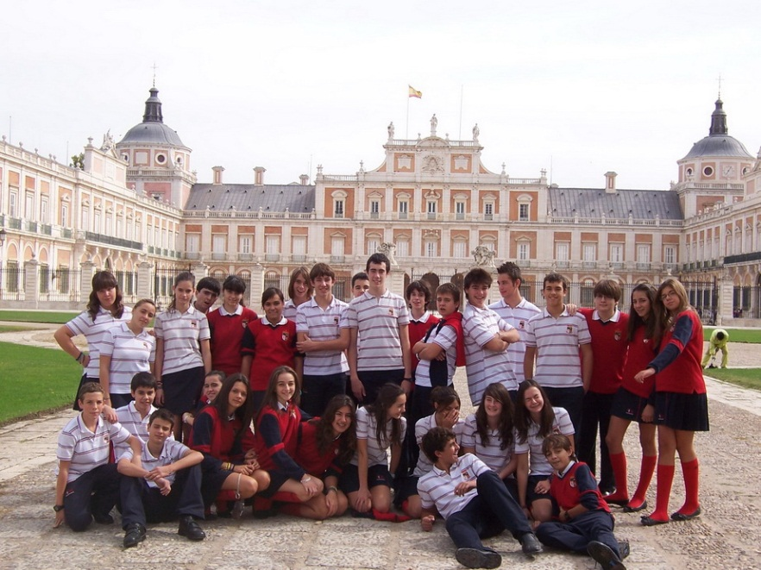
Our class is 3rd B. We’re a nice class, and all of us are fantastic people.
Before the walk, we went to Saint Anthony church, where we were photographed by our teachers.
After that, we visited the Royal Palace of Aranjuez. This place was ordered to build by the Spanish king Phillip the Second, but he didn’t see it finished. Some centuries later, another king, Phillip the Sixth, continued the building work, and in times of Charles the Third the palace was finished.
After this wonderful place we went to Mariblancas’s Square where there is a famous statue.

Slide 14
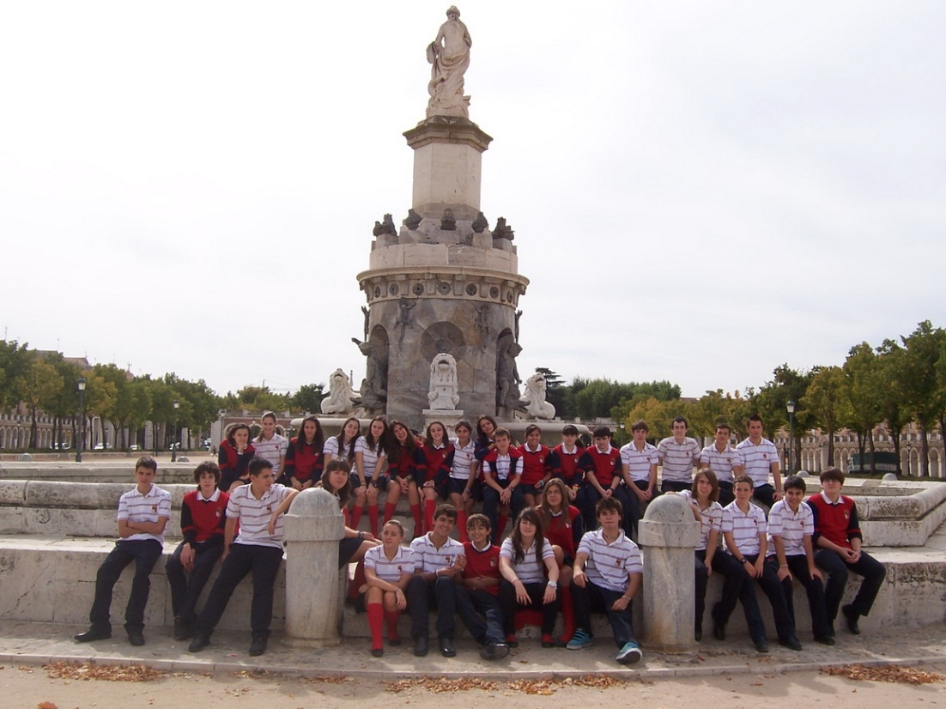
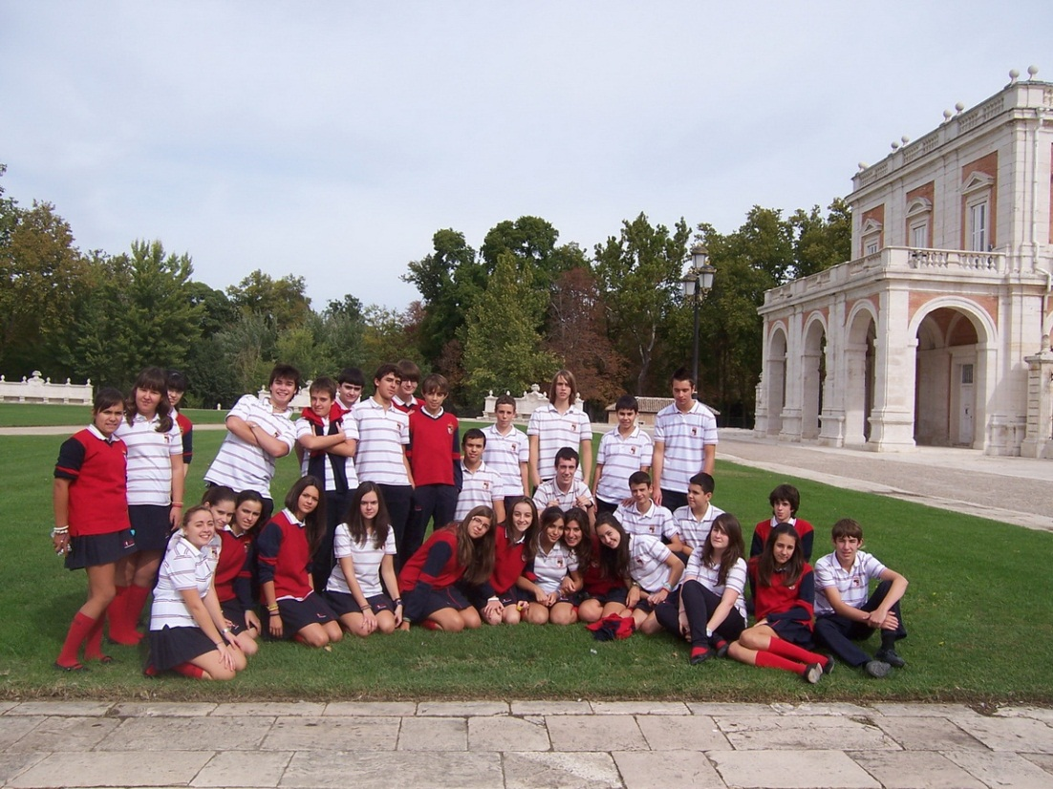
Among the most outstanding monuments of Aranjuez you must visit Mariblanca Square. At the entrance, you can distinguish San Antonio church and at the wings there are houses with many arches. From there, you can see Mariblanca´s fountain, which was built in 1776.
These are my classmates. We are behind the palace.
The palace is huge and beautiful. Inside it, there are many rooms with different decoration. The river Tajo is next to the palace, just behind us. The palace has got a big garden too where the nobility walked in the past. Here, the King and the Queen of Spain spent their time in summer. They could go hunting too. In the square where we are, they usually went for a walk and talked to the citizens sitting on the benches.

