Slide 1
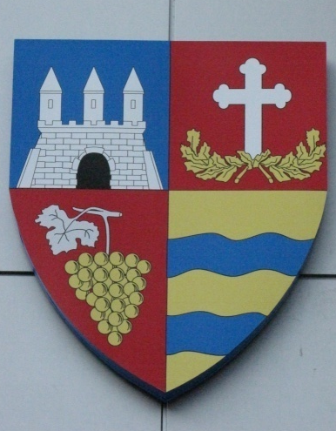
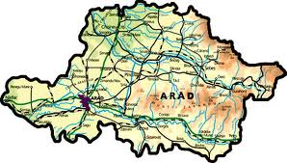
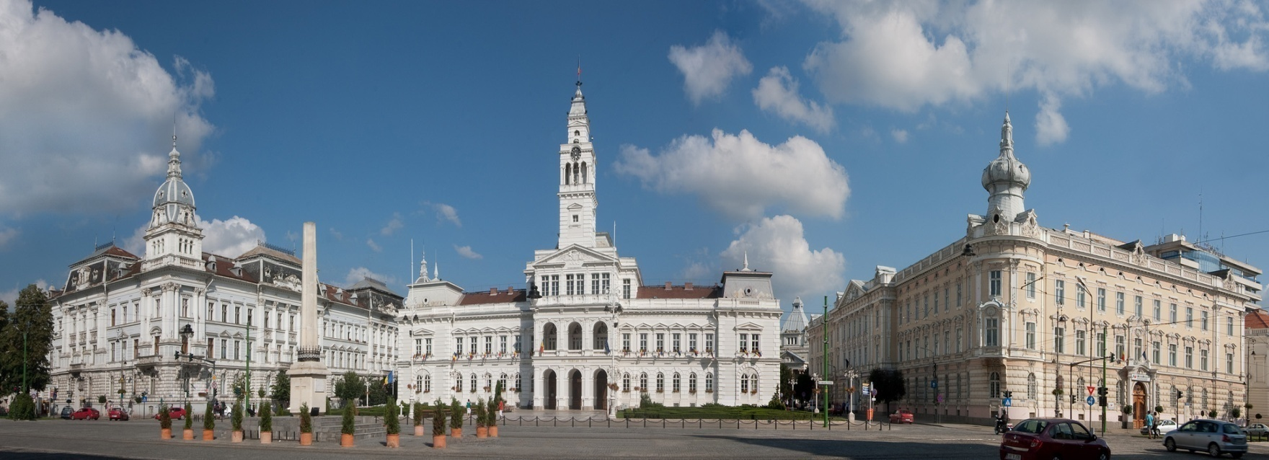
ARAD
“COME CLOSER,
MY WORLD IS YOUR WORLD”
COMENIUS PROJECT
2011-2013

Slide 2
The City of Arad is situated in the western part of Romania, on the banks of the river Mures.
It was first mentioned in documents in the 11th century and it was under the rule of the Kingdom of Hungary, Ottoman Empire and the Habsburg Empire.
In the 19th and 20th centuries Arad became an important economic and cultural centre.
In 1918 the city of Arad played an important part in the movement for the unification of Romania.
Now Arad is the capital city of Arad County, and the third largest city in the western part of Romania.

Slide 3
OUR SCHOOL
Școala Generală Nr.5 Arad
Our school is situated at no.22, Udrea Street, postal code 310171. The number of the pupils is almost 1000 and there are 56 teachers. The pupils are divided in 33 classes, namely 17 for the primary school and 16 for the middle school. One can find both 26 large and up-to-date classrooms for teaching process, and 4 laboratories (the Chemistry lab, the Physics lab and the IT lab). There are also 4 Art subjects departments for foreign languages (English, French, German), one for the Romanian lessons, one for the History subject and the last one for Religion studies. The School is also endowed with 2 sport grounds and 1 library containing 16400 books. Our students are taken care by the school doctor and nurses in a special small school clinic for human health and dental problems.There is a festival hall which has 250 seats.

Slide 4
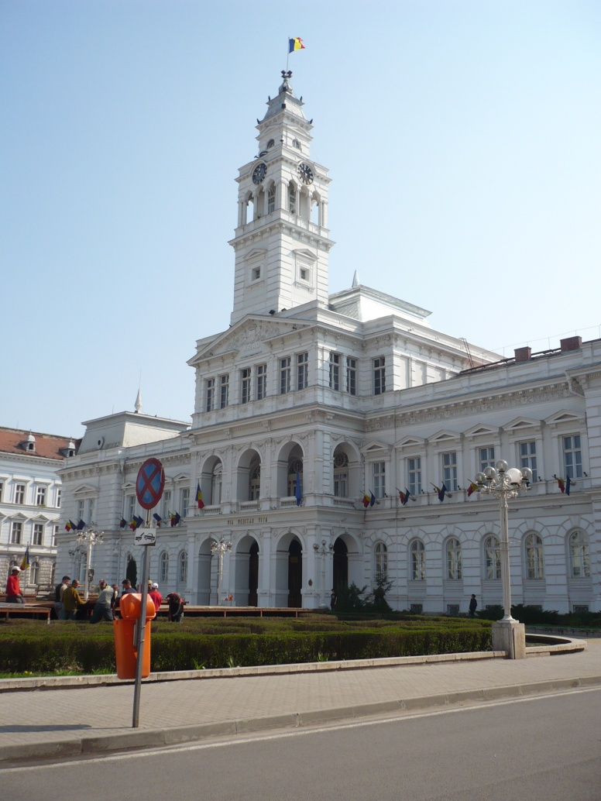
The Administrative Palace
This is the City Hall of Arad. It is U shaped and was built between 1872 and1874.

Slide 5
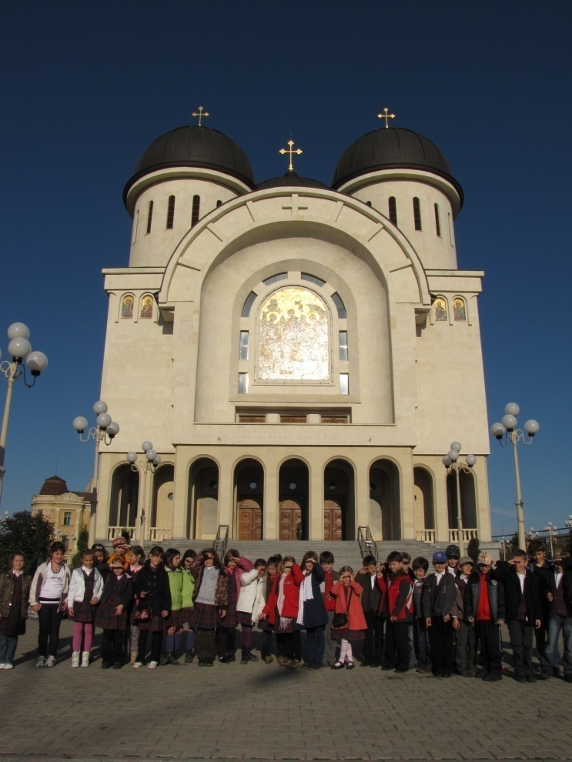
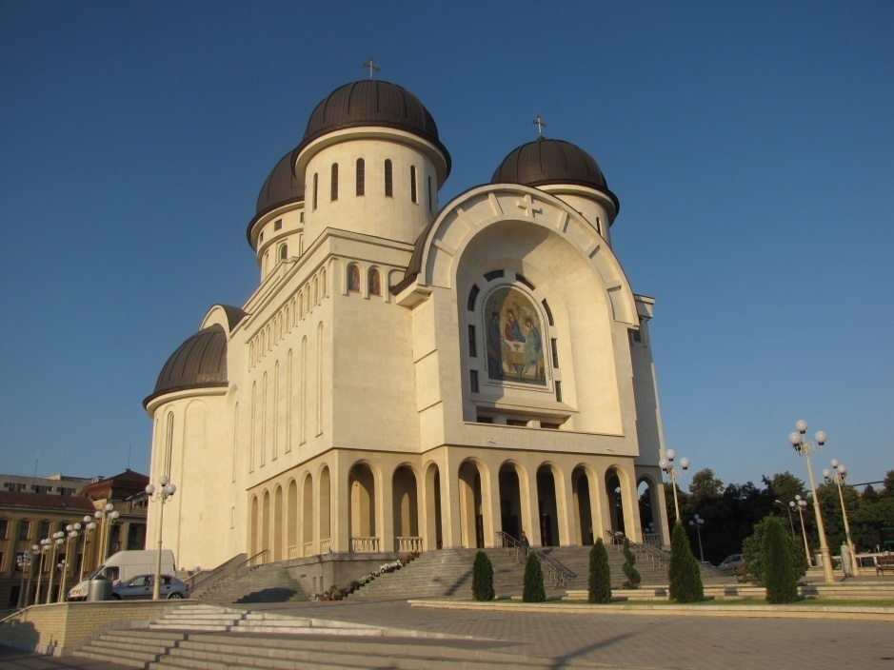
This is the New Orthodox Cathedral. Its interior has not been finished yet.

Slide 6
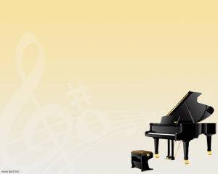
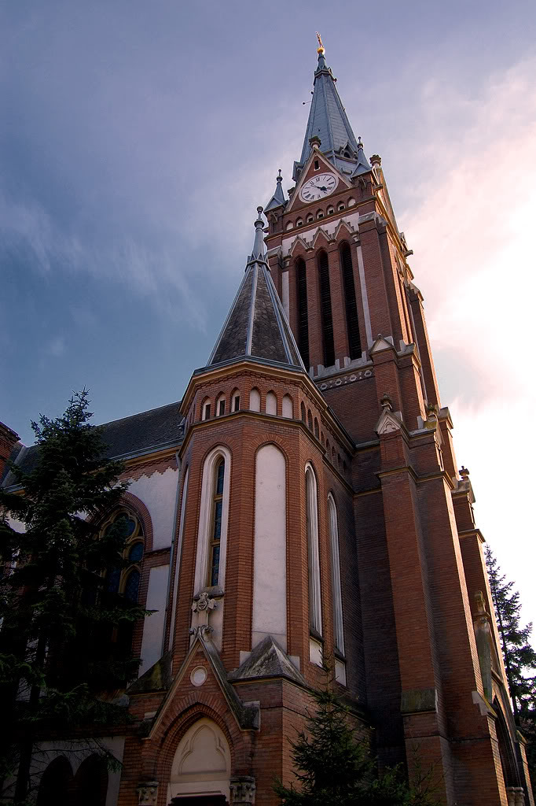
People call it “The Red Church”. It is an Evangelical Church built in 1909, in a Neo-Gothic style.
This is the Roman-Catholic Cathedral built in a monumental Renaissance style.

Slide 7
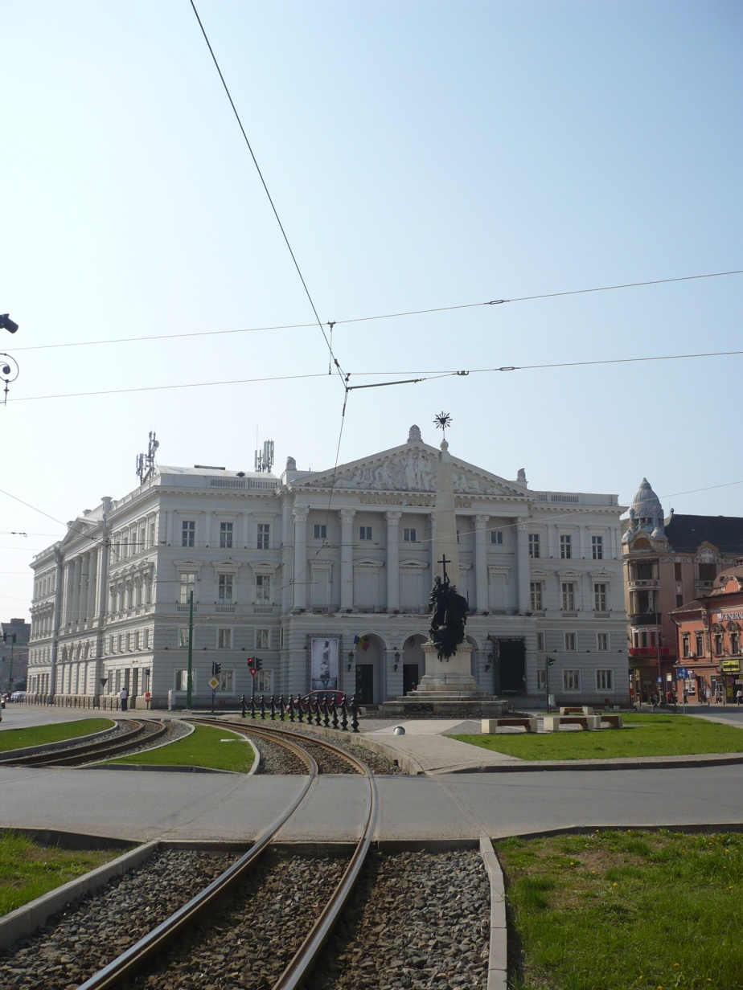
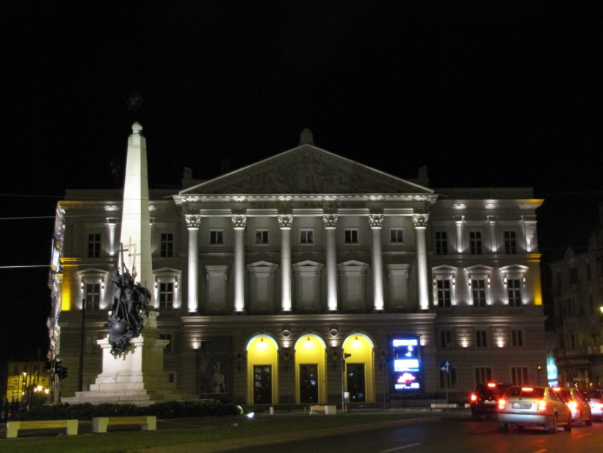
Ioan Slavici Classical Theatre
Here you can see on stage performances given by actors from Arad, other cities of Romania and abroad.

Slide 8
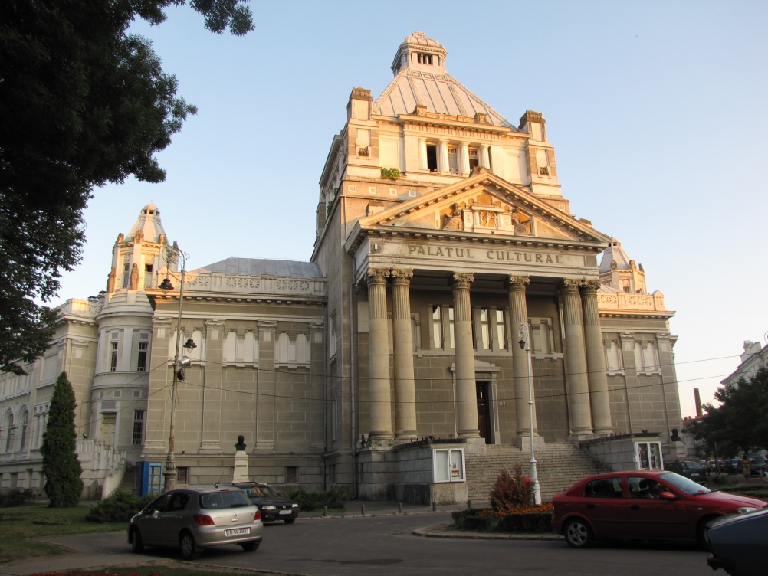
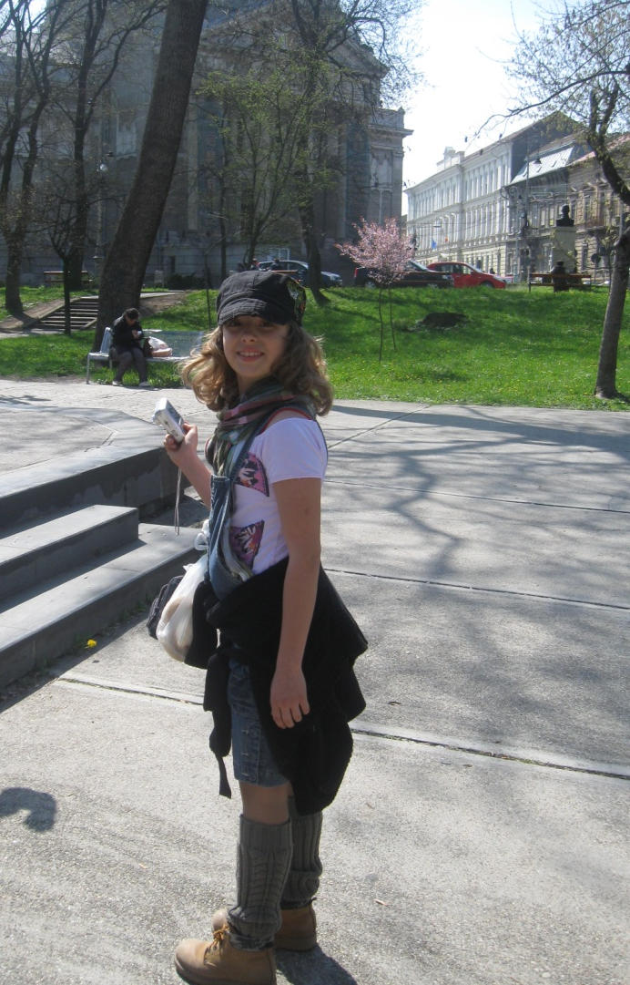
The Palace of Culture houses the County Museum and the State Philharmonic.

Slide 9
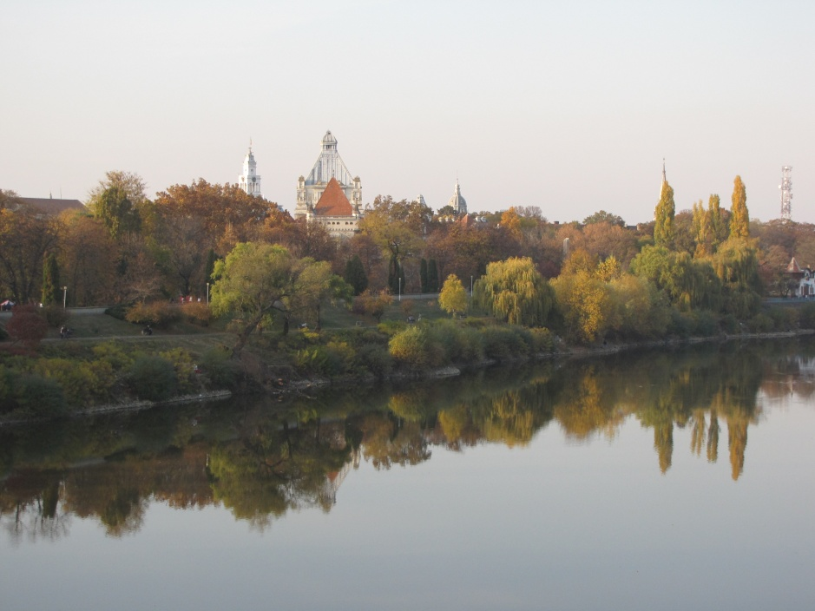
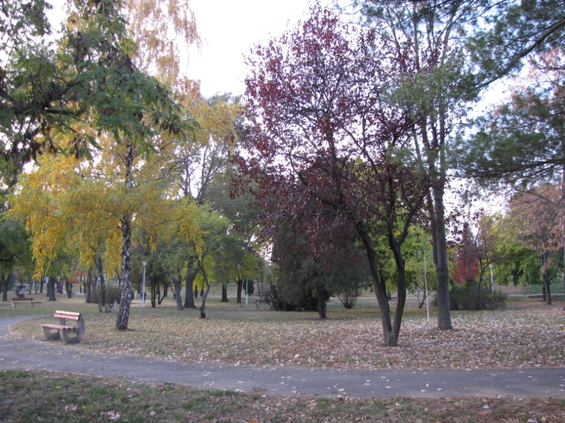
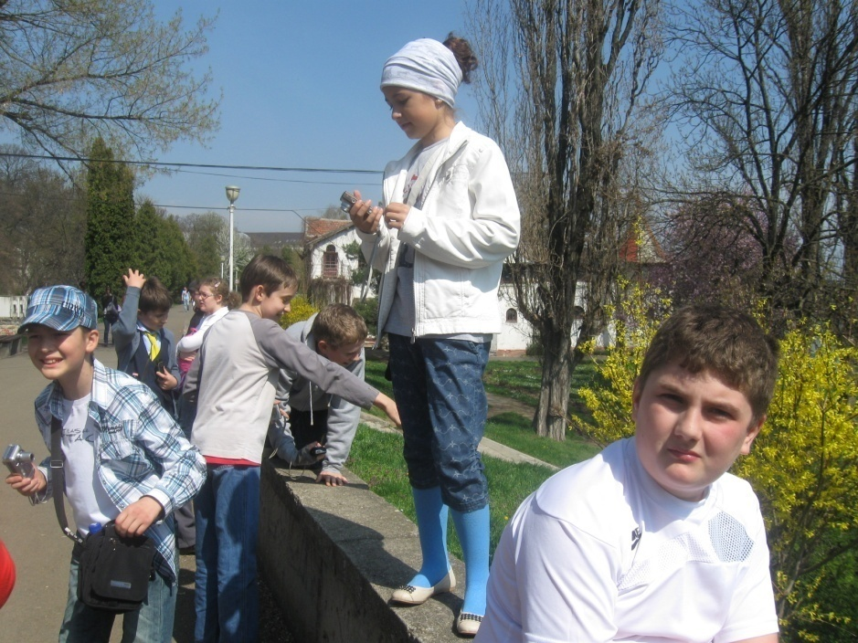
Join us for a walk on the banks of the river Mureș!

Slide 10
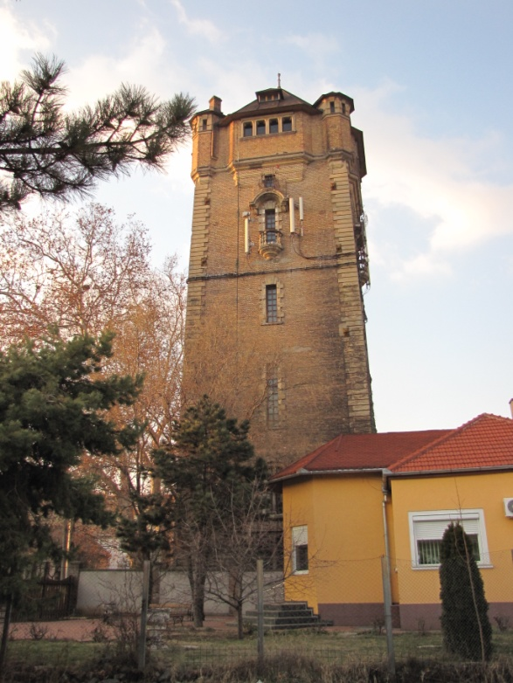
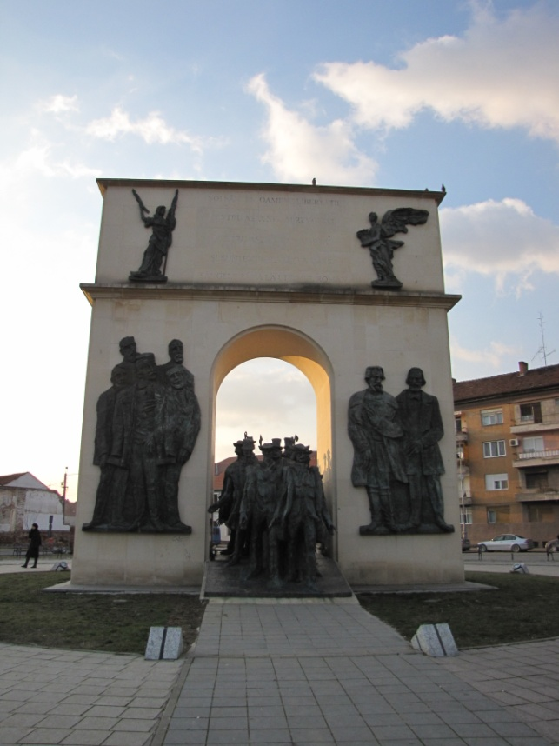
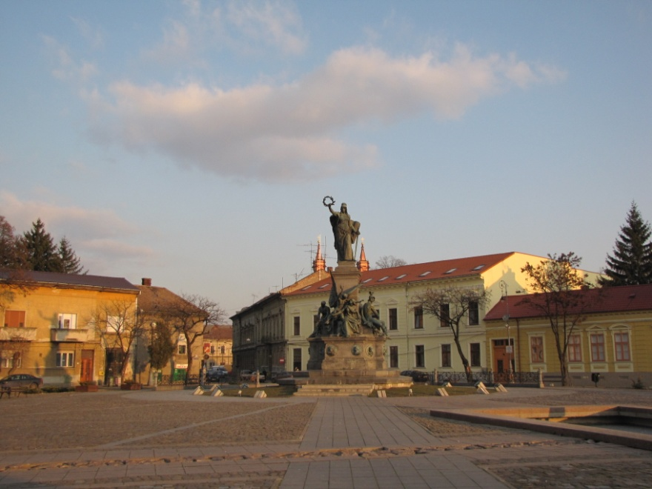
The Reconciliation Park
where you can see the
Statue of Liberty and
the Arch of Triumph are
a symbol of friendship
between the Romanian
and the Hungarian people.
The Water Tower
The Arch of Triumph
The Statue of Liberty

Slide 11
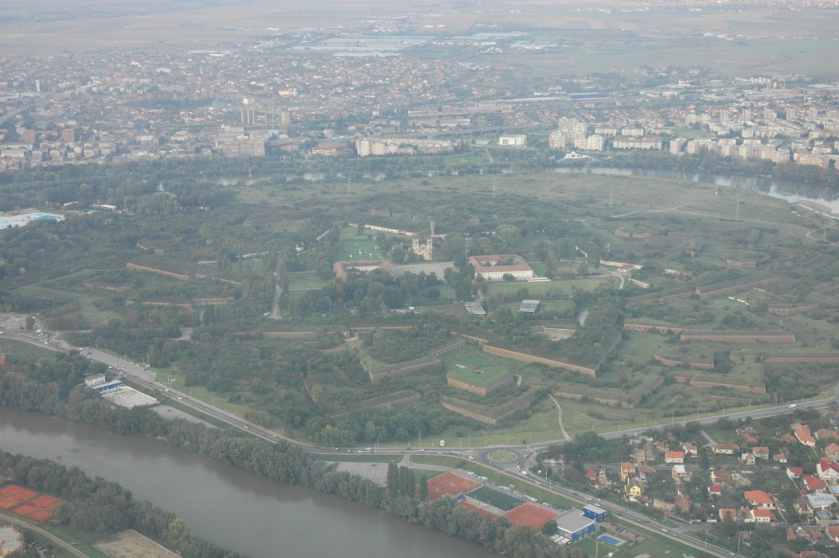
The Fortified Town of Arad is one of the most important historical monuments in the West Side of the country. Built in the second half of the 17th century, the fortification was considered to be a very important military building. It has the shape of a star.

Slide 12
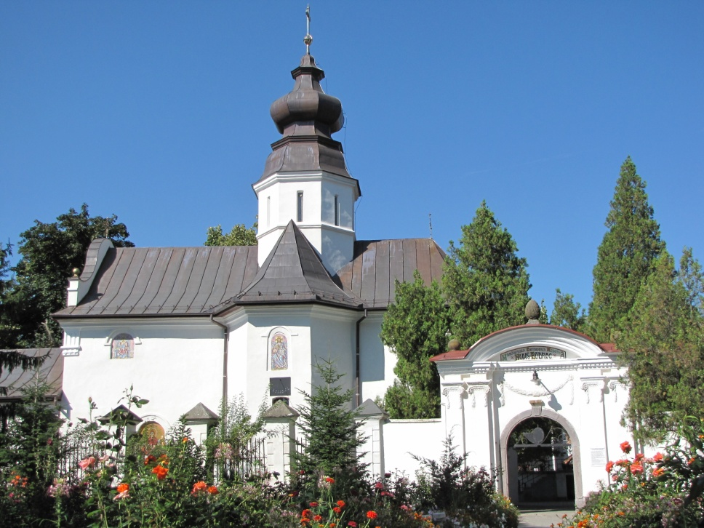
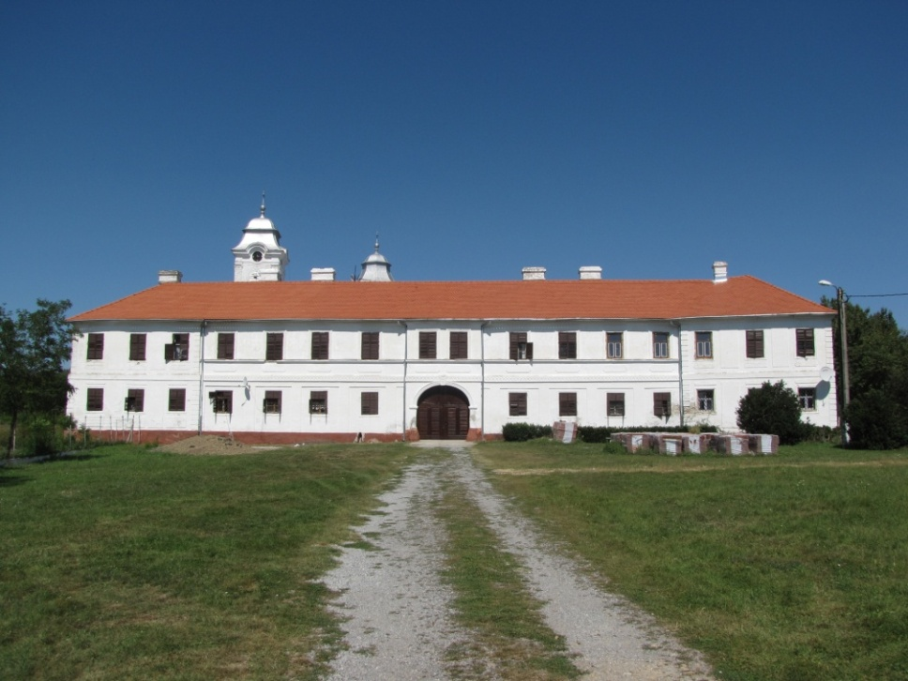
Situated at 36 km west of Arad, Bezdin is a Serbian monastery which dates back to 1539.
This is the Hodos-Bodrog orthodox monastery situated at a distance of 15 km from Arad city. It is one of the oldest monasteries in our country. (1177)

Slide 13
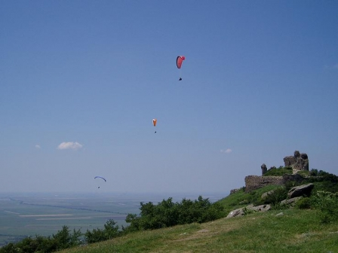
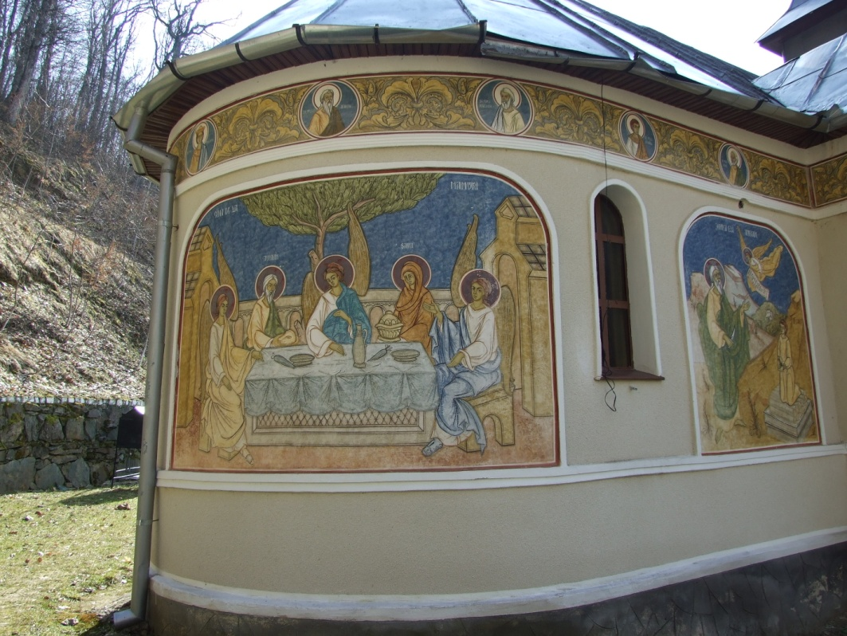
Siria fortress dates from the 13th century It was considered to be an important strategic and economic point of the region.
If you go to Siria you can go paragliding, if you are into extreme sports or visit the Feredeu Monastery in the neighbourhood.

Slide 14
LIPOVA
The Soimos Fortress, situated in the village of Şoimoş, now part of the town of Lipova, was built at the end of the 13th century.
The Turkish Bazaar is a symbol of the Ottoman rule in the 17th century.

Slide 15
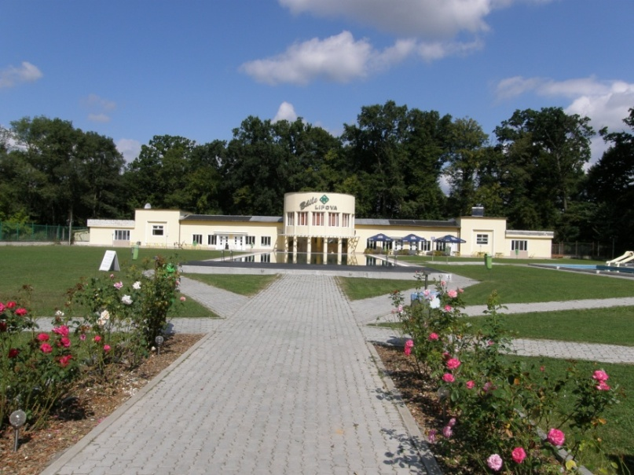
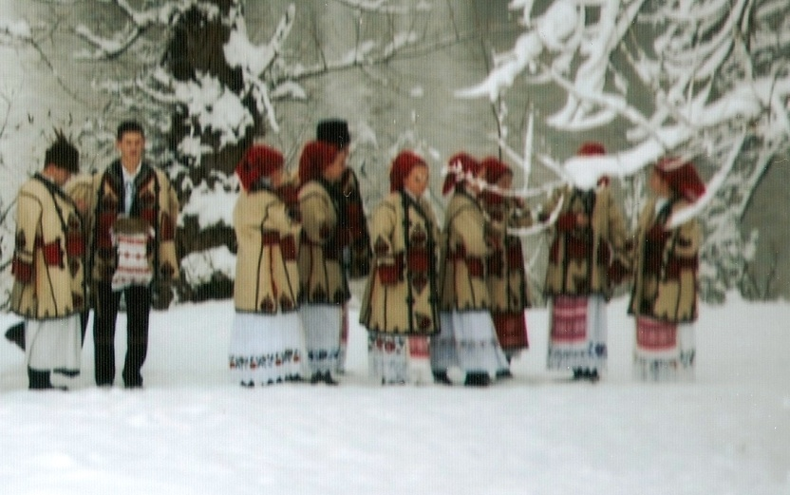
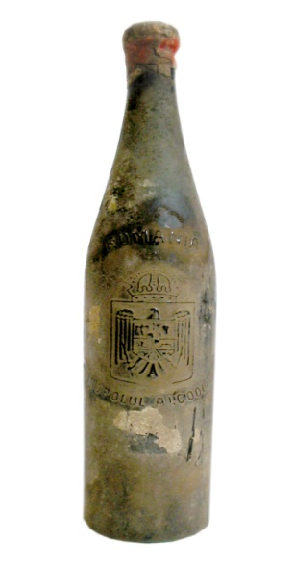
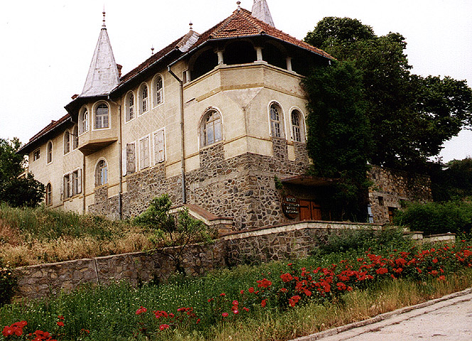
1
2
Lipova – the Spa with mineral water
Folk costume
The Wine museum in Ghioroc
3
1926

Slide 16
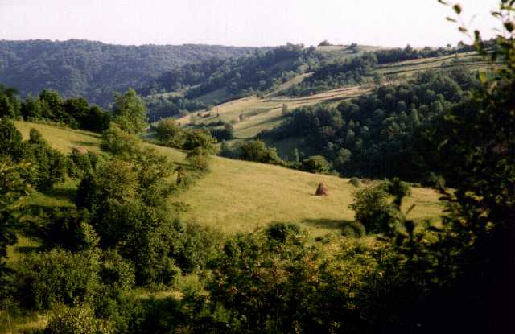
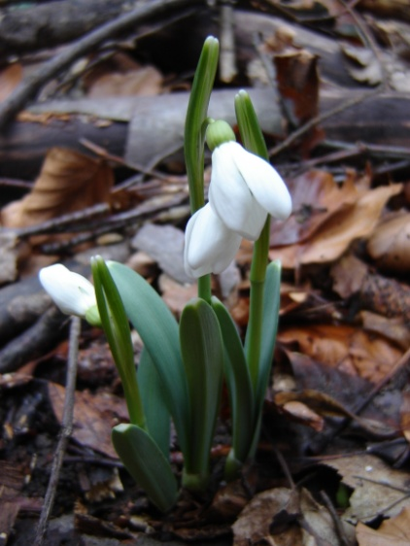
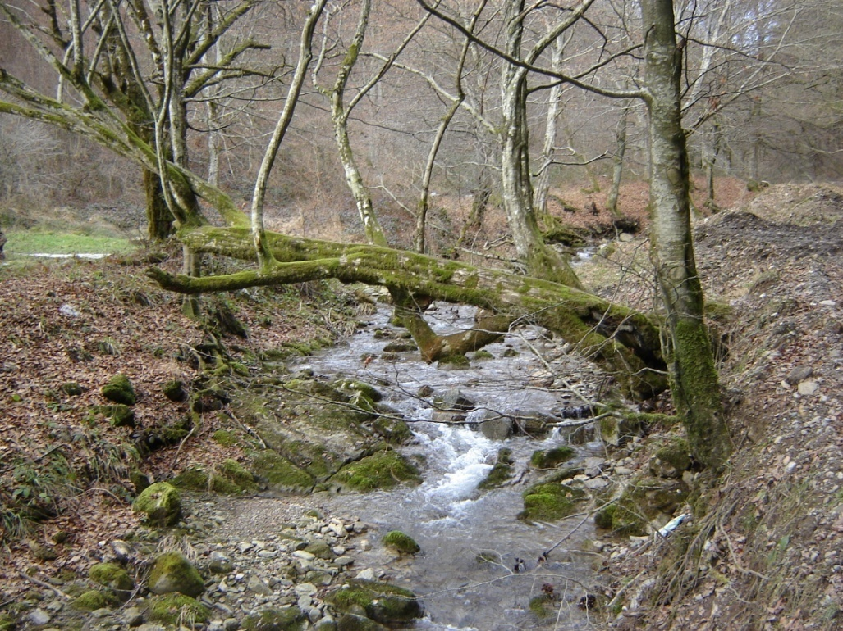
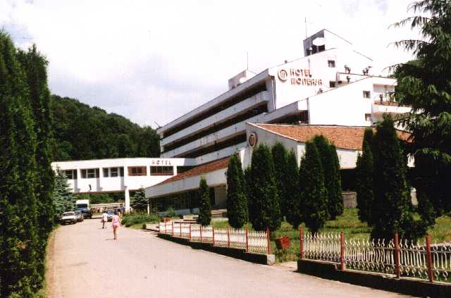
Moneasa - a resort in the Codru Moma Mountains.

Slide 17
We hope you have enjoyed the trip through Arad!

