Slide 1
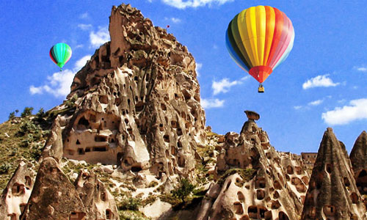
Rich in history going back to Hittite times (+4000 years) and once a province of the , Roman Emprie Cappadocia is now the sprawling area of central Turkey which lies between Aksaray in the west.

Slide 2
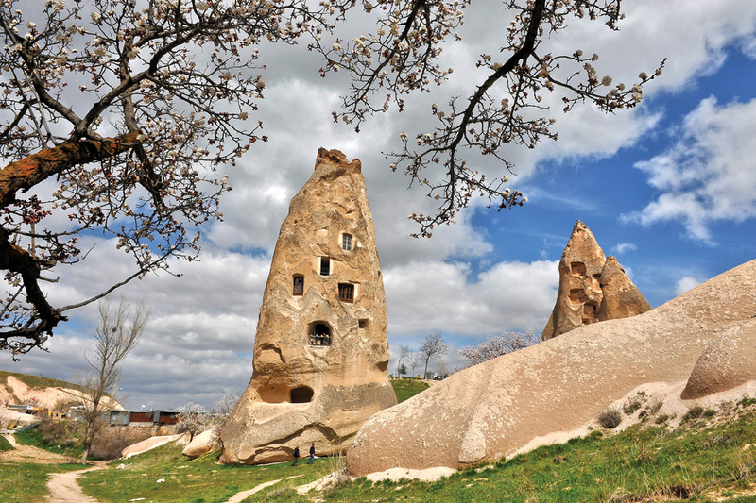
Kayseri in the east and Niğde in the south. Modern Cappadocia is an incredible place, criss-crossed with valleys and dotted with dramatic rock formations.

Slide 3
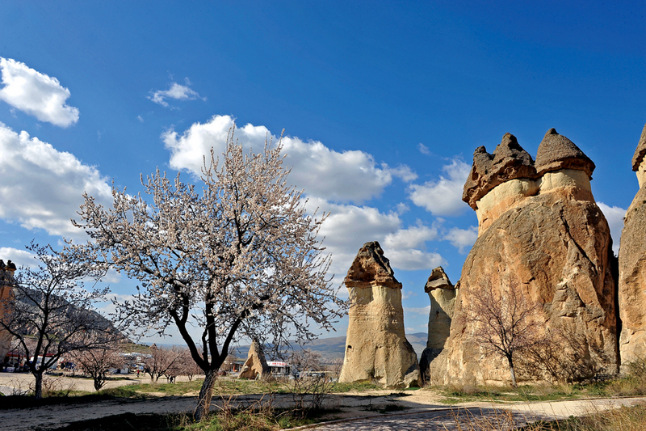
Whatever your expectations or travel style, it's impossible to go home disappointed.

Slide 4
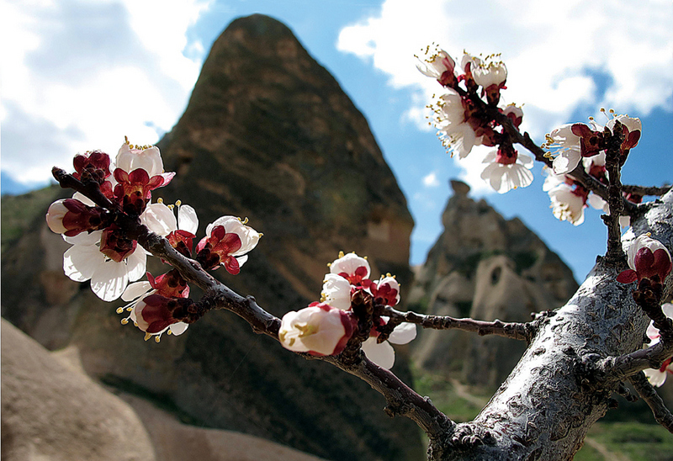
There are so many fascinating things to see in Cappadocia that you could spend a lifetime here and still discover new places.

Slide 5
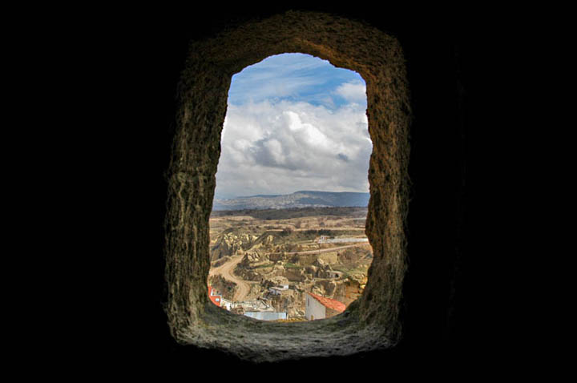
Cappadocia is a wonderland of visual delights for travelers of all ages, interests and travel styles.

Slide 6
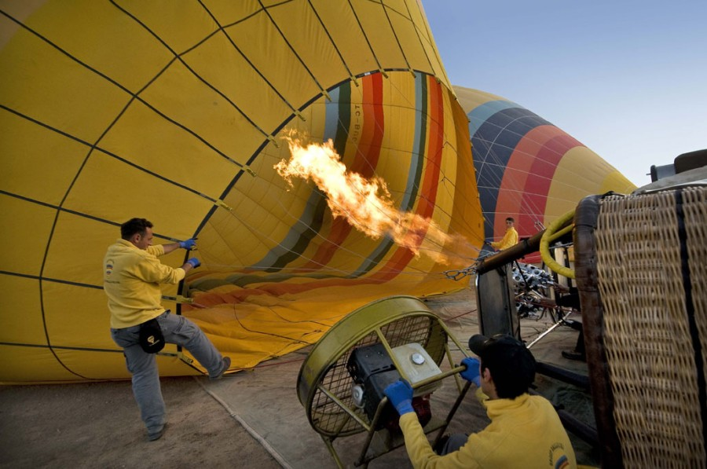
Cappadocia is known around the world as one of the best places to fly with hot air balloons.

Slide 7
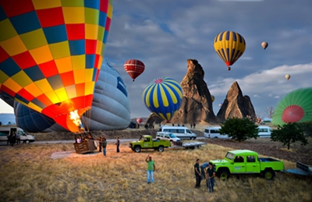
The spectacular surrealistic landscapes combined with excellent flying conditions allow the balloons to gently drift over and between fairy chimneys .

Slide 8
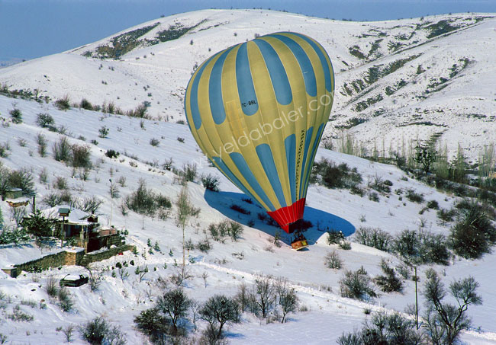
After the flight lands, there is a small celebration with champagne and you will receive your flight certificate …

Slide 9
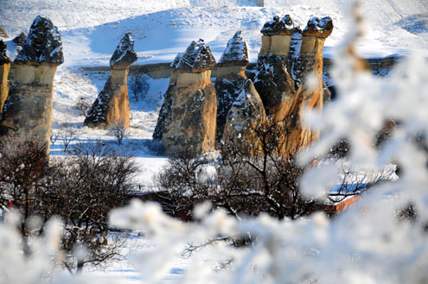
To this day many of the soaring pinnacles are still inhabited and many of the rock-cut storerooms are still stuffed with grapes, lemons, potatoes and flat bread waiting for the winter.

Slide 10
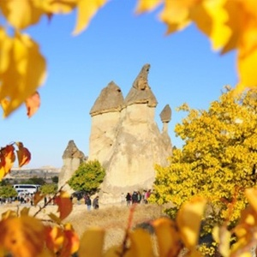
Eventually these caps fall off, whereupon the wind and rain start to whittle away the cone until eventually it, too, collapses.

Slide 11
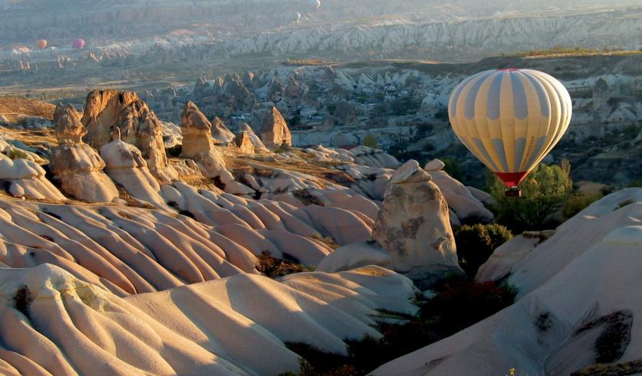
Once here you can easily comfortably explore all the highlights and the hidden gems that this area is known for .

Slide 12
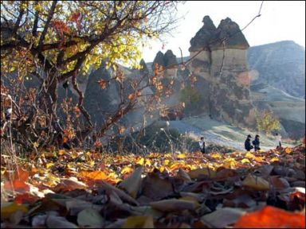
Cappadocia, known as the "Land of Beautiful Horses" is the ideal place to explore on horseback.

Slide 13
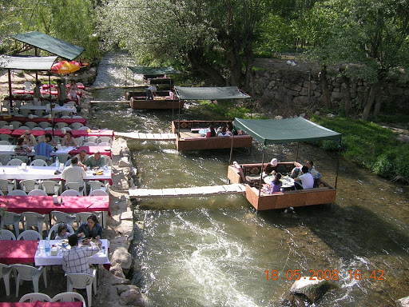
The stunning & lush Ihlara Valley boasts the deepest gorge in Asia Minor . The total length of the valley is 14 km, and there are three different walking tours available for Ihlara valley.

Slide 14
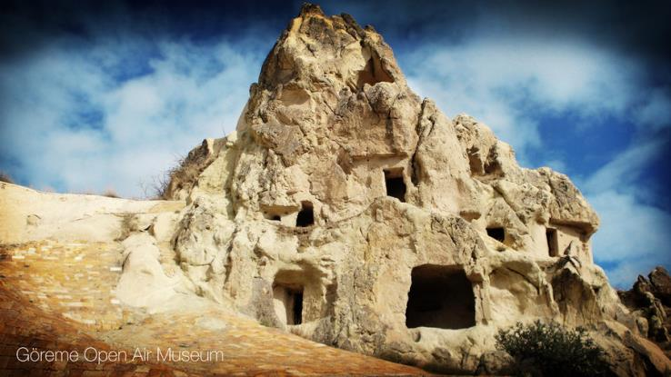
GÖREME OPEN AİR MUSEUM

Slide 15
Kayseri was already an ancient Hittite settlement called Mazaca when it was renamed Caesarea of Cappadocia by the Romans in the 1st century AD. Nearby, archaeological excavations at Kultepe have revealed that the area was first occupied around 4000 BC and known as Kanesh in ancient times.

Slide 16
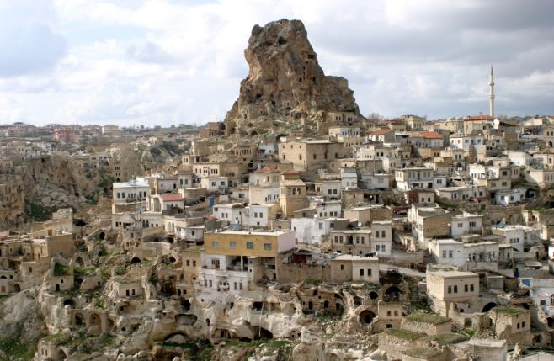
During Byzantine times, Caesarea Mazaca maintained its prominence as a city of commerce and trade as well as a major metallurgical center that specialized in the manufacture of heavy cavalry armor.

Slide 17
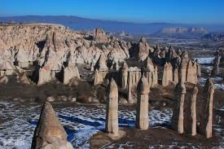
Under the Seljuks, Kayseri became prominent once again as the second most important city in the empire with many architecturally important structures. Theological schools, a medical school and hospitals were built here.

Slide 18
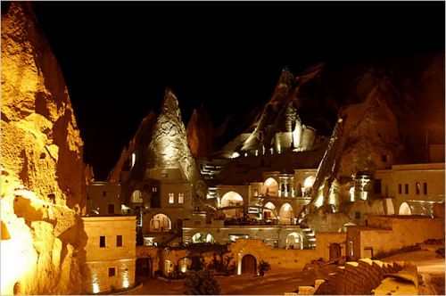
These two ancient volcanoes mark the western and eastern boundaries of a region known for its curious volcanic landscape that has been relentlessly carved by nature and by the people who have lived here.

Slide 19
The traditional main sources of income of the city, carpet weaving and viticulture have been overtaken by tourism, because of its proximity to the underground shelters, the fairy chimneys, monasteries, caravanserais and the famous rock-hewn churches of Göreme.

Slide 20
The origin of the charming town of Avanos, Nevsehir is known to the Hittites made ​​based on the test.

Slide 21
The test is the most famous dish of Cappadocia, a local kebab flavor. Traditional testi kebab meat into jar placed in Avanos is cooked in Tandoor.

Slide 22
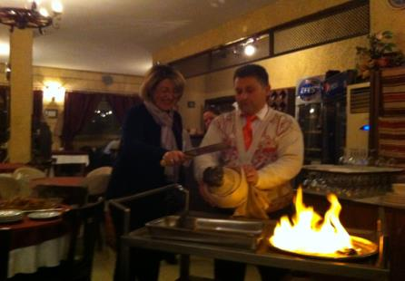

Slide 23
The city is located at a distance of 290 km (180 mi) from the capital Ankara, and is within the historical region of Cappadocia.

Slide 24
When the Ottoman sultan Selim I destroyed the Dulkadir Principality, Nyssa became part of the the Ottoman empire and was renamed Muskara .

Slide 25
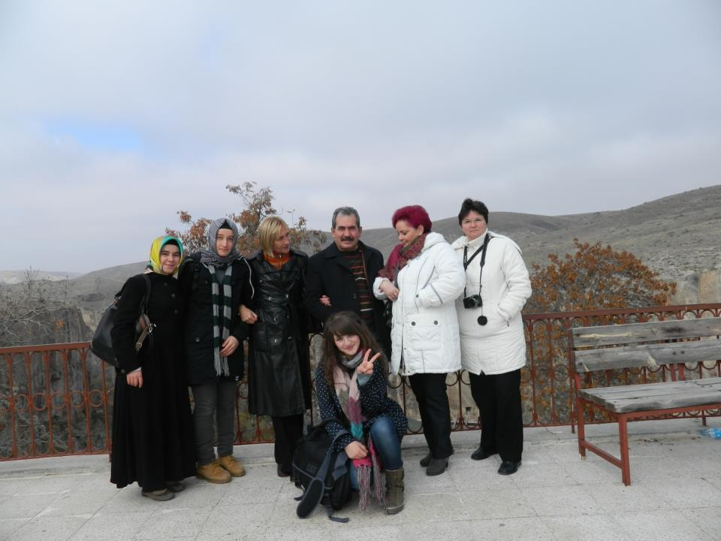
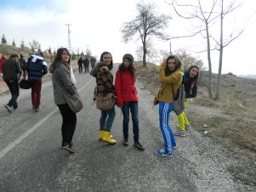

Slide 26
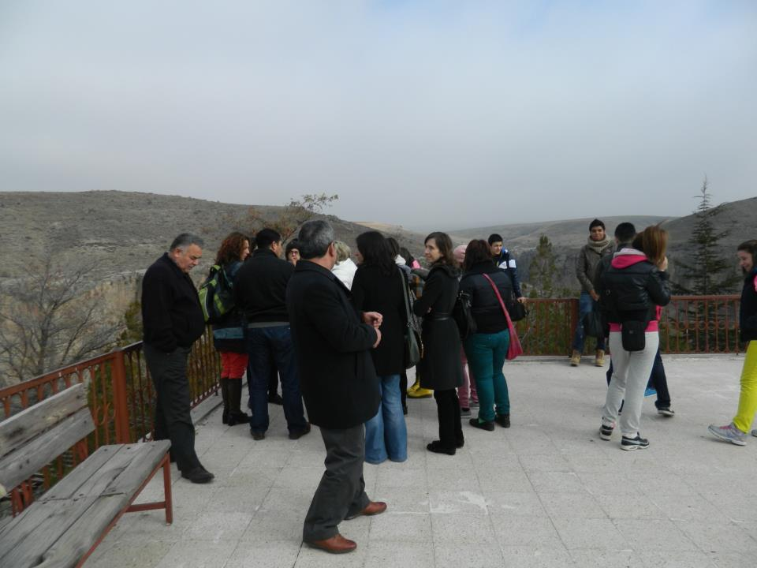

Slide 27
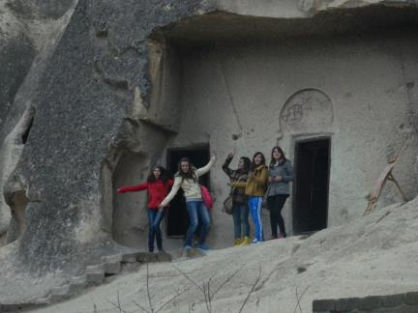
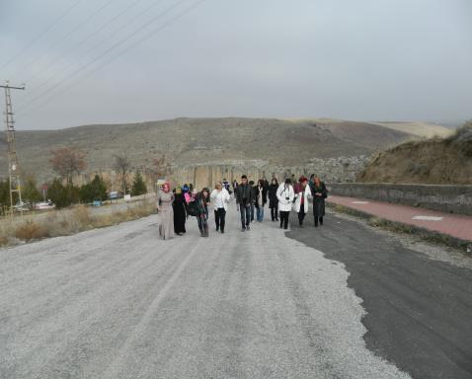

Slide 28
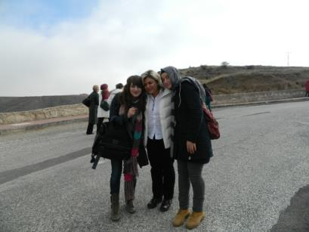
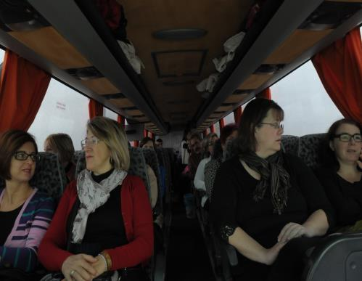
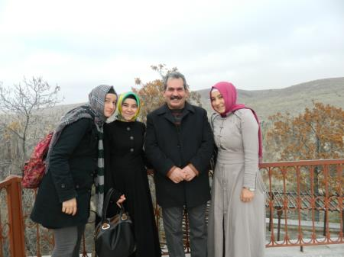

Slide 29
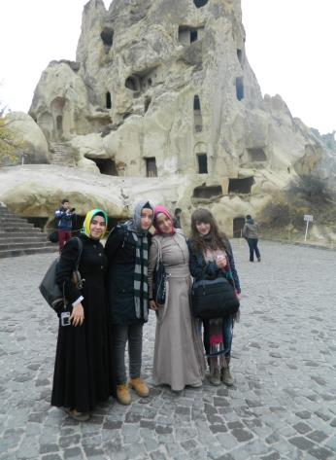
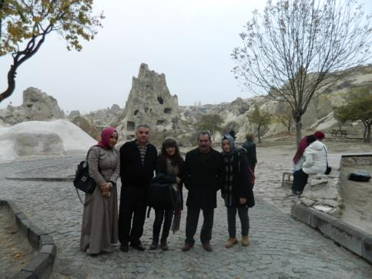

Slide 30
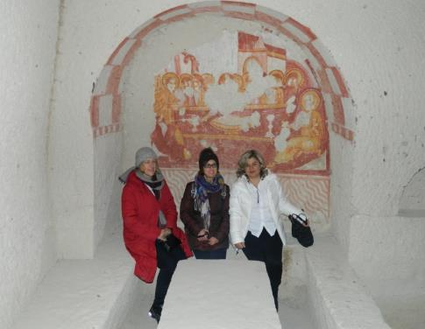
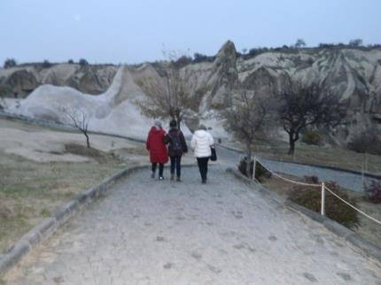

Slide 31
Hacı Bayram Anadolu İmam Hatip High School
Ankara / Turkey

